Slide 1

From “Frictionless” to “Friction Efficient”
Using Problem Analysis to Guide Smarter Security and Sales Strategies
Cory Lowe, PhD
Director of Research
Loss Prevention Research Council

Slide 2

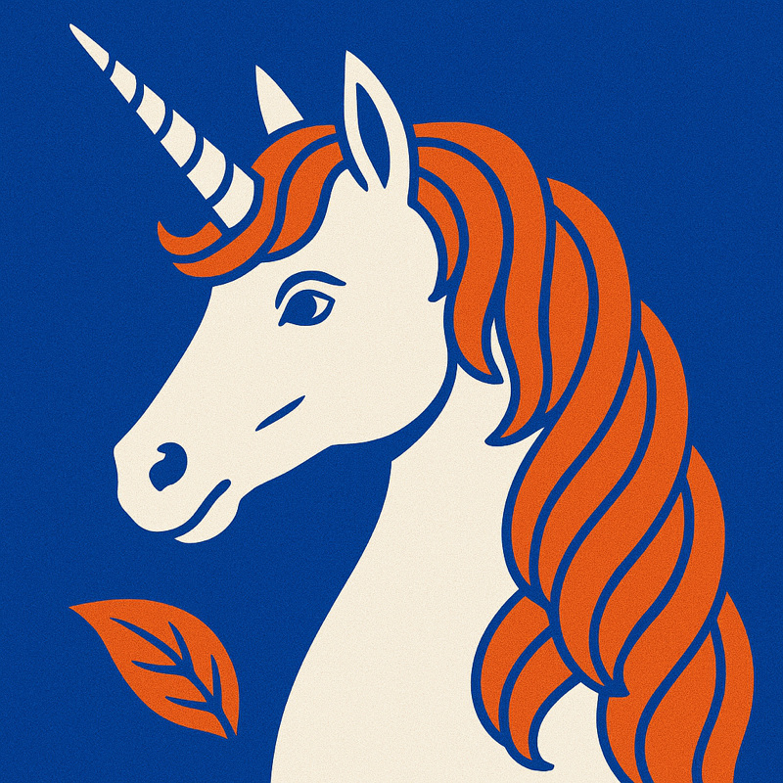
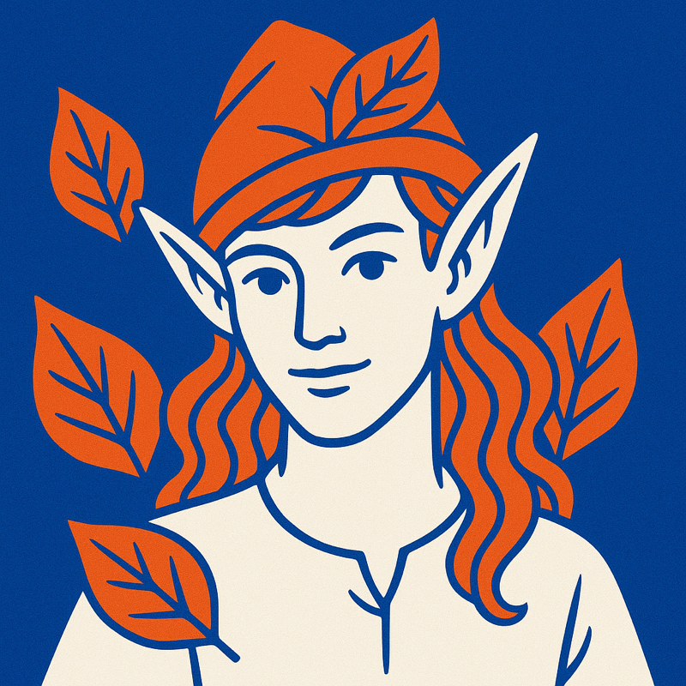
What do these things have in common?
Frictionless Retail

Slide 3
None of them are real!
FRICTION EFFICIENCY

Slide 4
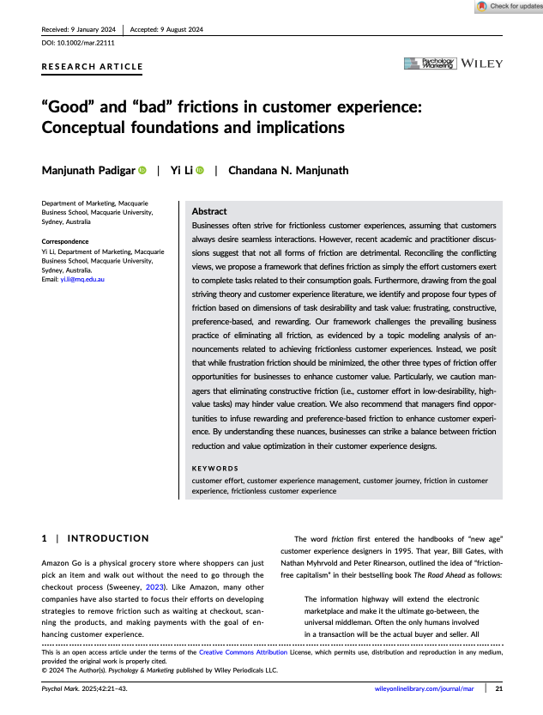
Why is frictionless retail unrealistic?
Laying the Foundations
Friction is poorly defined by almost everyone
But see Padigar, Li, and Manjunath, 2024
Friction, like value, is subjectively experienced
Absolute knowledge of every customer
Absolute ability to tailor experience
If that isn’t enough… laws of physics
FRICTION EFFICIENCY

Slide 5
What is real? Crime and Criminality (and many other uncomfortable things)
FRICTION EFFICIENCY

Slide 6


“Red Guests” & “Green Guests”

Slide 7
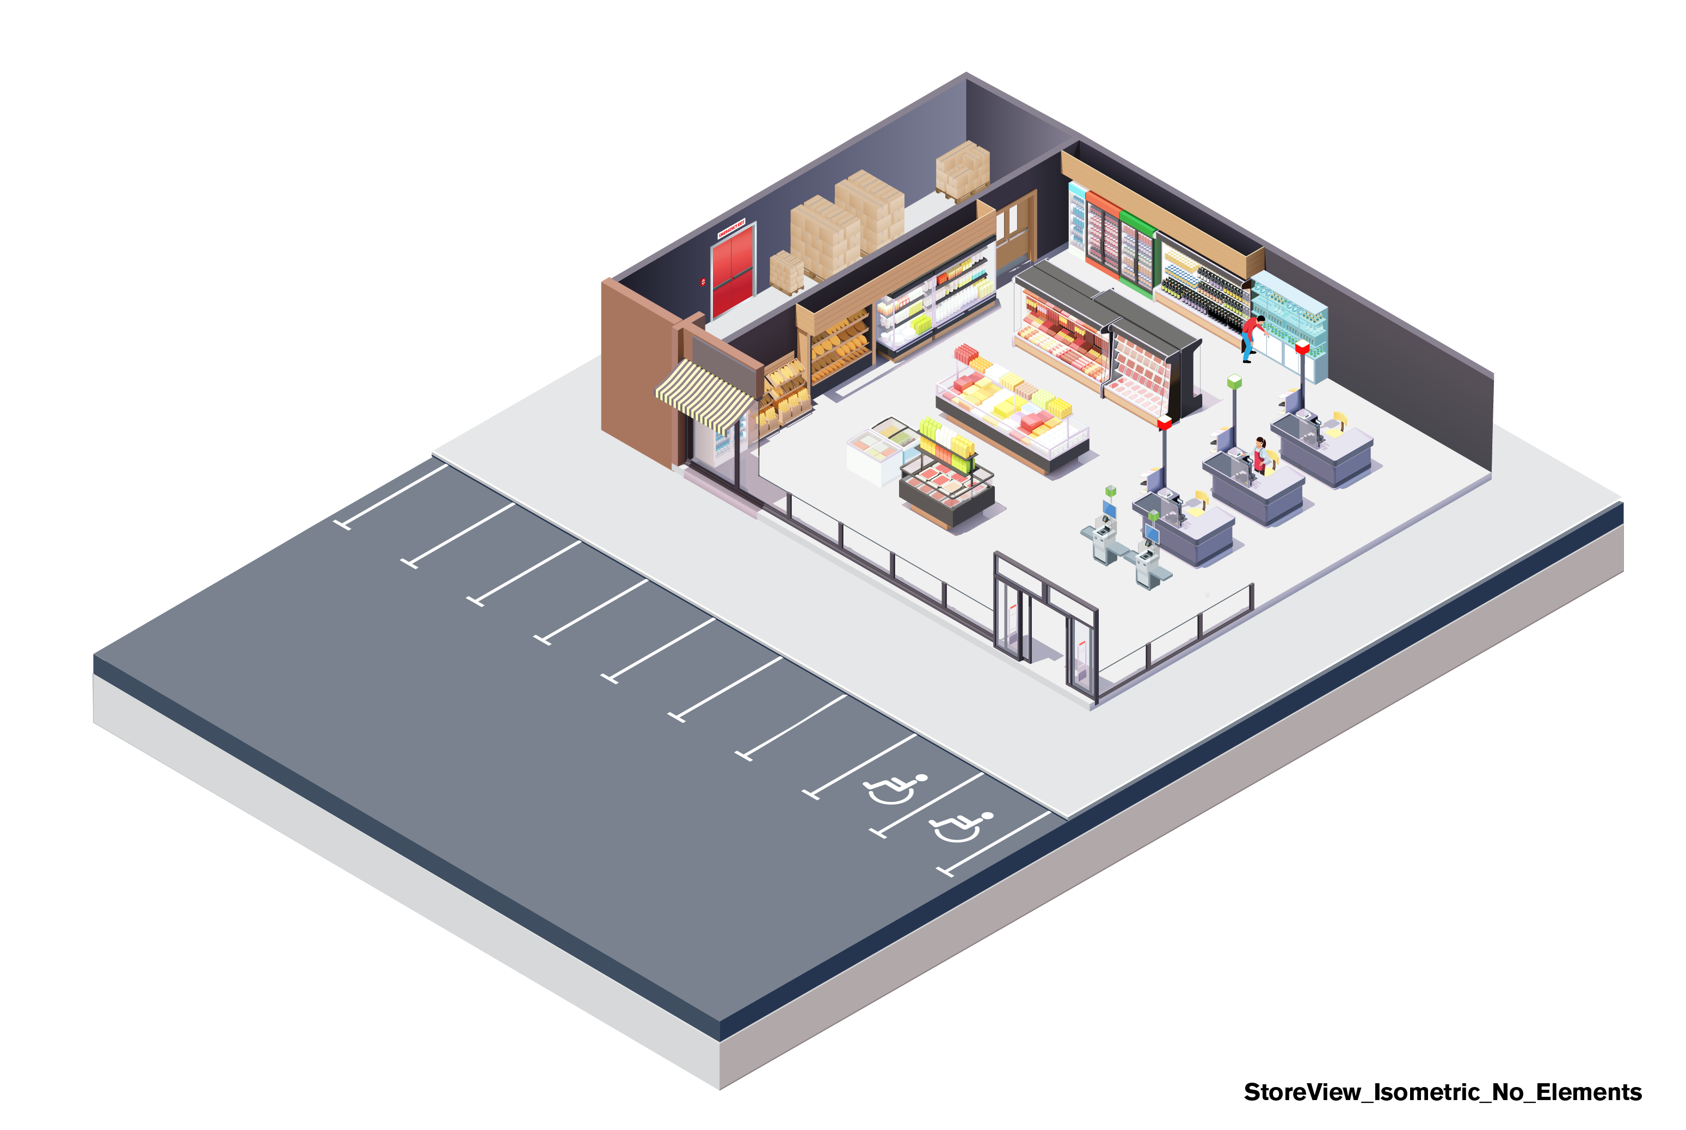


Two Journeys
Green Guests and Red Guests
Green Guests – legitimate intent
Legitimate “place users”
Shop, work, vend, manage, etc.
Shopper’s Journey
Red Guests
Illegitimate place users
Kill, steal, defraud, destroy, etc.
Offender’s Journey
FRICTION EFFICIENCY

Slide 8
Rational Choice – Costs and Benefits
WHAT’S THE COST? A HELPFUL OVERSIMPLICATION
What does a shopper pay?
Item price, transaction costs, opportunity costs, risks, etc.
Why do they pay? Subjective value > total costs (real and perceived)
What does a thief “pay”?
(Everything above) – item price = total offender cost
Why do they pay? Subjective value > total costs (real and perceived)
FRICTION EFFICIENCY

Slide 9
Situational Crime Prevention
MAKING OFFENDERS PAY MORE (BEFORE AND AFTER THE CRIME)
Increase risk of consequences
Increase time and effort required to offend
Reduce benefits of crime
Reduce provocations
Eliminate excuses and rationalizations
FRICTION EFFICIENCY

Slide 10
Where are the Opportunities to Influence Behavior?
AIMING POINTS

Slide 11
Five Zones of Influence Place Matters
FRICTION EFFICIENCY

Slide 12
Objectives: Affect, Connect, Detect.
TYING EVERYTHING TOGETHER
Affect – behaviors and intentions
Detect – offenders, offenses, and signatures
Aural – sound
Visual – sight
Digital – signals (cellular, RFID, etc.)
Connect – people, places, technology, process, organizations
Within-organization
Between-organization
FRICTION EFFICIENCY

Slide 13
The Bowtie Model
OFFENDER’S JOURNEY THROUGH SPACE & TIME

Slide 14
Question: When would you like to influence a shopper’s purchase decisions? A. Before they decide to go to the store B. In the parking lot C. At the store entrance D. In the store department E. When they are standing in front of their options F. All the above
All of this is the same for influencing offenders’ behaviors

Slide 15
Slightly Different Question: When would you like to first influence a shopper’s decisions? A. Before they decide to go to the store B. In the parking lot C. At the store entrance D. In the store department E. When they are standing in front of their options F. All the above
All of this is the same for influencing offenders’ behaviors

Slide 16
Situational Sales Promotion
MAKING CUSTOMERS PAY LESS, BENEFIT MORE
Situational Crime Prevention
Increase transaction risks
Increase time and effort
Reduce benefits of transaction
Reduce provocations (crime generating emotional “strains”)
Eliminate excuses and rationalizations
Situational Sales Promotion
Reduce transaction risks
Reduce time and effort
Increase benefits of transaction
Induce provocations (pro-purchase emotions)
Generate excuses and rationalizations to make a purchase
FRICTION EFFICIENCY

Slide 17
The Bowtie Model
SHOPPER’S JOURNEY THROUGH SPACE & TIME

Slide 18
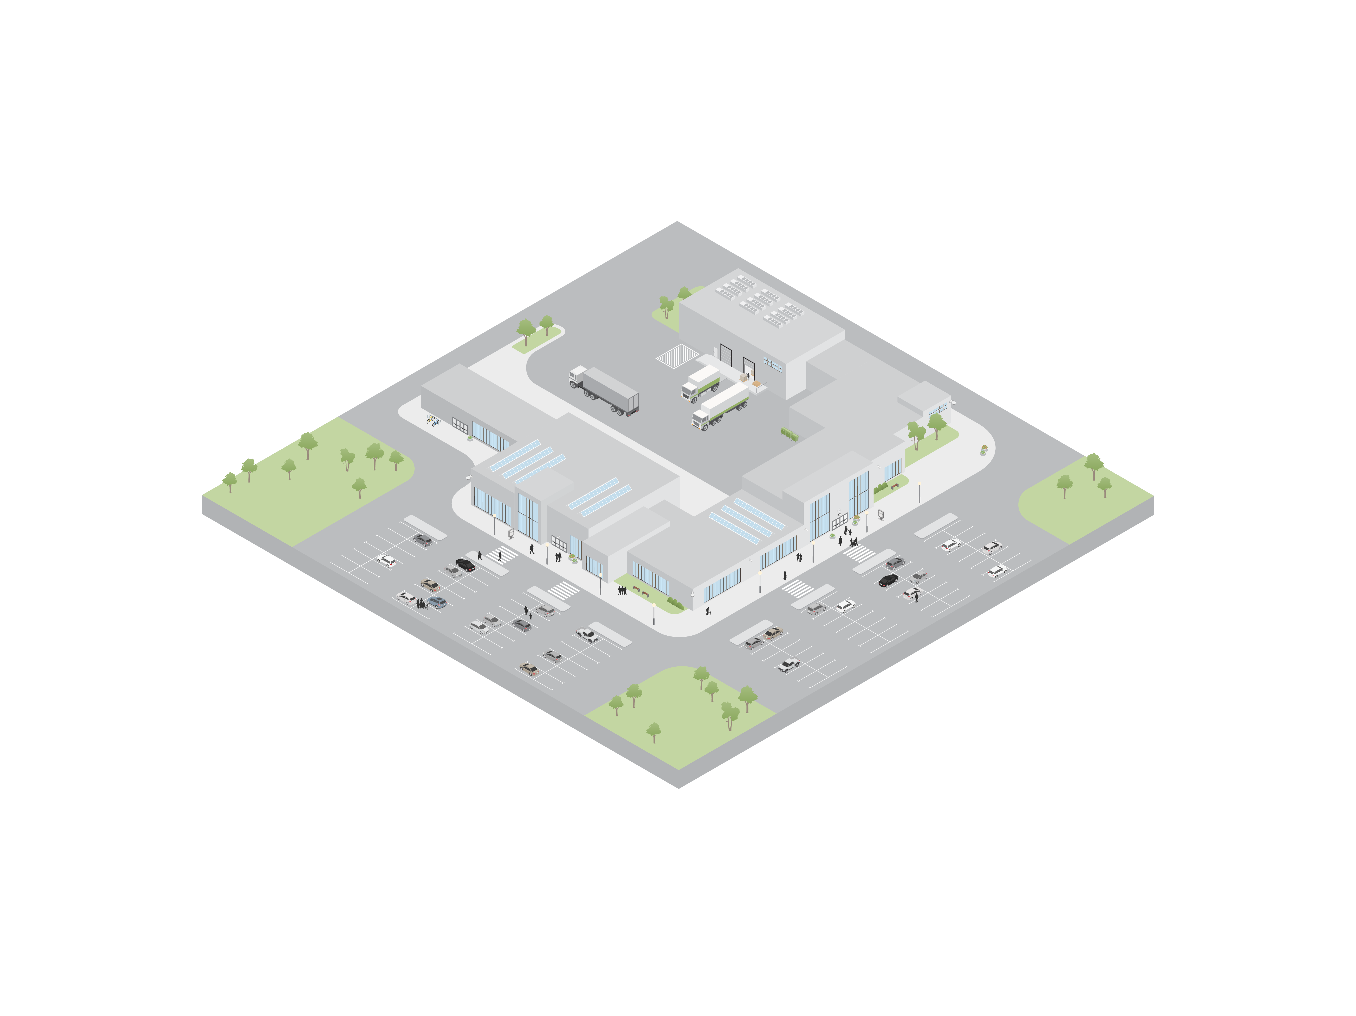
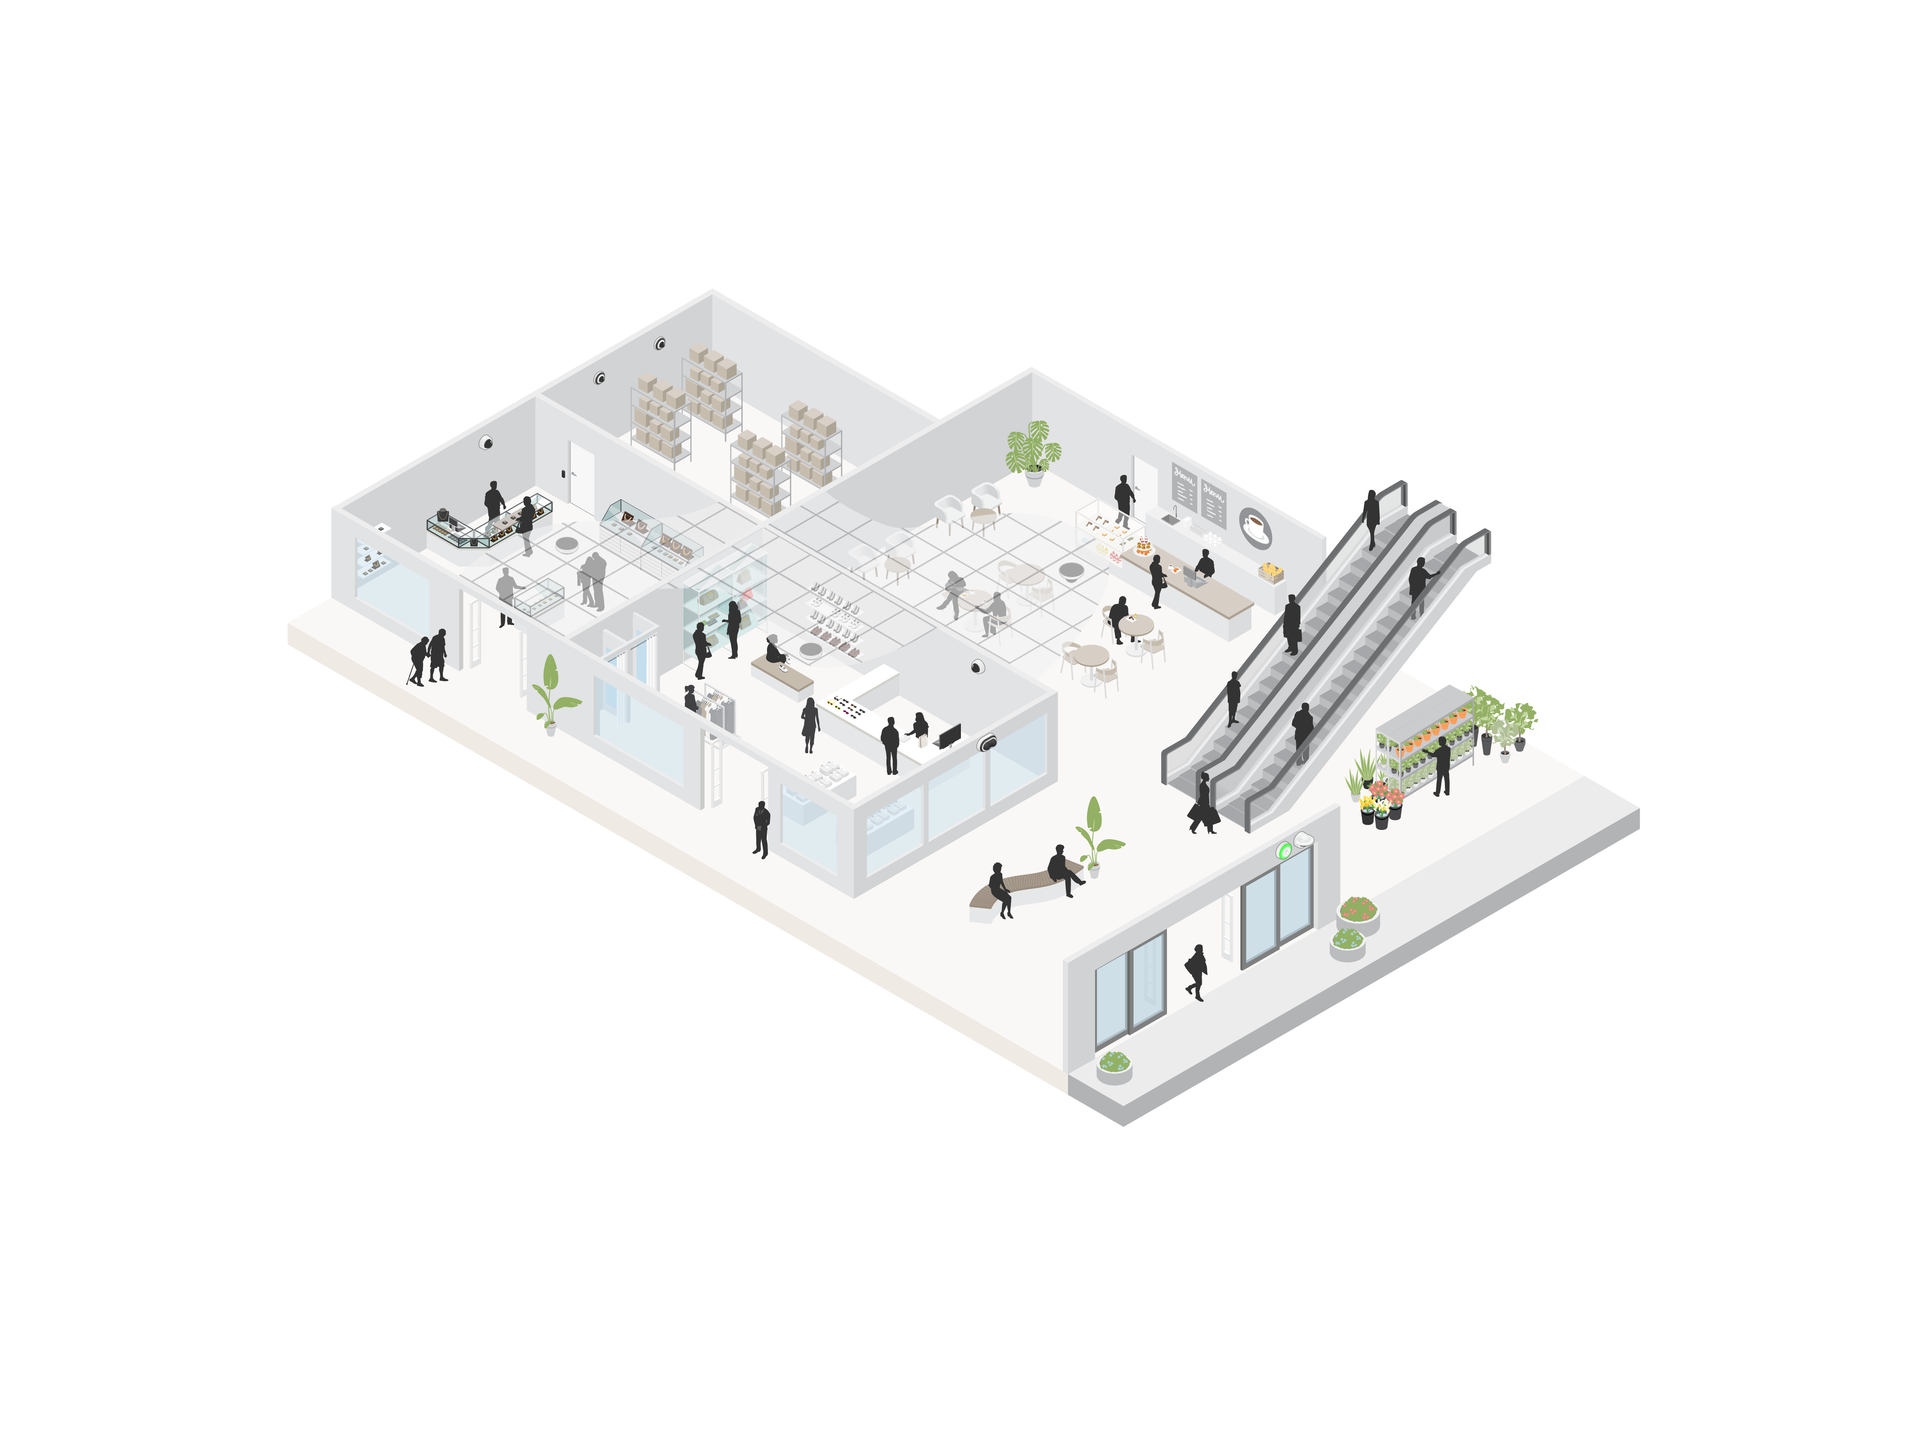
Influence Ecosystems across the Five Zones
Retailers and manufacturers do a lot to influence behaviors.
FRICTION EFFICIENCY

Slide 19

Zone 5
Social Media Scraping
Relationship with Law Enforcement and Prosecutors
Sharing Useful/Usable Case Intelligence and Evidence
BEYOND THE PARKING LOT
Collaboration with Other Retailers and Property Owners
Engagement with Community Social Service Providers
Technological Integration and Data Sharing with Law Enforcement
Incident Link Analysis
FRICTION EFFICIENCY

Slide 20

Zone 4
Talk-down Capabilities
Perimeter Surveillance
PARKING LOT ENTRY AND INTERIOR
Capable Guardianship
Lighting
Camera (with LPR)
Unobstructed Sightlines
FRICTION EFFICIENCY

Slide 21

Zone 3
Networked Security Ecosystem
Facility Interior
ENTRIES, EXITS, OVERALL INTERIOR
Entry/Exit Point
Entry/Exit Point
FRICTION EFFICIENCY

Slide 22

Zone 2
Jewelry Case
Seating Area
GENERAL CATEGORY AREA
Dressing Rooms
Service Desk
Plant Kiosk
Influence ecosystem applies in all these places
FRICTION EFFICIENCY

Slide 23

Zone 1
Jewelry
Shoes
PRECISE LOCATION OF A TARGET
Elderly Couple
Couple
Influence Ecosystems must Consider Targets – People, Products, Places, Other Assets
FRICTION EFFICIENCY

Slide 24
Customer Segmentation and Offender Segmentation

Slide 25
Customer Segmentation
Differences in Customers
Demographics – age, gender, income, education level, household size
Geographics – region, city, neighborhood, store proximity
Psychographics – lifestyle, personality traits, values, interests
Behavioral data – purchase history, frequency of shopping, brand loyalty, price sensitivity, average transaction value, preferred channels
Social networks – how are they related to other customers (spouses, friends, other associates)
FRICTION EFFICIENCY

Slide 26
Offender Segmentation
Differences in Offenders
Demographics – age, gender, etc…
Geographics – region, city, neighborhood, store proximity
Psychographics – lifestyle, personality traits, values, interests
Behavioral data – offense history, frequency of offending, brand loyalty (repeat offending), price sensitivity (friction sensitivity), average transaction (offense) value, preferred channels (type of crime), reselling activity
Social networks – co-offending networks and groups, booster-fence relationships, etc…
FRICTION EFFICIENCY

Slide 27
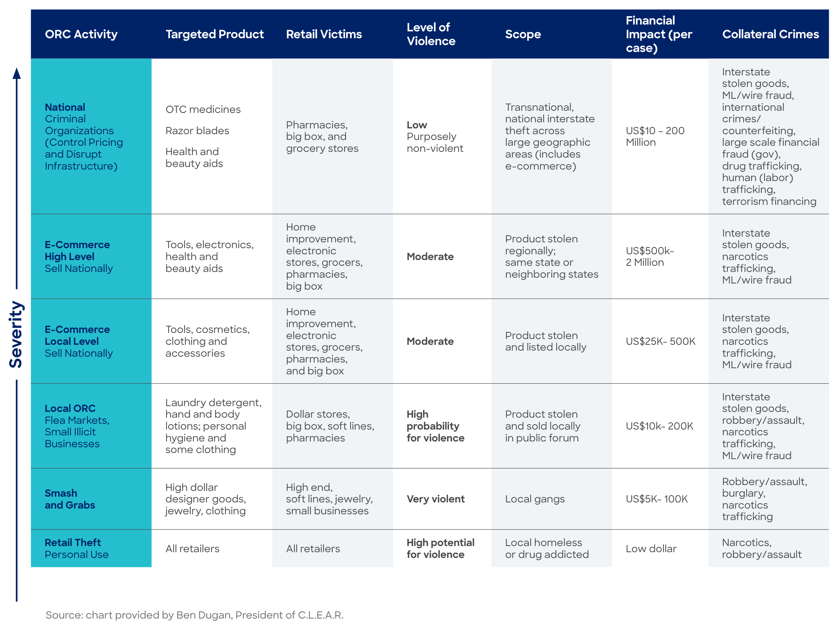
Types of Retail Crime
IT IS NOT ALL THE SAME
ACAMS, CLEAR, HSI ORC Report, 2023
FRICTION EFFICIENCY

Slide 28
Offender Segmentation
OPPORTUNISTIC AND (MORE OR LESS) ORGANIZED
Opportunistic
Stealing for personal use/enjoyment
Less Organized
Local groups
Smash and grabs
Grab and runs
Highly organized
Booster/fence networks
Major resellers
Repackaging/palletizing operations
FRICTION EFFICIENCY

Slide 29
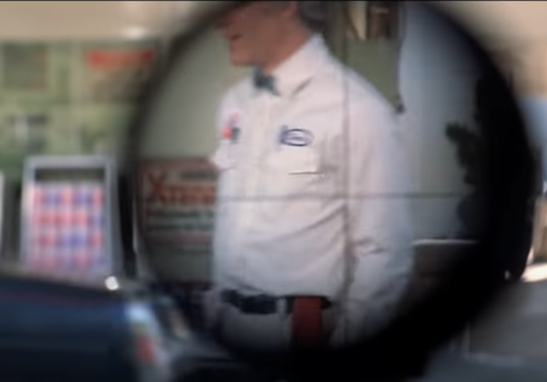
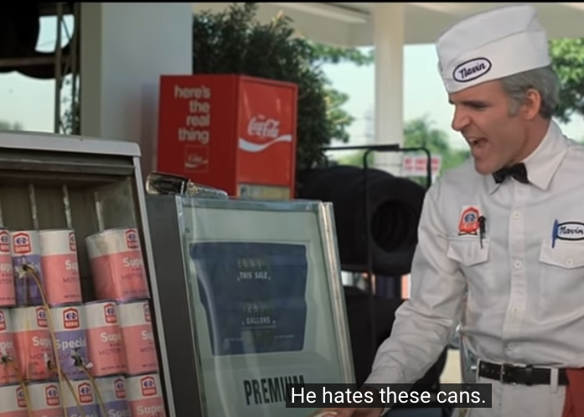
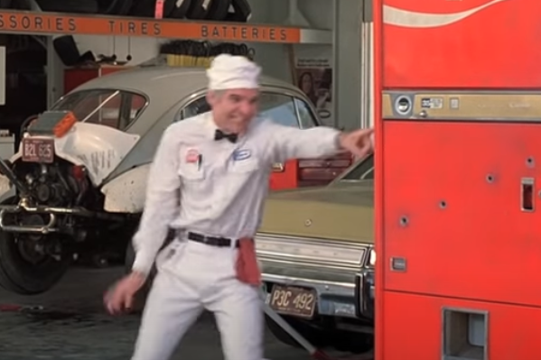
Why Does this Matter?
PROBLEM & SOLUTION MUST BE RELATED
The Jerk with Steve Martin
“He hates these cans!”
“There’s cans in there too!”
FRICTION EFFICIENCY

Slide 30
The Double Bowtie
Within- and Between-Retailer Offending

Slide 31
Friction Efficiency

Slide 32


Friction
GOOD, BAD, OR IT DEPENDS?
Deter – effort, risk, reward
Increasing effort = increasing friction
Friction word association…
What are some words you associate with “retail friction”?
FRICTION EFFICIENCY

Slide 33
Ex., Locking Cases
RESEARCH - EFFECTIVE BUT DESPISED
“My issue with the locked cases is their prevalent use in communities of color.”
Unfair Treatment
Frustration
“I hate having to track down an associate to unlock a case. Or stand there waiting until the associate is available to help me. More times than not I have left the store without the item because I got tired of waiting for someone. It's very frustrating.”
Embarrassment
“…anything sexual or medical I get embarrassed about buying these products and having to wait for someone. Make that awkward small talk.”
FRICTION EFFICIENCY

Slide 34
Friction Efficiency
A DIFFERENT APPROACH
Efficiency = output ÷ input
Friction Efficiency
The positive impact of a loss prevention solution/strategy, including deterring/investigating red actors and positive benefits… Relative to all solution costs, including negative impacts on green guests and operations
FRICTION EFFICIENCY

Slide 35
Retail Options
A DIFFERENT APPROACH
Key options for optimizing friction
Green-focused friction reduction – continue to focus on reducing for green without considering red
Targeted Friction – apply in-store friction to red and not green
Friction Shift – move “friction” outside of store, focus on investigations/prosecutions
Leveraged Friction – use friction to enhance experience, deliver value
FRICTION EFFICIENCY

Slide 36
Targeted Friction
THE VALUE EXCHANGE
Make friction conditional on intentions
Back to the basics
Two questions - how do offenders’ pay? What do they pay that legitimate customers do not?
Increase effort – inefficient
Risk of consequences?
FRICTION EFFICIENCY

Slide 37
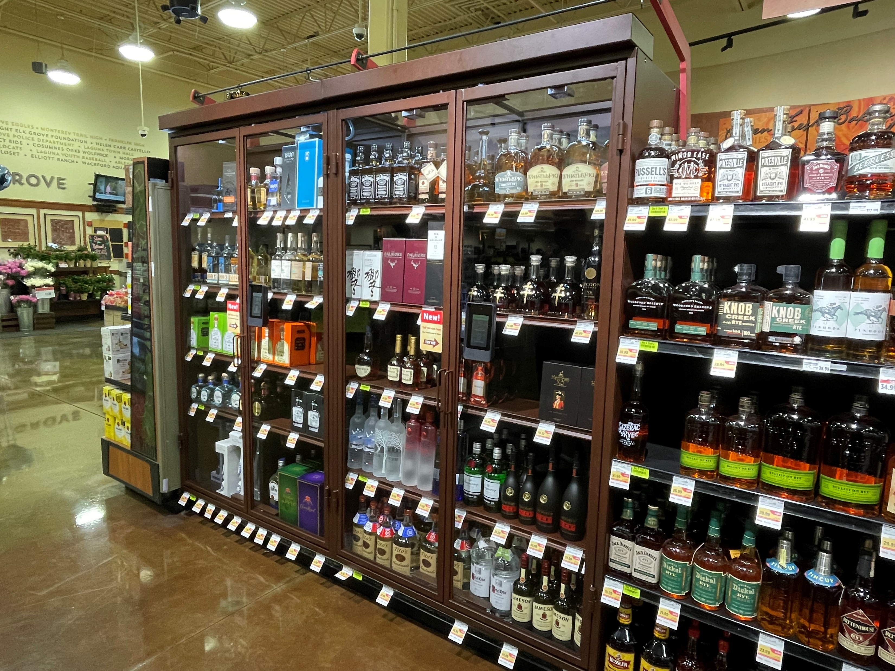
Targeted Friction
THE VALUE EXCHANGE
Self-service locking case
What increases total (subjective) costs more for offenders than customers?
Loss of anonymity
“Nothing to hide”
Identification as part of transaction costs
FRICTION EFFICIENCY

Slide 38
Targeted Friction
THE VALUE EXCHANGE
What would they like to see in self-service cases?
39% Electronics 37% Razors 23% OTC Medications 20% Beauty 14% Reproductive health 13% Liquor 11% Everything 9% Baby Formula 4% Detergents 4% Jewelry
770-person survey
Comfortability using:
Loyalty card - 91%
Retailer’s app - 90%
Cell phone – 67%
Facial recognition – 39%
Fingerprint – 35%
FRICTION EFFICIENCY

Slide 39
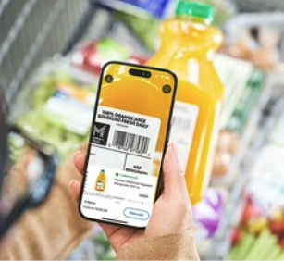
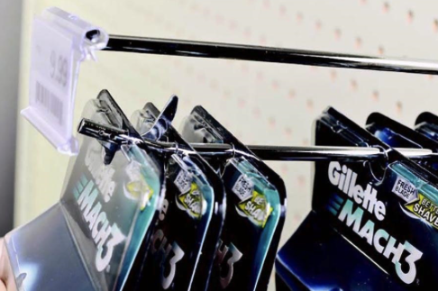
Targeted Friction
THE VALUE EXCHANGE
Other opportunities
“Members Only” or Loyalty SCO
Restrooms access
“Members Only” Scan-and-Go
Self-service EAS
Protection = Premium Brand; Elite Access
Related – intention-based targeted friction
Any other options come to mind?
FRICTION EFFICIENCY

Slide 40
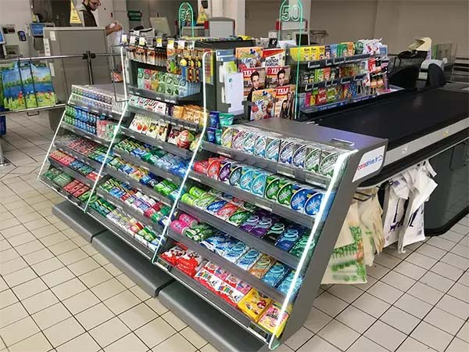
Leveraged Friction
MAKE FRICTION USEFUL
How many of you have products at checkout?
Leveraged friction
Using friction as a ”lever” to drive sales
FRICTION EFFICIENCY

Slide 41
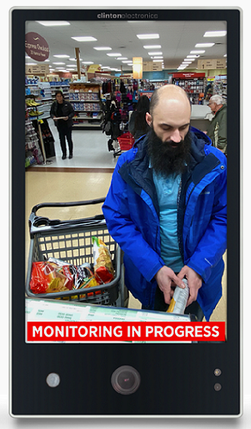
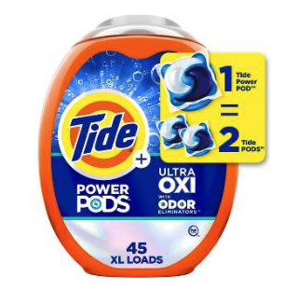
Leveraged Friction
MAKE FRICTION USEFUL
Leveraged friction – PVMs with ads in conjunction with locking technologies
Captive audience
Dwell detection
Targeted ads
Channeled entrance/exits with advertising
Smart (and secure) pushers and peg hooks
B&M engagement funnel
SALE!
FRICTION EFFICIENCY

Slide 42
Friction Shift
ESCAPING THE PROACTIVE/REACTIVE MINDSET
Friction shift
Inside store → outside of store
Proactive/Reactive mindset – harmful and limiting
Issues are not linear
Cyclical, high-frequency, high-harm offenders
Have a strategy, processes, and tools for when incidents occur to capture criminal intelligence
Integrated video and alarms, RFID, offender identification, LPR
FRICTION EFFICIENCY

Slide 43

Cory Lowe, PhD
Director of Research
Loss Prevention Research Council
cory@lpresearch.org
For More Information about the LPRC:
LPRESEARCH.ORG

