Slide 1

Scan to receive a copy of the IQVIA presentation: 2025 Pharmaceutical Trends, Issues and Forecasts

Slide 2
NACDS TSE Conference:
2025 Pharmaceutical Trends, Issues and Forecasts
Pharmacy Industry Trends
August 25, 2025
Presented by: Scott Biggs
Prepared by: Mary Kate Newell, David Mennen, and Scott Biggs
Scan this QR Code to receive a copy of the presentation

Slide 3
Table of contents
Current Market Performance
Retail Performance
GLP-1s
Generics and Biosimilars
Cough, Cold, Flu, and Vaccines
On the Radar
Outlook
Appendix
  Top Lists

Slide 4









Our industry is facing numerous challenges today
Inflation Reduction Act
Changing Distribution Models/DTC
Drug Supply Chain
Security Act
Issues affecting our industry
Tariffs
Drug Shortages
PBM Reform
Biosimilars
Store Closures
Profitability Challenges

Slide 5
Current Market Performance

Slide 6
91% of the last year’s Retail sales growth came from volume increases
U.S. Retail Sales Growth Contributions MAT June 2023 – MAT June 2025
100%
100%
Sales in $ Billions
0%
4%
3%
380
+11.9%
36.1
1.3
1.5
370.5
360
340
+11.4%
6.0
0.0
331.0
2.9
16.3
-2.4
320
8.2
3.2
300
297.2
MAT Jun-24
MAT Jun-25
280
New Products
Line Ext
MAT Jun-23
New Products
Price
Volume
Line Ext
Other
MAT Jun-24
New Products
Price
Volume
Line Ext
Other
MAT Jun-25
Price
Other
Volume

Slide 7
The overall market has experienced sales expansion
Total Market
Sales Growth
Sales $ in Billions

Slide 8


Retail has maintained a steady sales share; Mail sales share has increased while Rx share is on the decline
Sales Share
Adjusted Rx Share
+0.1%
88.5%
88.6%
88.7%
88.6%
0.0%
42.5%
43.0%
42.5%
42.5%
-0.2%
+0.2%
28.0%
30.0%
28.9%
29.1%
29.8%
27.5%
28.5%
27.7%
-0.6%
+0.5%
4.7%
4.5%
4.3%
4.1%
6.8%
6.9%
7.0%
7.3%
Retail
Mail
Non-Retail
Retail
Mail
LTC
MAT Jun 2022
MAT Jun 2023
MAT Jun 2024
MAT Jun 2025
Source: IQVIA, RxInsights and National Sales Perspective, June 2025

Slide 9
Retail, Mail, and Non-Retail sales all show strong year-over-year growth
Retail
Mail
Non-Retail
Sales Growth
Sales $ in Billions

Slide 10
Retail channels all show accelerating year-to-date growth
Chain & Mass
Food
Independent
Sales Growth
Sales $ in Billions

Slide 11
Non-Retail channels also show accelerating growth, especially Home Health Care
Clinics
Hospitals
Home Health Care
Long-Term Care
Sales Growth
Sales $ in Billions

Slide 12

42.9% of the Market’s growth is coming from Retail; Retail’s growth is heavily weighted by GLP-1s and other traditional brands
Sales Growth Contribution MAT June 2024 vs. MAT June 2025
Indep
Food
Chain & Mass
Non-Retail
Other
Generic
Branded Generic
Brand
0.4%
4.7%
96.0%
Retail
Traditional
Specialty
Non-GLP-1
GLP-1
Mail

Slide 13






Immunology remained the top therapy class and experienced strong growth, driven by Skyrizi and Dupixent
MAT June 2025 top six total market therapy classes with top moving products
Immunology | $158.5B
18.2% MS | +10.4%
Antidiabetics | $147.2B
16.9% MS | +7.7%
Oncologics | $129.3B
14.8% MS | +17.4%
Skyrizi $20.5B | +54.3%
Humira $20.3B | -36.2%
Dupixent $18.3B | +35.3%
Mounjaro $31.3B | +77.4%
Ozempic $37.2B | +19.4%
Jardiance $22.4B | +21.6%
Keytruda $18.8B | +11.6%
Darzalex Faspro $7.3B | +27.9%
Kisqali $2.5B | +95.9%
Antithrombotics | $40.1B
4.6% MS | +8.8%
HIV Antivirals | $34.3B
3.9% MS | +9.9%
Anti-obesity Preps | $32.7B
3.8% MS | +139.5%
Eliquis $27.5B | +13.2% Brilinta $1.2B | -10.0%
TNKase $0.6B | +20.7%
Biktarvy $16.2B | +15.1%
Dovato $2.3B | +27.4%
Descovy $4.1B | +13.3%
Zepbound Pen and Vial $15.3B | +474.6%
Wegovy $16.8B | +66.0%
Orlistat $6.3M | +88.9%
Note: MS = Market Share

Slide 14

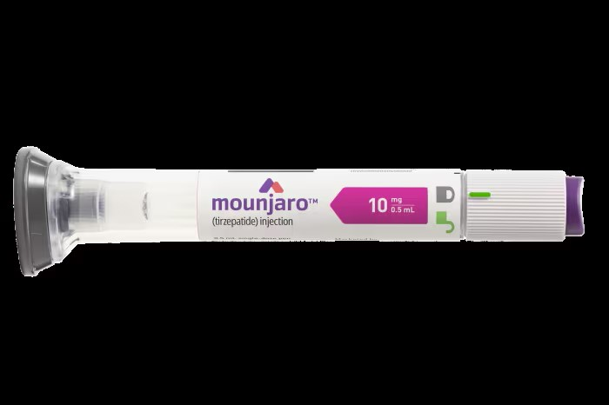
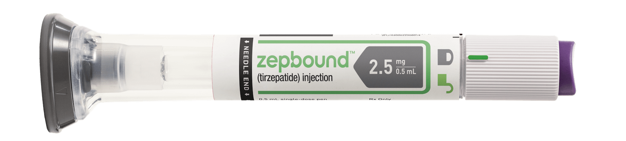

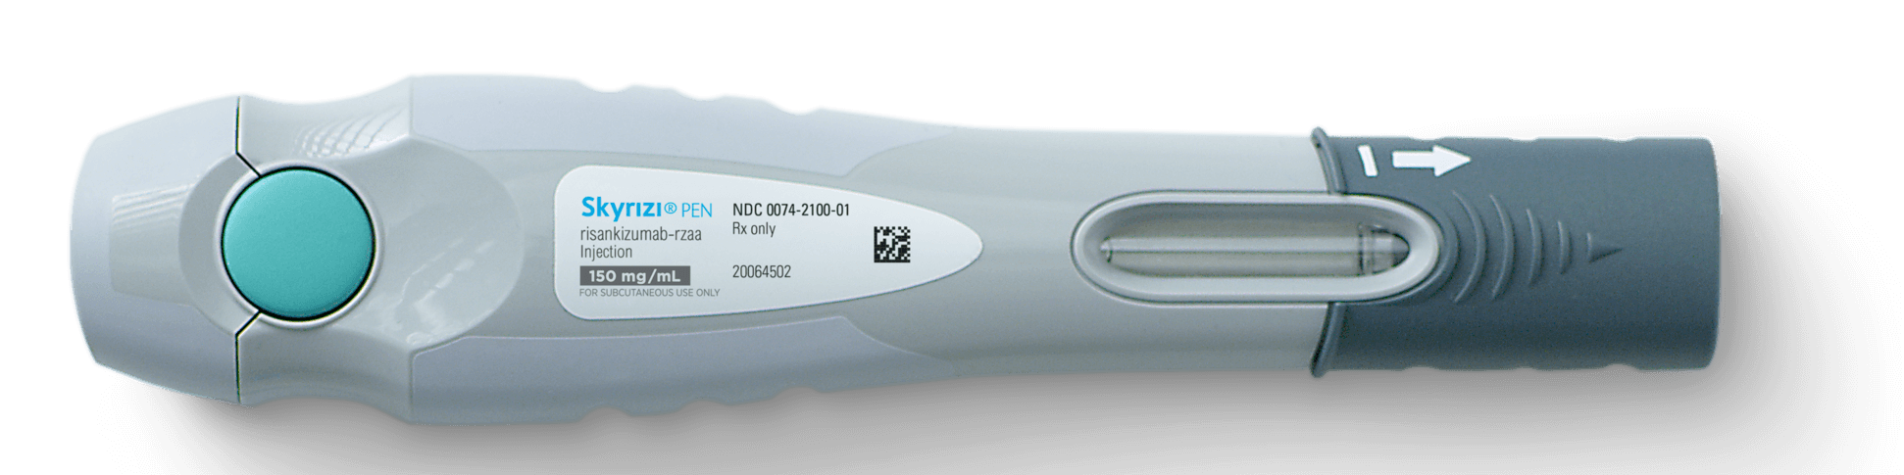

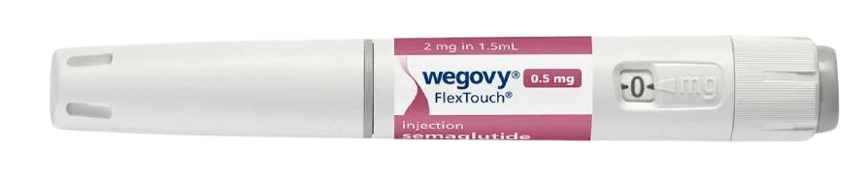
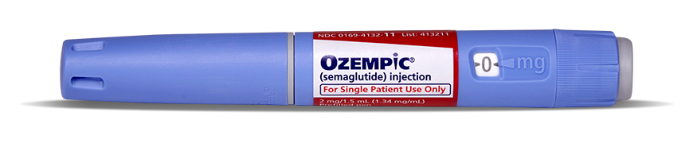

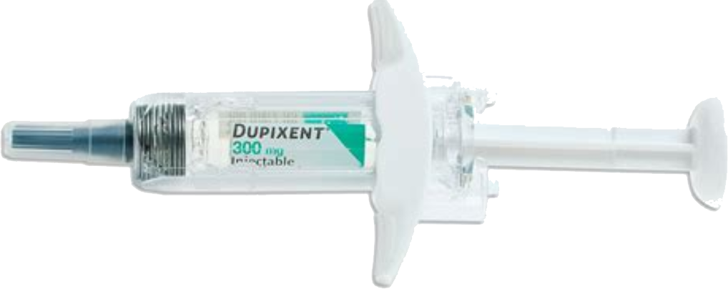

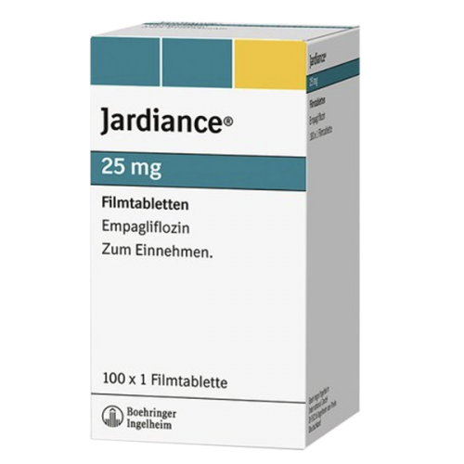
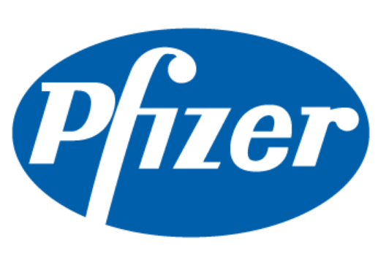
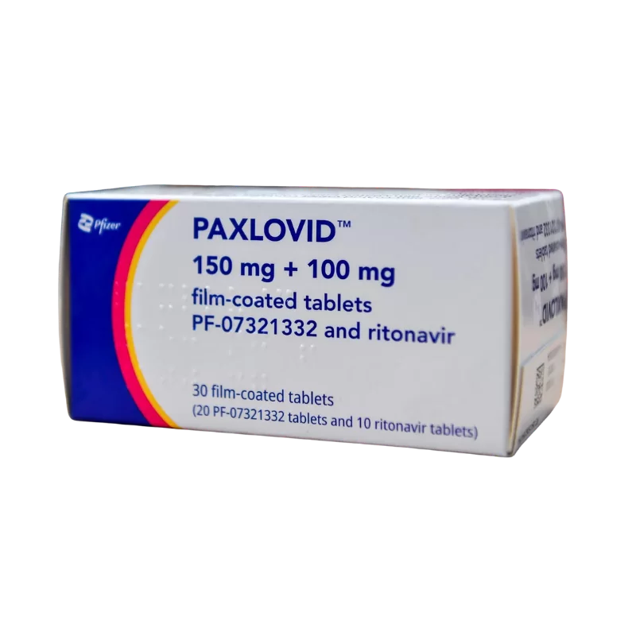

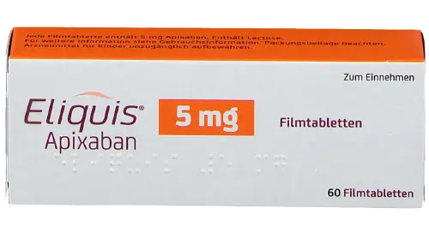
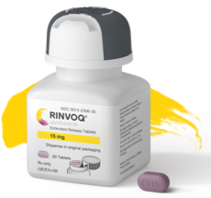
Four the of the top five fastest growing products are GLP-1s
Top 10 fastest growing products based on MAT June 2025 absolute sales $ growth
MOUNJARO $32.3B
+$13.6B (+77.4%)
ZEPBOUND $15.3B
+$12.6B (+474.6%)
SKYRIZI $20.5B
+$7.2B (+54.3%)
WEGOVY $16.8B
+$6.7B (+66.0%)
OZEMPIC $37.2B
+$6.1B (+19.4%)
DUPIXENT $18.3B
+$4.8B (+35.3%)
JARDIANCE $22.4B
+$4.0B (+21.6%)
PAXLOVID $5.3B
+$3.3B (+159.3%)
ELIQUIS $27.6B
+$3.2B (+13.2%)
RINVOQ $8.5B
+$2.7B (+47.7%)

Slide 15
Product growth contributions vary greatly across the three major channels
Top and bottom product sales growth contributors by super channel MAT June 2025
In RETAIL, Mounjaro and Zepbound account for over 57%
of the growth
In MAIL, Humira has been weighing very negatively
on growth
In NON-RETAIL, growth contributions are spread out across many different products
5.9%

Slide 16
For the total market, specialty growth outpaced traditional growth and has 51.8% share of total non-discounted spend
In MAT June 2025, specialty spend grew by 13.5% while traditional growth grew 10.0%
Non-Discounted Spend ($ Billions)
+11.8%
$900
$871
$800
$779
CAGR
$700
$690
Traditional
+9.7%
$618
$420
$600
$565
$382
Billions
$500
$343
$310
$400
$289
$300
$451
Specialty
+13.1%
$200
$347
$397
$276
$308
$100
$0
MAT Jun 2021
MAT Jun 2022
MAT Jun 2023
MAT Jun 2024
MAT Jun 2025
Source: IQVIA, National Sales Perspectives, June 2025

Slide 17

Specialty is showing the highest growth in Non-Retail
Years based on Moving Annual Total June 2025
Percent of Sales $
YoY Sales Growth $
Retail
Mail
Non-Retail

Slide 18
Retail Performance

Slide 19


Prevailing Retail trends
Avg. unadjusted annual Rxs per store – MAT June
6,200 fewer pharmacies than seven years ago
Net loss of 429 in 2025
(as of June)
+13.0%
Pharmacy
closures
+7.4%
+9.1%
+7.8%
Thousands
150
107
+3.6%
Increased
100
94
69
74
75
82
70
76
Output
50
42
43
0
2022
2025
2022
2025
2022
2025
2022
2025
2022
2025
CHAIN
INDEP
FOOD
MASS
RETAIL
% of 90-day Maintenance scripts continues to increase
CHAIN
INDEP
FOOD
MASS
RETAIL
90-Day
Rxs
Pay
type share
CHAIN
INDEP
FOOD
MASS
Cash
Overall
3rd Party
Disc. Cards
Overall
Cash
Cash
Overall
Disc. Cards
Medicaid
Overall
Disc. Cards

Slide 20
In Retail, Food and Mass had the highest Rx volume growth
Data is based on Moving Annual Total, June 2025
YoY Absolute Growth
YoY % Growth
+2.4%
6,120
48.3
6,110.8
6,100
6,080
Adjusted Rxs in Millions
48.1
6,060
6,040
Market Share
6,020
14.2
6,000
31.8
5,980
5,968.5
5,960
5,940
MAT Jun 2024
Chain
Indep
Food
Mass
MAT Jun 2025

Slide 21
In Retail, Med D had the largest growth and market share gains
Data is based on Moving Annual Total, June 2025
YoY Absolute Growth
YoY % Growth
+2.4%
6,150
107.4
6,110.8
6,100
-25.4
Adjusted Rxs in Millions
6,050
99.1
Market Share
6,000
5,968.5
0.2
5,950
-38.9
5,900
MAT Jun 2024
Cash
Discount Cards
3rd Party
Med D
Medicaid
MAT Jun 2025

Slide 22
Medicaid enrollment has been consistently dropping
Total Medicaid Enrollment (CMS) vs. Month-over-Month enrollee change
Data Source: Medicaid and CHIP Eligibility Operations and Enrollment Snapshot Data

Slide 23
Med D was the driver in Independents and Food while 3rd party was the driver in Chain and Mass
Adjusted Rxs in Millions
3,060
+1.1%
1,100
32.9
+1.3%
3,030
3,023.1
11.4
37.2
-23.8
1,090
1,088.9
CHAIN
INDEP
-3.0
3,000
2,991.3
1.8
1,080
4.8
2,970
-16.3
3.0
1,074.7
-2.0
2,940
MAT Jun 2024
Cash
Disc. Cards
3rd Party
Med D
Medicaid
MAT Jun 2025
1,070
MAT Jun 2024
Cash
Disc. Cards
3rd Party
Med D
Medicaid
MAT Jun 2025
+4.8%
1,060
38.0
1,053.8
960
+5.4%
-0.3
25.0
1.7
945.1
1,040
940
1,020
29.7
FOOD
1,005.6
MASS
27.4
920
1,000
-4.0
980
-15.3
900
896.8
-0.6
-5.3
960
MAT Jun 2024
Cash
Disc. Cards
3rd Party
Med D
Medicaid
MAT Jun 2025
880
MAT Jun 2024
Cash
Disc. Cards
3rd Party
Med D
Medicaid
MAT Jun 2025

Slide 24
The top five major therapy classes are the same with all four classes of trade
Major Class Rank based on MAT Ending June 2025 Retail Adj. Rx Volumes

Slide 25
Eliquis leads in Rx volume for every class of trade except for Mass, where the top product is Ozempic
Brand Product Rank based on MAT Ending June 2025 Retail Adj. Rx Volumes

Slide 26
Atorvastatin Calcium leads in Rx volume for each class of trade
Overall Product Rank based on MAT Ending June 2025 Retail Adj. Rx Volumes

Slide 27
Adjusted Rxs per patient increase across retail classes of trade for maintenance, acute, and vaccines
Total Rxs per Patient
Vaccines per Patient
+4.5%
+5.9%
+2.4%
+0.8%
+0.8%
+2.7%
+3.9%
+6.4%
Chain
Food
Indep
Mass
Chain
Food
Indep
Mass
Maintenance Rxs per Patient
Acute Rxs per Patient
+3.2%
+1.6%
+3.6%
+1.1%
+2.6%
+1.8%
+2.7%
+4.0%
Chain
Food
Indep
Mass
Chain
Food
Indep
Mass
MATLY
MATTY

Slide 28
Mass and Food had the highest generic growth, but both had drops in percentage of generic Rxs dispensed
Adjusted Generic Rx Percent by Retail Class of Trade
Generic Growth by Class of Trade

Slide 29
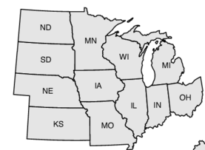
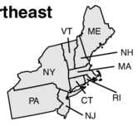
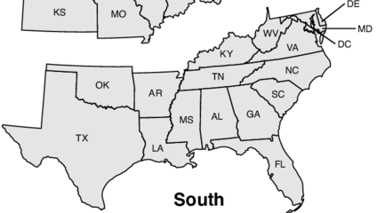
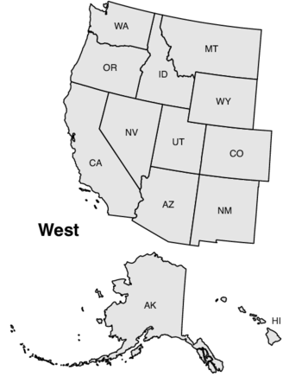
Adjusted Rxs per patient increase among most Regions except Midwest Independents
Chain
Indep
Food
Mass
Chain
Indep
Food
Mass
Chain
Indep
Food
Mass
Chain
Indep
Food
Mass
Midwest
Northeast
South
West
MATLY
MATTY

Slide 30
GLP-1s

Slide 31


GLP-1s are growing most in the Northeast with growth rates closely correlated to median incomes
MAT Jun 2024 vs. MAT Jun 2025
Source: S1903 - Median Income in the Past 12 Months - US Census Bureau

Slide 32
Women held a higher proportion of Weight Loss GLP-1 prescriptions in comparison to Diabetes GLP-1 prescriptions
Weight-Loss GLP-1 Rxs
Diabetes GLP-1 Rxs
2,200,000
4,000,000
2,000,000
3,500,000
1,800,000
+29.5%
1,600,000
3,000,000
1,400,000
188.3%
2,500,000
1,200,000
2,000,000
1,000,000
800,000
1,500,000
600,000
1,000,000
400,000
200,000
500,000
0
Apr-21
Jul-21
Oct-21
Jan-22
Apr-22
Jul-22
Oct-22
Jan-23
Apr-23
Jul-23
Oct-23
Jan-24
Apr-24
Jul-24
Oct-24
Jan-25
Apr-25
Jul-25
0
Apr-21
Jul-21
Oct-21
Jan-22
Apr-22
Jul-22
Oct-22
Jan-23
Apr-23
Jul-23
Oct-23
Jan-24
Apr-24
Jul-24
Oct-24
Jan-25
Apr-25
Jul-25
FEMALE
MALE

Slide 33
Sales of GLP-1 agonists accounted for 57.1% of the diabetes market, whereas the market share for insulin sales fell to 11.7%
Diabetes Sales Share by Type
Diabetes Rx Share by Type
70.8
89.7
147.2
244.5
248.3
294.9
0.7%
0.6%
0.5%
2.7%
2.8%
3.5%
2.3%
2019
2021
MAT Jun 2025
2019
2021
MAT June 2025
Traditional diabetes therapies
GLP-1 agonists
SGL T2 inhibitors
DPP-IV inhibitors
Insulins
Other

Slide 34
GLP-1 sales grew 41.8% over the last 12 months; 85% of sales is coming from Retail
GLP-1 Sales $ (Billions) MAT Jun 2025
+41.8%
120
+42.2%
$116
100
+68.6%
$82
Billions
80
$84
Diabetes
+37.6% CAGR
60
+33.5%
+44.5%
$58
40
$34
$69
$18
$24
$52
Weight Loss
+116.5% CAGR
20
$17
$23
$32
$32
0
$1
$1
$2
$5
$13
MAT Jun 2020
MAT Jun 2021
MAT Jun 2022
MAT Jun 2023
MAT Jun 2024
MAT Jun 2025
What % of sales growth are GLP-1s?
Where are the sales coming from?
78%
58%
56%
37%
46%
32%
27%
20%
11%
10%
4%
8%
8%
7%
8%
3%
Total Market
Retail
Non-Retail
Mail
MAT Jun 2022
MAT Jun 2023
MAT Jun 2024
MAT Jun 2025

Slide 35
Mass saw the highest year-over-year Rx growth with both types of GLP-1s as well as all other products
Adjusted Rx Share MAT Jun 2025
Diabetes GLP-1 Growth
Weight Loss GLP-1 Growth
All Other Product Growth
Total Market Growth
Retail Market

Slide 36
Retail and Mail over-index in share with both Diabetes and
Weight Loss GLP-1s
Adjusted Rx Share MAT Jun 2025
7.0
6.6
6.5
Millions
6.0
5.5
Diabetes GLP-1 Rxs
5.0
0.3
0.0
0.2
May-23
Jul-23
Sep-23
Nov-23
Jan-24
Mar-24
May-24
Jul-24
Sep-24
Nov-24
Jan-25
Mar-25
May-25
Jul-25
2.5
2.42
2.0
Millions
1.5
Weight Loss GLP-1 Rxs
0.5
0.46
0.0
0.02
May-23
Jul-23
Sep-23
Nov-23
Jan-24
Mar-24
May-24
Jul-24
Sep-24
Nov-24
Jan-25
Mar-25
May-25
Jul-25
Retail
Mail
LTC

Slide 37
GLP-1’s contribution to Retail growth is down slightly, but still contributes over 78%
Non-GLP-1 Retail Sales $ by Quarter (in Billions)
GLP-1 Retail Sales $ by Quarter (in Billions)
GLP-1 YoY Growth
GLP-1 Growth Contribution
Non-GLP-1 YoY Growth
Q2 2022
$59.5
$8.1
90%
Q3 2022
$60.9
$9.2
80%
Q4 2022
$62.1
$10.4
Q1 2023
$62.2
$13.4
70%
Q2 2023
$63.6
$15.4
60%
Q3 2023
$66.3
$15.3
50%
Q4 2023
$68.3
$15.8
40%
Q1 2024
$63.9
$16.2
Q2 2024
$64.7
$20.4
30%
Q3 2024
$70.1
$22.5
20%
Q4 2024
$67.1
$23.8
10%
Q1 2025
$67.5
$24.9
Q2 2025
$66.8
$27.6
0%
Q2 2022
Q2 2023
Q2 2024
Q2 2025

Slide 38

IQVIA’s data shows that while the trend is decreasing, 44% of Independent stores do not fill Weight Loss GLP-1 products
% of Stores not filling Rxs
Business Rules
Diabetes GLP-1
Weight Loss GLP-1
Using IQVIA data, stores were analyzed that filled more than 1,000 or more Rxs in each quarter of the observation period
The observation period was based on calendar quarters from January 2024 through June 2025
Each store then had to have filled <10 Rxs for the specified category of drugs in each quarter
53.0%
44.0%
Indep
14.7%
11.0%
Indep
6.5%
Food
Food
3.1%
3.0%
Chain
0.2%
0.2%
0.4%
0.4%
0.4%
Chain
2.8%
1.4%
0.9%
Mass
1.7%
2024 Q1
2024 Q2
2024 Q3
2024 Q4
2025 Q1
2025 Q2
2024 Q1
2024 Q2
2024 Q3
2024 Q4
2025 Q1
2025 Q2
During the study period only 2 Mass Merchandiser locations were found not to have filled Diabetes GLP-1 products

Slide 39
Patients have consistently been switching out of non-insulin diabetes products for the last two years and primarily into GLP-1s
Net Patient Switching by Diabetes Product Type
Business Rules
Analysis includes Diabetes patients who have switched from one type of product to another
A switch is defined as a patient who had a script for a product within the 12-month look-back period and has now switched to a new product within a defined grace period
Grace Periods
  Retail: 30 days
  Mail: 90 days
20,000
15,000
10,000
5,000
0
-20,000
-21,469
-25,000
-30,000
Jul-23
Aug-23
Sep-23
Oct-23
Nov-23
Dec-23
Jan-24
Feb-24
Mar-24
Apr-24
May-24
Jun-24
Jul-24
Aug-24
Sep-24
Oct-24
Nov-24
Dec-24
Jan-25
Feb-25
Mar-25
Insulins
Diabetes GLP-1s
Weight Loss GLP-1s
Non-Insulins

Slide 40
There are 181 obesity medicines in development or marketed with multiple mechanisms beyond the leading GLP-1 therapies
Obesity pipeline by phase, target and route of administration
Source: Citeline Trialtrove; IQVIA Institute, June 2025.
Global Trends in R&D: Overview through 2025. Report by the IQVIA Institute for Human Data Science.

Slide 41
Generics and Biosimilars

Slide 42

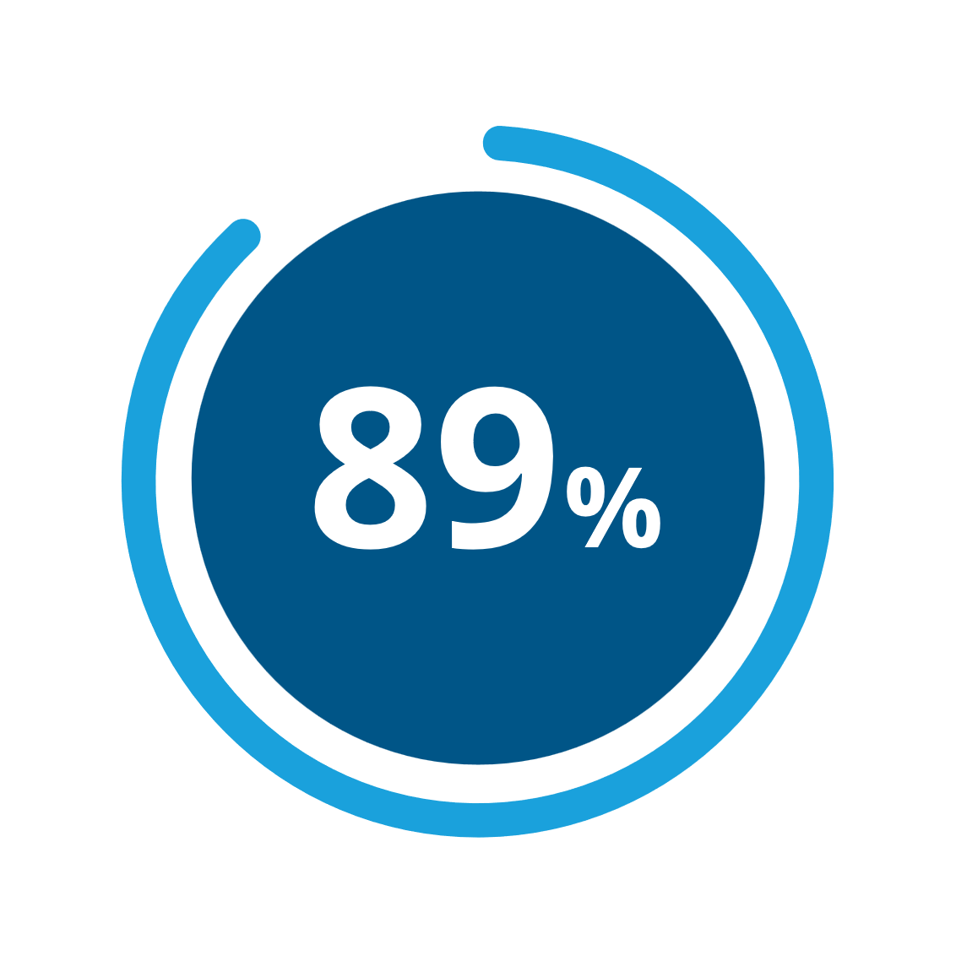
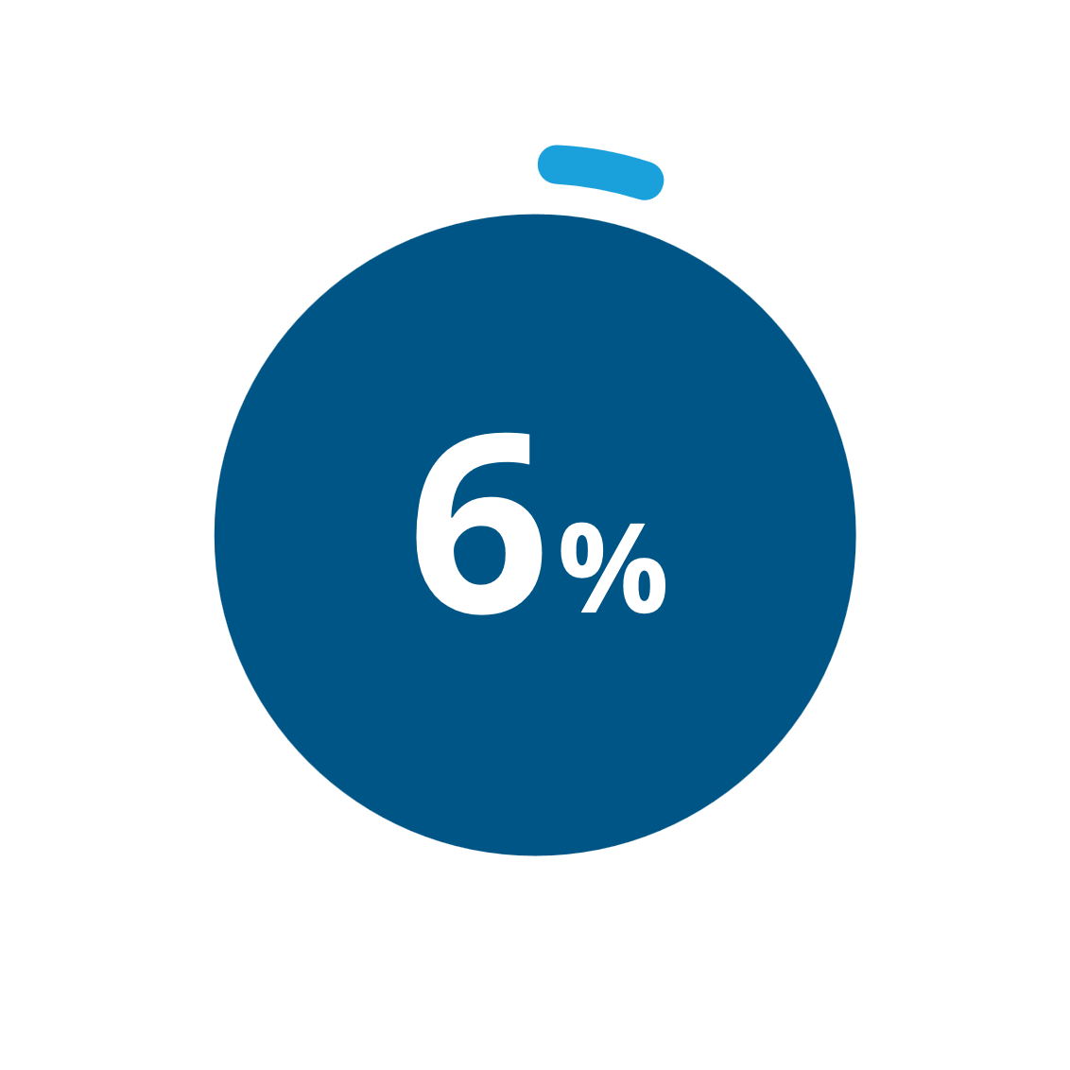
Our usual generic trends continue to remain consistent
Unlaunched
ANDAs
Generic manufacturers continue to make careful decisions about launching new products
Two products, Ozempic and Mounjaro, total $68.5B in sales compared to the entire generic market of over 1,100 products and $56.3B in sales
of Rxs are for Generic products
of sales are for Generic products

Slide 43

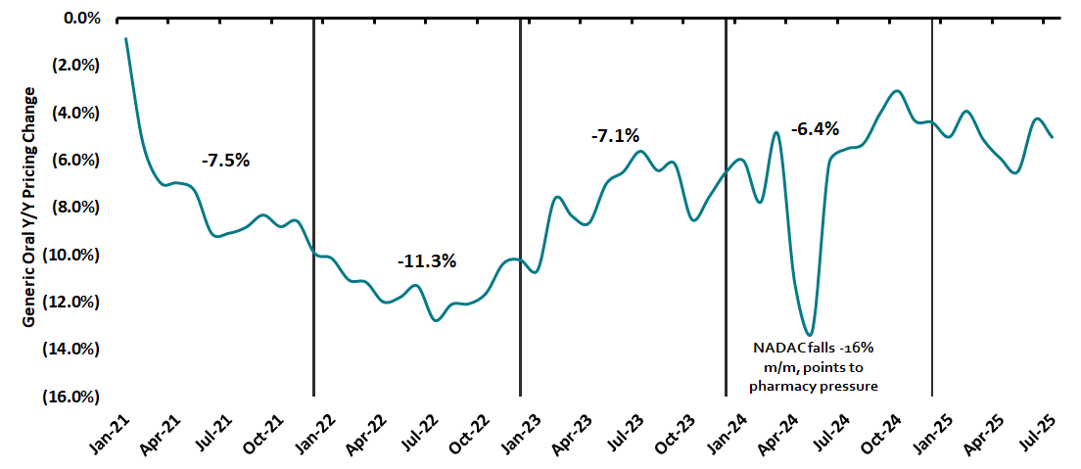

Year-over-year deflation is consistent with mid-single digits thus far in 2025
Mature Oral YoY Generic Price Trend
Nephron Observations
Generic drug prices fell 5.0% year-over-year in July
Data on pharmaceutical imports and drug distributor commentary indicates the impact of tariffs and tariff threats has been modest and easily managed year to date
Distributors remain well positioned to navigate this uncertainty, provided shortages do not trigger supply chain disruptions
Pharmacies face potential margin pressure if input tariffs drive higher generic costs and higher annual brand inflation
Adjusted
Source: Nephron Research Analysis of IQVIA and Glass Box Analytics Data

Slide 44
The sales of the Adalimumab biosimilars lag in comparison to the usual pace of a generic drug adoption
Lipitor and Atorvastatin Generics 3-Month Average Sales Over Time
Atorvastatin
Lipitor
Jan 1997
Jan 2001
Jan 2004
Jan 2008
Jan 2012
Jan 2016
Jan 2020
Jun 2025
Humira and Adalimumab Biosimilars 3-Month Average Sales Over Time
Humira
Biosimilars
Jan 2003
Jan 2008
Jan 2013
Jan 2018
Jan 2023
Jun 2025

Slide 45
Sales of the six initial products that encountered biosimilar alternatives have significantly declined
Originator (Biologic) Sales ($ Billions) MAT ending December
Originator (Biologic) Sales ($ Billions) MAT ending December
Sales in Billions
-89.5%
Sales in Billions
-77.5%
1.0
$0.8
4
$3.1
Biosimilar Market Share: 72.4%
$0.6
$2.4
$2.4
$2.4
$2.1
$1.8
0.5
$0.4
$0.3
2
$1.6
$1.6
$0.2
$0.2
$0.1
$0.1
$0.1
$0.1
$0.7
$0.5
0.0
0
NEUPOGEN (FILGRASTIM)
EPOGEN/PROCRIT (ERYTHROPOIETIN ALPHA)
Sales in Billions
-71.9%
Sales in Billions
-87.0%
6
$5.0
$5.3
$5.5
$5.3
4
$3.1
$3.1
$3.1
Biosimilar Market Share: 46.0%
$4.7
$2.9
$3.0
4
$3.7
$2.8
$2.0
$2.0
$1.6
2
$1.1
2
$1.5
$0.6
$0.5
$0.4
0
0
REMICADE (INFLIXIMAB)
AVASTIN (BEVACIZUMAB)
Sales in Billions
-79.8%
Sales in Billions
4
-90.4%
6
$4.2
$4.2
$4.2
$2.6
$2.8
$3.1
$2.9
Biosimilar Market Share: 69.8%
4
$4.2
$3.4
$2.5
$2.8
$2.2
$1.8
2
$1.5
2
$1.5
$0.9
$0.7
$0.4
$0.3
$0.3
0
0
NEULASTA (PEGFILGRASTIM)
HERCEPTIN (TRASTUZUMAB)
Launch Year
Source: IQVIA, National Sales Perspectives, March 2025

Slide 46
Sales have begun to decline for Humira
Originator (Biologic) Sales ($ Billions) MAT ending December
Originator (Biologic) Sales ($ Billions) MAT ending December
Sales in Billions
-23.8%
6
-76.2%
Sales in Billions
Biosimilar Market Share: 72.4%
$3.7
$3.9
$4.0
$4.3
$4.3
40
$28.2
$32.3
$35.3
4
$3.1
$19.2
$22.3
$24.8
$26.9
2
$1.9
$1.3
$1.1
20
$10.6
$14.2
$17.1
$1.0
0
0
RITUXAN (RITUXIMAB)
HUMIRA* (ADALIMUMAB)
Sales in Billions
-76.7%
Sales in Billions
$2.0
$9.5
Biosimilar Market Share: 46.0%
10
$8.7
2
$1.7
$1.9
$7.5
$6.3
$6.0
$6.2
$6.5
$1.4
$1.4
$5.5
$5.0
$0.8
$1.0
$1.0
5
1
$0.5
$0.7
$1.4
0
0
LANTUS* (INSULIN GLARGINE)
ACTEMRA (TOCILIZUMAB)
Sales in Billions
3
Sales in Billions
0.2
$0.2
-80.5%
$0.2
Biosimilar Market Share: 69.8%
$1.9
$2.0
$1.8
$1.8
$0.1
$0.1
2
$1.6
$1.5
$1.5
$1.3
0.1
$0.1
$0.1
1
$0.7
$0.0
$0.0
$0.1
$0.3
$0.0
0
0.0
LUCENTIS (RANIBIZUMAB)
EYLEA (AFLIBERCEPT)
Launch Year
Source: IQVIA, National Sales Perspectives, March 2025

Slide 47
There is one biosimilar in the pipeline for biologics with under $1B in forecast pre-expiry sales
Share of biologics by pre-expiry sales and number of biosimilars in development, expiries 2025–2034
55
15
9
17
7
9
6
Data Source: Assessing the Biosimilar Void in the U.S.

Slide 48
Biosimilar development is concentrated in high-sales biologics with near term patent expiries in the next five years
Cluster of biologics assessed for biosimilar development
Share of total biologic expiries (n=118)
46%
Biosimilars in development
n=11
9%
50%
Expiry in near term (2025-2029)
n=24
54%
No biosimilars in development
n=13
11%
41%
High sales biologics
n=48
50%
Expiry in long term (2030-2034)
n=24
No biosimilars in development
n=24
20%
100%
Biologics with patent expiries 2025-2034
n=118
51%
Expiry in near term (2025-2029)
n=36
3%
Biosimilars in development
n=1
<1%
97%
No biosimilars in development
n=35
30%
59%
Low sales biologics
n=70
49%
Expiry in long term (2030-2034)
n=34
No biosimilars in development
n=34
100%
29%
Data Source: Assessing the Biosimilar Void in the U.S.

Slide 49
Complex biologics represent another important segment of the biosimilar void where challenges exist to biosimilar competition
Number of complex biologics losing patent protection by type, 2025–2034
Data Source: Assessing the Biosimilar Void in the U.S.

Slide 50
Cough, Cold, Flu, and Vaccines

Slide 51
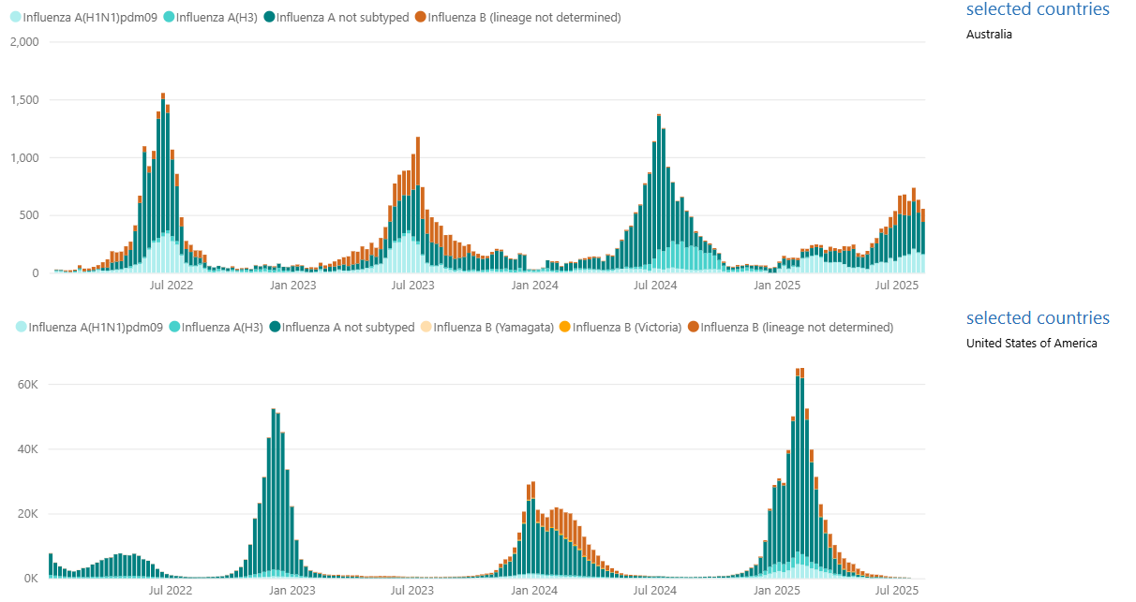
Based on season to date information from Australia, they are trailing behind last season in flu
Australia
United States
Data Source: World Health Organization, Comparison of number of influenza detections by subtype – Link: Power BI – Updated through 8/10/25

Slide 52
FAN Total Affected Population 2017/18 through 2024/25
Current illness levels are almost at an unprecedented low for this time-period driven by the softness in the pediatric segment.
Trend Line
Same week
each year
Alignment to current year
18/19 35.1MM
19/20 33.8MM
22/23 31.3MM
21/22 29.6MM
20/21 17.9MM

Slide 53
IQVIA’s FAN® data shows the 2024/2025 season was weaker than prior seasons
2024/25 Season vs. Prior 8 Seasons & 3 Season Averages

Slide 54
IQVIA’s FAN® data shows the 2024/2025 season was weaker than prior seasons
2024/25 Season vs. Prior 8 Seasons and 3-Season Averages

Slide 55
Flu vaccine season trailed behind the previous four seasons; Pneumonia vaccines made a strong push in Q1 relative to past seasons
Flu Vaccines
COVID-19 Vaccines
Pneumonia Vaccines
RSV Vaccines

Slide 56

Individuals aged 65 and older are up 4% with flu vaccines in the last year and make up almost half of the flu vaccines given
Flu Vaccines
By COT and Season
YoY Growth by Age
MAT Jun-24 vs. MAT Jun-25
-0.6%
Millions
30
24.6
25.3
22.1
22.0
+3.1%
+0.5%
20
-6.5%
10
8.1
8.3
7.7
8.0
6.9
6.9
6.4
6.5
3.2
3.7
3.3
3.1
0
Chain
Indep
Food
Mass
2021-22
2022-23
2023-24
2024-25
50%
Share by Age
40%
30%
20%
10%
0%
Under 18
18-24
25-34
35-44
45-54
55-64
65+
MAT Jun-22
MAT Jun-23
MAT Jun-24
MAT Jun-25
Season defined as Week Ending 7/26/24 through Week Ending 3/14/25

Slide 57
COVID-19 vaccines are now mostly being received by individuals aged 65 and older; Food is the only COT trending higher
COVID-19 Vaccines
By COT and Season
YoY Growth by Age
MAT Jun-24 vs. MAT Jun-25
Millions
80
76.3
60
-17.3%
40
-12.0%
+0.6%
-5.1%
26.0
19.2
15.9
21.2
22.9
20
14.3
4.5
7.2
5.4
5.4
6.4
4.6
4.3
2.8
2.5
0
Chain
Indep
Food
Mass
2021-22
2022-23
2023-24
2024-25
60%
Share by Age
40%
20%
0%
Under 18
18-24
25-34
35-44
45-54
55-64
65+
MAT Jun-22
MAT Jun-23
MAT Jun-24
MAT Jun-25
Season defined as Week Ending 7/26/24 through Week Ending 3/14/25

Slide 58
Pneumonia vaccines are up 24.5% year-over-year, driven by individuals aged 45-64 and by Food and Mass
Pneumonia Vaccines
By COT and Season
YoY Growth by Age
MAT Jun-24 vs. MAT Jun-25
+9.1%
Millions
1.5
1.2
1.3
+49.4%
+28.5%
1.0
1.0
+1.1%
0.6
0.5
0.5
0.5
0.5
0.2
0.3
0.4
0.3
0.4
0.1
0.1
0.2
0.2
0.0
Chain
Indep
Food
Mass
2021-22
2022-23
2023-24
2024-25
80%
Share by Age
60%
40%
20%
0%
0.1%
Under 18
18-24
25-34
35-44
45-54
55-64
65+
MAT Jun-22
MAT Jun-23
MAT Jun-24
MAT Jun-25
Season defined as Week Ending 7/26/24 through Week Ending 3/14/25

Slide 59
Other vaccines at Retail exhibit consistent year-over-year growth
-18.8%
Other Vaccines
10,000
9,365
9,539
8,996
8,523
8,084
8,000
Vaccines in Thousands
6,566
6,000
+32.6%
4,283
4,000
+45.2%
3,040
3,231
2,001
2,473
2,267
2,000
1,889
1,561
+48.0%
+24.5%
840
1,091
499
553
259
319
380
563
240
283
275
343
136
166
170
164
0
Varicella
Diphtheria Toxoids, Comb.
Hepatitis
HPV
Meningitis
MAT Jun 2020
MAT Jun 2021
MAT Jun 2022
MAT Jun 2023
MAT Jun 2024
MAT Jun 2025

Slide 60
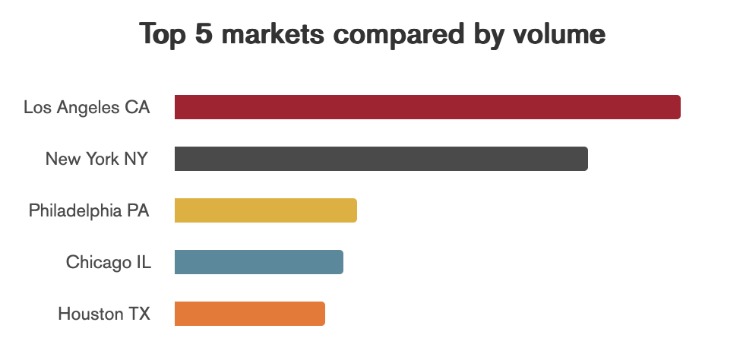
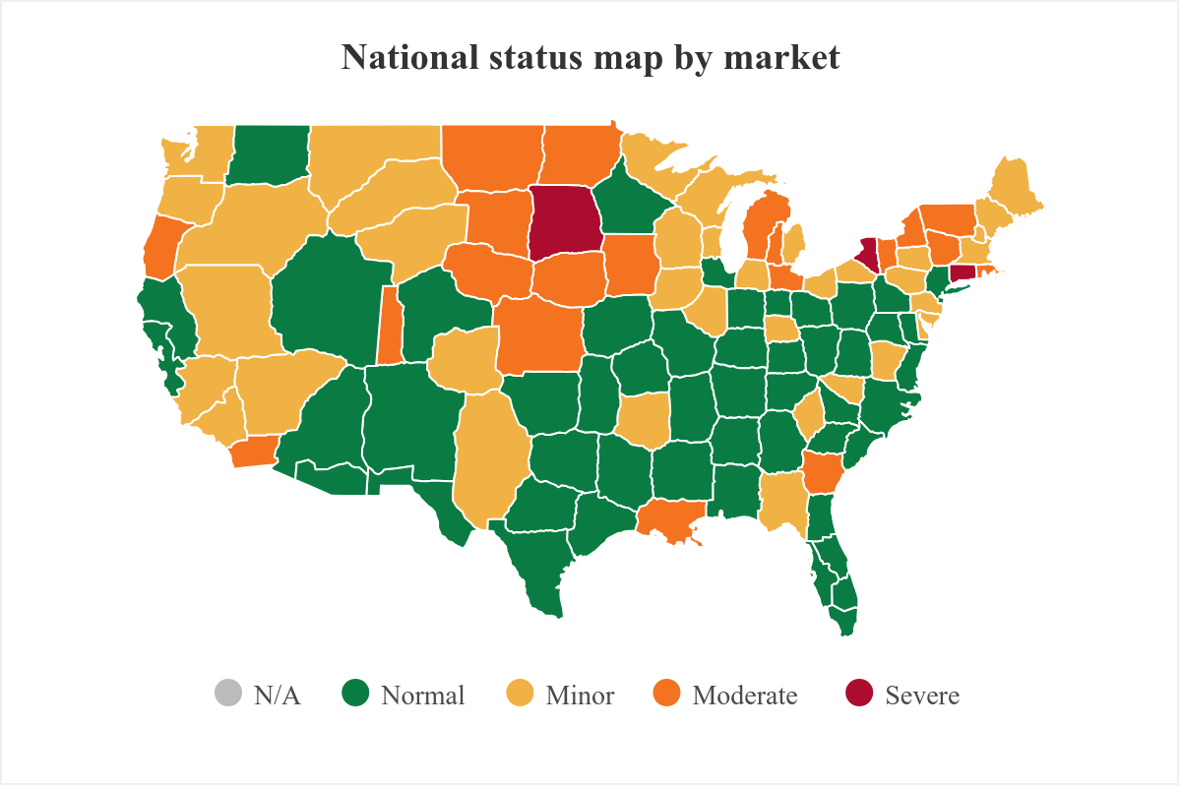
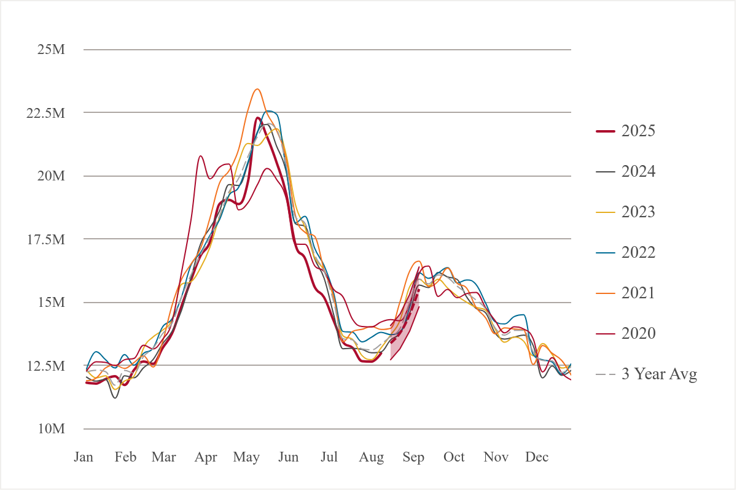
IQVIA’s AAN - Allergy Activity Notification Program® forecasts an increase in allergy symptoms in the next weeks
National Seasonal Trends
Week Ending 8/8/2025

Slide 61
On the Radar

Slide 62
The number of reported shortages has begun to slow; however, over 77% of shortages are ongoing over 2 years
Drug Shortages
FDA Inspections
IRA
340B
Product Launch
Current Unresolved Drug Shortages by Year Reported
90
80
70
# of Molecules
60
50
40
30
20
3
10
0
As of 2017
2018
2019
2020
2021
2022
2023
2024
YTD 2025
Current
Data Source: https://www.accessdata.fda.gov/scripts/drugshortages/default.cfm, data pulled 7/20/2025
Based on FDA Status of “Current”

Slide 63
Emerging biopharma companies account for a larger share of generics launched following the announcement of a shortage
Drug Shortages
FDA Inspections
IRA
340B
Product Launch
Launched generics by company size, 2013–Q1 2024
All launched generics (shortage and non-shortage)
n=4,379
n=114
n=93
Source: FDA Drug Shortage Database, June 2024; FDA Orange Book, Mar 2024; IQVIA National Sales Perspective, May 2024; IQVIA Institute, Oct 2024.
IQVIA Institute Report “Trends in Drug Shortages and ANDA Approvals in the U.S.” Exhibit 11

Slide 64
Over half of the active pharmaceutical ingredients (API) for prescription medicines in the U.S. come from India and the European Union*
Drug Shortages
FDA Inspections
IRA
340B
Product Launch
API manufacturing landscape excluding IV fluids, 2024 volume in extended units
Volume share of US prescription API, by country (2024)
Key Takeaways from their findings:
Major hubs of production are India and the EU
35% of generics come from India
43% of brands come from the EU
Note: IV fluids, such as saline, were excluded from the analysis. If those had been included, the U.S. contribution would have been significantly higher
100%
100%
100%
100%
United States
2%
India
EU
3%
China
Others
Unknown
All
Brand
Generic
* Source- https://qualitymatters.usp.org/over-half-active-pharmaceutical-ingredients-api-prescription-medicines-us-come-india-and-european

Slide 65
Inspections of pharmaceutical manufacturing facilities were lower for most countries in 2024 but up in China
Drug Shortages
FDA Inspections
IRA
340B
Product Launch
Important Notes:
  Not all inspections are included in the database. Inspections conducted by States, pre-approval inspections, mammography facility inspections, inspections waiting for a final enforcement action, and inspections of nonclinical labs are not included.
  The results show final classifications of No Action Indicated (NAI), Voluntary Action Indicated (VAI), Official Action Indicated (OAI) for each project area within an inspection.
The U.S. Government’s Fiscal Year runs October 1 through September 30
Data Source: https://datadashboard.fda.gov/ora/cd/inspections.htm , data pulled 7/20/2025

Slide 66
Eliquis, Jardiance, and Farxiga have been experiencing high sales growth every year
Drug Inspections
FDA Inspections
IRA
340B
Product Launch
IRA Products chosen for price negotiation August 2023, based on MAT June
ELIQUIS
+20.0%
XARELTO
34.8M
-9.1%
35
10.8M
12
29.0M
30
9.8M
10
+34.5%
25
+2.8%
8
$24.3B
$27.6B
20
6
$20.5B
15
$6.9B
$7.7B
$8.2B
$8.4B
$8.5B
$14.3B
$17.4B
10
$6.4B
4
$11.5B
5
2
2020
2021
2022
2023
2024
2025
0
2020
2021
2022
2023
2024
2025
0
Sales $
Unadjusted Rxs
Sales $
Unadjusted Rxs
JARDIANCE
+53.7%
FARXIGA
+35.6%
JANUVIA
22.8M
25
10.3M
12
-16.8%
10
20
10
7.3M
8
14.8M
7.6M
8
6.1M
15
+37.7%
6
+61.2%
6
-31.9%
10
$8.6B
$9.2B
4
$6.2B
$6.3B
$6.4B
4
$18.4B
$22.4B
$4.6B
$6.7B
$6.0B
$5.8B
$4.1B
$6.7B
$9.8B
$13.9B
5
$2.0B
$2.9B
2
2
$4.8B
2020
2021
2022
2023
2024
2025
0
2020
2021
2022
2023
2024
2025
0
2020
2021
2022
2023
2024
2025
0
Sales $
Unadjusted Rxs
Sales $
Unadjusted Rxs
Sales $
Unadjusted Rxs

Slide 67
Sales growth has been steady for the two immunology products chosen for price negotiations, Stelara and Enbrel
Drug Inspections
FDA Inspections
IRA
340B
Product Launch
IRA Products chosen for price negotiation August 2023, based on MAT June
STELARA
ENBREL
+2.5%
-0.3%
0.7M
0.7M
0.7
1.3M
1.4M
1.4
+12.9%
0.6
+17.0%
1.2
0.5
1.0
$14.9B
$16.7B
$16.8B
0.4
$9.7B
$10.7B
0.8
$12.1B
0.3
$7.9B
$7.9B
$8.4B
$9.2B
0.6
$7.4B
$9.5B
0.2
0.4
0.1
0.2
2020
2021
2022
2023
2024
2025
0.0
2020
2021
2022
2023
2024
2025
0.0
Sales $
Unadjusted Rxs
Sales $
Unadjusted Rxs
ENTRESO
+36.8%
IMBRUVICA
FIASP/NOVOLOG
6.7M
7
0.25
10
6
-30.2%
-17.9%
4.9M
5
0.2M
0.20
8
+48.3%
6.1M
6
4
0.1M
0.15
5.0M
$5.6B
$6.6B
3
-17.6%
0.10
-69.2%
4
$3.3B
$4.5B
2
$6.7B
$6.1B
$6.0B
$5.7B
2
$1.7B
$2.3B
1
$3.7B
$4.0B
$4.0B
$3.2B
$2.8B
$2.7B
0.05
$3.7B
$1.8B
2020
2021
2022
2023
2024
2025
0
2020
2021
2022
2023
2024
2025
0.00
2020
2021
2022
2023
2024
2025
0
Sales $
Unadjusted Rxs
Sales $
Unadjusted Rxs
Sales $
Unadjusted Rxs

Slide 68
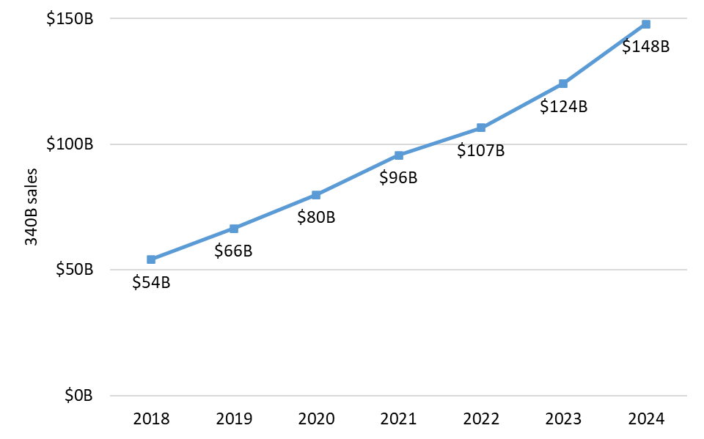
From 2018 to 2024, the 340B Drug Pricing Program grew 174.6%, reaching nearly $150B in sales at list price
Drug Shortages
FDA Inspections
IRA
340B
Product Launch
340B sales at list price, 2018 to 2024
Martin R and Karne H. The size and growth of the 340B program in 2024. IQVIA. 2025.

Slide 69
Post-pandemic launches underperform pre-pandemic trends for nearly all therapeutic categories
Drug Shortages
FDA Inspections
IRA
340B
Product Launch
Average First Year Gross Sales per Brand: All Launches
$400M
GLP-1/obesity
COVID
Hep C
Vaccine
Avg Gross Sales
(CPI Adj. - Dec 2023)
$141M
$139M
$135M
$163M
$118M
$131M
$111M
$92M
$73M
$67M
$84M
$0M
2013
2014
2015
2016
2017
2018
2019
2020
2021
2022
2023
Source: National Sales Perspective; Center of Launch Excellence, IQVIA; Methodology: Total launch year revenue divided by number of launches

Slide 70
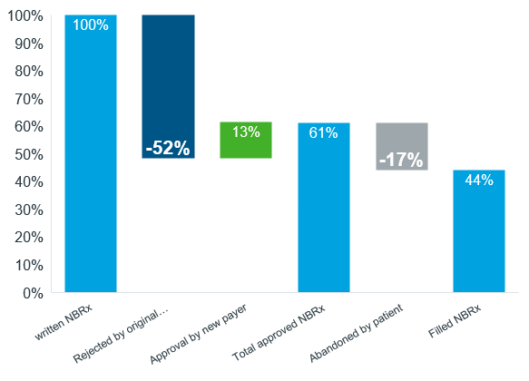
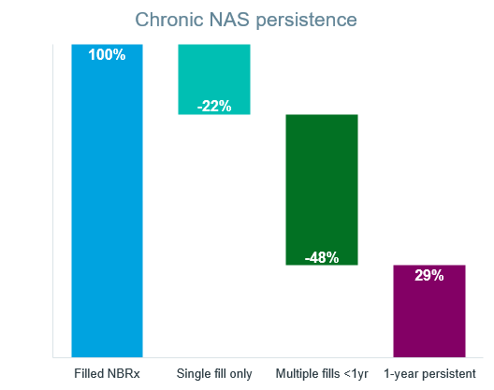
Over half of new prescriptions for novel medicines go unfilled, and only 29% of patients remained on therapy for a year
Drug Shortages
FDA Inspections
IRA
340B
Product Launch
Pharmacy claim status and persistence for novel active substances (NAS) launched in 2022 and 2023 in first year after patient first new written prescription
Acute and chronic NAS claims by status
Rejected all payers 39%
Written but unfilled 56%
Rejection by original payer
Source: IQVIA Libraries – Payer Control Library, Dec 2024.
IQVIA Insitute Report - Understanding the Use of Medicines in the U.S. 2025, Exhibit 37

Slide 71
Outlook

Slide 72
The impact of exclusivity losses will increase to $90.9Bn over 5 years including significant biosimilar entries
Impact of brand losses of exclusivity at estimated net manufacturer prices, 2020–2029, US$Bn
Forecast
$44.6Bn
$39.1Bn
$27.2Bn
$63.7Bn
$75.3Bn
$90.9Bn
$
Source: IQVIA Market Prognosis, Mar 2025; IQVIA Institute, Apr 2025.

Slide 73
Oncology and obesity will drive growth through 2029 while diabetes, immunology, and COVID-19 will contribute to slowing
Historic and forecast spending growth at estimated net manufacturer prices for leading therapy areas
Size of bubble:
Spending in 2029
$100Bn
$50Bn
$10Bn
Obesity
COVID-19 vaccines & therapeutics
70%
NM
Source: IQVIA Institute, Apr 2025.

Slide 74
Spending on obesity drugs will reach $60Bn with a wide range of scenarios dependent on reimbursement and costs to patients
Obesity spending at estimated manufacturer net prices, 2019–2029, US$Bn
2025–2029 spending scenarios
Forecast
High scenario $204Bn+ invoice spending / net $84Bn based on significant expansion in usage and reimbursement
Base case $145Bn invoice spending / net $60Bn as a mix of patient payment, industry assistance, new care delivery paradigms augment limited traditional payer reimbursement
Low scenario $69bn invoice spending / net $28Bn in low scenario where access remains limited and costly to patients
Source: IQVIA Institute, Apr 2025.

Slide 75





Wrap-up
Current Market Performance
Volume was the biggest driver of sales growth in the last 12 months
GLP-1s are the biggest contributor to the growth being observed in the market today
Retail Performance
Store closures continue to happen with 6,200 few pharmacies than seven years ago
Mass and Food are the drivers of Rx growth in Retail
Chain continues to lose share
GLP-1s
These products continue to dominate the headlines and are having an impact beyond the pharmacy
Retail continues to be the predominant sales channel for these products
IQVIA data suggests that 44% of Independent pharmacies did not fill a weight loss GLP-1 in Q2 2025
Generics and Biosimilars
Generic deflation was -5% YoY
There is one biosimilar in the pipeline for biologics with under $1B in forecast pre-expiry sales
Cough, Cold and Flu
Australian flu season has been weak so far this year
Flu hit late last season but still didn’t provide a significant YoY lift for the entire season
Last season growth was primarily seen in the 65 and over age group

Slide 76







Presentations like this could not be completed without the help of many teams across the IQVIA organization
U.S. and Global Supplier Services
Government Solution
Thanks to the following teams
The IQVIA Institute for Human Data Science™
Data Management
Consumer Health
Thought Leadership

Slide 77

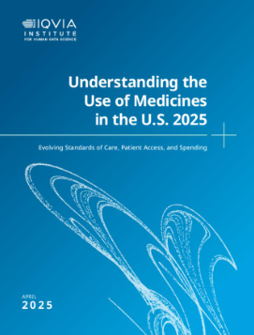
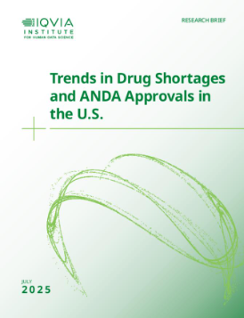



IQVIA Institute reports used in today’s presentation
Scan to receive a copy of today’s IQVIA presentation: 2025 Pharmaceutical Trends, Issues and Forecasts

Slide 78
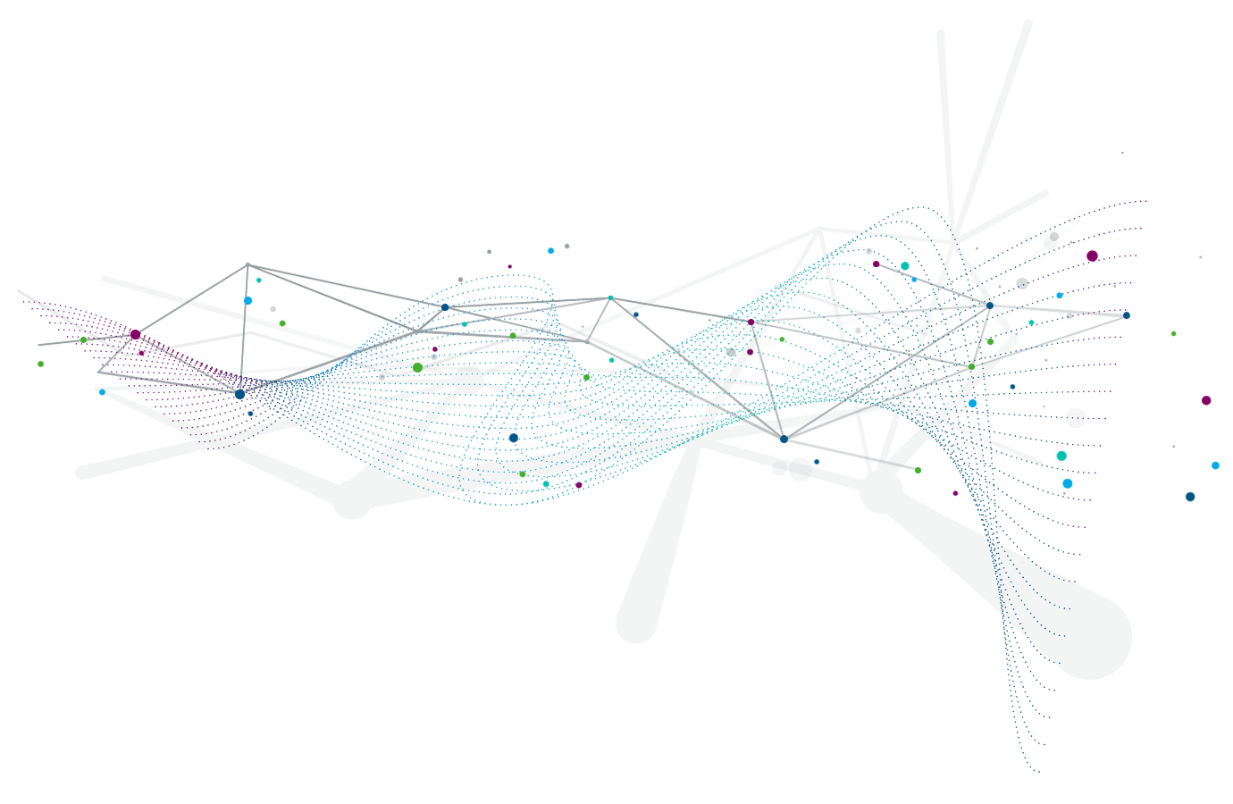



  U.S Progress Point
https://www.iqvia.com/progresspoint
Market insights
The IQVIA U.S. Launch Quarterly
The IQVIA Monthly Launch Tracker
Pharmaceutical Market and MedTech Trends
Next Generation Payor Segmentation
Person-centric health
Impact of Medicare Part D Cost Sharing
Health Equity in the Time of COVID-19
Advancing Outcomes with Home Healthcare
A curation of IQVIA’s best thinking on topics and trends driving change, disruption, and progress in the United States healthcare market.
Engagement innovation
HCP Consent at Scale
Hidden Peer-to-Peer Learning Communities
Importance of End-to-End Data in Physician Marketing

Slide 79

Scott Biggs, Director, Supplier Services
Scott Biggs is Director of Supplier Services at IQVIA (previously known as QuintilesIMS), the world’s largest pharmaceutical information company, serving over 101 countries. He has been with IQVIA since 2011.
Prior to IQVIA, Scott worked for other pharmaceutical information companies for several years and worked at Rite Aid Corporation in multiple roles for over 10 years. Scott received a Bachelor of Science in Accounting from Penn State University in and has been working with pharmacy data for 30 years.
In his role at IQVIA, Scott has worked with retailers, software vendors, and other data suppliers where he has helped them to understand their performance in the marketplace through business reviews and market analysis.
Scott.Biggs@iqvia.com
717.585.8503

Slide 80

Disclaimer slide

Slide 81
Disclaimer
The analyses, their interpretation, and related information contained herein are made and provided subject to the assumptions, methodologies, caveats, and variables described in this report and are based on third party sources and data reasonably believed to be reliable. No warranty is made as to the completeness or accuracy of such third-party sources or data.
As with any attempt to estimate future events, the forecasts, projections, conclusions, and other information included herein are subject to certain risks and uncertainties and are not to be considered guarantees of any particular outcome.
All reproduction rights, quotations, broadcasting, publications reserved. No part of this presentation may be reproduced or transmitted in any form or by any means, electronic or mechanical, including photocopy, recording, or any information storage and retrieval system, without express written consent of IQVIA.
Copyright © 2025 IQVIA. All rights reserved. IQVIA® is a registered trademark of IQVIA Inc. in the United States and various other countries.

Slide 82
Appendix

Slide 83








IQVIA Definition of a Specialty Drug
  Specialty drugs at IQVIA are classified as products that meet the following criteria
Treats chronic, rare and/or complex diseases
Expensive (USD $6K annual cost
of therapy)
Initiated and maintained by
a specialist
Unique distribution
Generally injectable and/or not
self-administered
Requires extensive or in-depth monitoring/patient counseling
Products that require an additional level of care in their chain of custody
Requires reimbursement assistance

Slide 84
Zepbound Pen has the greatest year over year sales growth in Retail
Top 20 Products for Retail Sales
$ Billions, MAT June 2025
RETAIL
Rank | Product | Class | Brand/Generic | MAT June 2025 | YoY Growth
1 | OZEMPIC | ANTIDIABETICS | BRAND | 31.3 | 20.2%
2 | MOUNJARO | ANTIDIABETICS | BRAND | 27.0 | 80.3%
3 | ELIQUIS | ANTITHROMBOTICS | BRAND | 21.4 | 14.1%
4 | JARDIANCE | ANTIDIABETICS | BRAND | 18.5 | 21.8%
5 | WEGOVY | ANTI-OBESITY PREPS, EXCL. DIETETICS | BRAND | 14.6 | 86.6%
6 | ZEPBOUND PEN | ANTI-OBESITY PREPS, EXCL. DIETETICS | BRAND | 12.2 | 438.8%
7 | BIKTARVY | HIV ANTIVIRALS | BRAND | 9.8 | 16.4%
8 | TRULICITY | ANTIDIABETICS | BRAND | 8.8 | -21.9%
9 | FARXIGA | ANTIDIABETICS | BRAND | 7.8 | 7.5%
10 | XARELTO | ANTITHROMBOTICS | BRAND | 6.8 | 1.2%
Source: IQVIA, National Sales Perspectives, 2025. Limited to Rx and OTC Insulins

Slide 85
The top 20 products total over 199 billion sales dollars
Top 20 Products for Retail Sales
$ Billions, MAT June 2025
RETAIL
Rank | Product | Class | Brand/Generic | MAT June 2025 | YoY Growth
11 | TRELEGY ELLIPTA | RESPIRATORY AGENTS | BRAND | 6.4 | 19.0%
12 | ENTRESTO | ANTIHYPERTENSIVES, PLAIN & COMBO | BRAND | 5.4 | 20.7%
13 | PAXLOVID | RESP ANTIVIRALS EX FLU | BRAND | 5.0 | 159.9%
14 | VRAYLAR | MENTAL HEALTH | BRAND | 4.4 | 19.2%
15 | NURTEC | MIGRAINE | BRAND | 3.8 | 27.8%
16 | RYBELSUS | ANTIDIABETICS | BRAND | 3.5 | -4.7%
17 | JANUVIA | ANTIDIABETICS | BRAND | 3.2 | -29.9%
18 | LINZESS | GI PRODUCTS | BRAND | 3.1 | 16.4%
19 | REPATHA SURECLICK | LIPID REGULATORS | BRAND | 3.1 | 58.3%
20 | DESCOVY | HIV ANTIVIRALS | BRAND | 2.9 | 15.0%
Source: IQVIA, National Sales Perspectives, 2025. Limited to Rx and OTC Insulins

Slide 86
Mounjaro & Zepbound have the greatest absolute sales gains in Retail in the last 12 months
Retail Products 1 - 10 (Highest One-Year Absolute Gains)
Product | MAT June 2024 | MAT June 2025 | Abs. Difference
MOUNJARO | 15.0 | 27.0 | 12.0
ZEPBOUND PEN | 2.3 | 12.2 | 9.9
WEGOVY | 7.8 | 14.6 | 6.8
OZEMPIC | 26.0 | 31.3 | 5.3
JARDIANCE | 15.2 | 18.5 | 3.3
PAXLOVID | 1.9 | 5.0 | 3.1
ELIQUIS | 18.8 | 21.4 | 2.6
DEXCOM G7 | 1.2 | 2.7 | 1.5
BIKTARVY | 8.4 | 9.8 | 1.4
REPATHA SURECLICK | 2.0 | 3.1 | 1.1
Retail Products 11 - 20 (Highest One-Year Absolute Gains)
Product | MAT June 2024 | MAT June 2025 | Abs. Difference
TRELEGY ELLIPTA | 5.4 | 6.4 | 1.0
ENTRESTO | 4.5 | 5.4 | 0.9
FLUZONE HIGH DOSE | 0.0 | 0.9 | 0.9
NURTEC | 3.0 | 3.8 | 0.8
ZEPBOUND VIAL | 0.0 | 0.8 | 0.8
VRAYLAR | 3.7 | 4.4 | 0.7
QULIPTA | 1.3 | 2.0 | 0.7
FARXIGA | 7.2 | 7.8 | 0.5
DUPIXENT | 1.2 | 1.8 | 0.5
FREESTYLE LIBRE 3 | 0.6 | 1.2 | 0.5
Sales $ in Billions
Source: IQVIA, National Sales Perspectives, 2025. Limited to Rx and OTC Insulins

Slide 87
Trulicity & Arexvy has the greatest absolute sales loss in Retail within last 12 months
Sales $ in Billions
Retail Products 1 - 10 (Highest One-Year Absolute Losses)
Product | MAT June 2024 | MAT June 2025 | Abs. Difference
TRULICITY | 11.2 | 8.8 | -2.5
AREXVY | 1.9 | 0.4 | -1.5
JANUVIA | 4.6 | 3.2 | -1.4
LANTUS SOLOSTAR | 2.2 | 1.0 | -1.2
VYVANSE | 3.2 | 2.1 | -1.1
SYMBICORT | 2.1 | 1.1 | -1.0
NOVOLOG FLEXPEN | 1.3 | 0.4 | -0.8
ADVAIR DISKUS | 1.0 | 0.2 | -0.8
LEVEMIR FLEXPEN | 0.8 | 0.0 | -0.7
SPIKEVAX | 1.8 | 1.1 | -0.7
Retail Products 11 - 20 (Highest One-Year Absolute Losses)
Product | MAT June 2024 | MAT June 2025 | Abs. Difference
VICTOZA 3-PAK | 0.8 | 0.1 | -0.7
FLUZONE HD QUADRI | 0.6 | 0.0 | -0.6
NOVOLOG | 0.9 | 0.4 | -0.5
HUMALOG KWIKPEN | 1.4 | 0.8 | -0.5
HUMALOG | 0.8 | 0.2 | -0.5
HUMIRA | 3.3 | 2.8 | -0.5
ABRYSVO | 0.9 | 0.4 | -0.5
FLOVENT HFA | 0.5 | 0.0 | -0.5
DEXCOM G6 | 1.7 | 1.2 | -0.5
MYRBETRIQ | 1.8 | 1.4 | -0.4
Source: IQVIA, National Sales Perspectives, 2025. Limited to Rx and OTC Insulins

Slide 88
Ozempic, Humira and Keytruda top super channels
Top 10 Products for Sales $, June 2025
RETAIL
 | Product | MAT June 2025 | YoY Growth
1 | OZEMPIC | 31.3 | 20.2%
2 | MOUNJARO | 27.0 | 80.3%
3 | ELIQUIS | 21.4 | 14.1%
4 | JARDIANCE | 18.5 | 21.8%
5 | WEGOVY | 14.6 | 86.6%
6 | ZEPBOUND PEN | 12.2 | 438.8%
7 | BIKTARVY | 9.8 | 16.4%
8 | TRULICITY | 8.8 | -21.9%
9 | FARXIGA | 7.8 | 7.5%
10 | XARELTO | 6.8 | 1.2%
MAIL
Product | MAT June 2025 | YoY Growth
SKYRIZI | 16.6 | 48.4%
HUMIRA | 15.7 | -40.3%
DUPIXENT | 14.8 | 32.7%
STELARA | 13.2 | -1.8%
ENBREL | 8.8 | 10.6%
RINVOQ | 7.0 | 47.1%
TREMFYA | 5.8 | 21.6%
TALTZ | 5.1 | 2.1%
OZEMPIC | 3.9 | 13.4%
OTEZLA | 3.5 | 7.4%
NON-RETAIL
Product | MAT June 2025 | YoY Growth
KEYTRUDA | 18.6 | 11.5%
DARZALEX FASPRO | 7.2 | 27.6%
OPDIVO | 5.8 | 5.9%
OCREVUS | 5.5 | 6.3%
ENTYVIO | 4.4 | 8.6%
VABYSMO | 3.5 | 16.7%
BIKTARVY | 3.5 | 16.1%
ELIQUIS | 3.4 | 14.0%
IMFINZI | 3.1 | 26.9%
PROLIA | 2.8 | 15.0%
Source: IQVIA, National Sales Perspectives, 2025. Limited to Rx and OTC Insulins

Slide 89
For Retail adjusted Rxs there are no changes for the top therapy and top product
Top 10 Retail Therapies and Products - MAT June 2025 (Adjusted Rxs in Millions)
Therapies
Rank | Therapy | MAT June 2025 | YoY Growth
1 | LIPID REGULATORS | 512.3 | 4.8%
2 | ANTIDEPRESSANTS | 491.7 | 2.7%
3 | B-BLOCKERS, PLAIN & COMBO | 248.8 | 0.0%
4 | ANTI-ULCERANTS | 243.2 | 2.5%
5 | ANGIOGENSIN II, PLAIN, COMBO & RENIN INHIB | 242.7 | 6.7%
6 | CALCIUM ANTAGONISTS, PLAIN & COMBO | 210.0 | 2.4%
7 | ACE INHIBITORS, PLAIN & COMBO | 200.0 | -4.0%
8 | DIURETICS | 193.4 | -0.4%
9 | THYROID PREPS | 190.3 | -0.2%
10 | TRADITIONAL TYPE II ANTIDIABETES | 183.1 | -0.1%
Products
Rank | Product | MAT June 2025 | YoY Growth
1 | ATORVASTATIN CA | 247.1 | 2.9%
2 | AMLODIPINE BESY | 174.0 | 2.8%
3 | LEVOTHYROXINE SOD | 159.0 | 0.0%
4 | LISINOPRIL | 143.7 | -3.1%
5 | LOSARTAN POT | 133.9 | 5.5%
6 | ROSUVASTATIN CAL | 131.4 | 15.6%
7 | METOPROLOL SUCCIN | 102.5 | 2.7%
8 | METFORMIN HCL | 90.8 | -2.9%
9 | GABAPENTIN | 83.9 | 2.2%
10 | SERTRALINE HCL | 79.2 | 2.7%
Source: IQVIA, National Sales Perspectives, 2025

Slide 90
HIV Antivirals, Immunology, and Oncologics top super channels
Top 10 Specialty Therapies for Retail, Mail, and Non-Retail MAT June 2025 (in $ Billions)
RETAIL
Therapy | MAT June 2025 | YoY Growth
HIV ANTIVIRALS | 20.9 | 10.5%
IMMUNOLOGY | 12.9 | 12.9%
ONCOLOGICS | 4.1 | 7.9%
LIPID REGULATORS | 3.8 | 38.2%
ANTI-INFLAMMATORY AND DIGESTIVE ENZY. | 3.0 | 8.2%
MENTAL HEALTH | 2.9 | 0.9%
OTHER CNS | 1.5 | 21.3%
VIRAL HEPATITIS | 1.2 | -5.9%
SEX HORMONES | 0.9 | 2.2%
BLOOD COAGULATION | 0.6 | 23.0%
MAIL
Therapy | MAT June 2025 | YoY Growth
IMMUNOLOGY | 116.1 | 7.5%
ONCOLOGICS | 37.7 | 15.8%
MULTIPLE SCLEROSIS | 7.6 | 0.5%
HIV ANTIVIRALS | 6.4 | 5.4%
OTHER CARDIOVASCULARS | 5.5 | 42.4%
ALL OTHER RESPIRATORY | 4.9 | 9.2%
GROWTH HORMONES | 3.2 | 28.1%
BLOOD COAGULATION | 3.0 | 10.2%
OTHER CNS | 2.5 | 27.4%
SEX HORMONES | 1.9 | 8.5%
NON-RETAIL
Therapy | MAT June 2025 | YoY Growth
ONCOLOGICS | 87.3 | 18.7%
IMMUNOLOGY | 29.5 | 22.3%
POLYVAL IMMUNOGLOBLULINS IV&IM | 8.2 | 21.1%
MULTIPLE SCLEROSIS | 7.3 | 6.3%
HIV ANTIVIRALS | 7.1 | 12.6%
OSTEOPOROSIS | 5.8 | 15.2%
OCULAR ANTINEOVASCULARISATION | 4.3 | 7.1%
MENTAL HEALTH | 4.0 | 13.8%
IMMUNOSUPPRESSANTS | 3.6 | 14.2%
BLOOD COAGULATION | 3.4 | 14.6%
Source: IQVIA, National Sales Perspectives, 2025. Limited to Rx and OTC Insulins

Slide 91
Immunology and Skyrizi top Specialty Mail sales
Top 10 Specialty Mail Therapies and Products - MAT June 2025 (Sales $ Billions)
Therapies
Rank | Therapy | MAT June 2025 | YoY Growth
1 | IMMUNOLOGY | 116.1 | 7.5%
2 | ONCOLOGICS | 37.7 | 15.8%
3 | MULTIPLE SCLEROSIS | 7.6 | 0.5%
4 | HIV ANTIVIRALS | 6.4 | 5.4%
5 | OTHER CARDIOVASCULARS | 5.5 | 42.4%
6 | ALL OTHER RESPIRATORY | 4.9 | 9.2%
7 | GROWTH HORMONES | 3.2 | 28.1%
8 | BLOOD COAGULATION | 3.0 | 10.2%
9 | OTHER CNS | 2.5 | 27.4%
10 | SEX HORMONES | 1.9 | 8.5%
Products
Rank | Product | MAT June 2025 | YoY Growth
1 | SKYRIZI | 16.6 | 48.4%
2 | HUMIRA | 15.7 | -40.3%
3 | DUPIXENT | 14.8 | 32.7%
4 | STELARA | 13.2 | -1.8%
5 | ENBREL | 8.8 | 10.6%
6 | RINVOQ | 7.0 | 47.1%
7 | TREMFYA | 5.8 | 21.6%
8 | TALTZ | 5.1 | 2.1%
9 | OTEZLA | 3.5 | 7.4%
10 | OFEV | 3.1 | 25.6%
Source: IQVIA, National Sales Perspectives, 2025

