Slide 1



WELCOME
Dr. Brian Harris
Julie Beck
Reinventing Category Management:
The Next Generation Powered By Ai
www.intentaitech.com

Slide 2

A Few Questions To Ask Yourself
PROCESS: Is your current Category Management process delivering acceptable business results and ROI? If not, why not?
DATA: Are you taking advantage of the multiple data sources now available for Category Management, but at the same time find it overwhelming?
TECHNOLOGY: Do you have plans to use AI tools to support your Category Management work?
SKILLS: Do you have the right skills in your organization to deliver next level Category Management work?

Slide 3

AGENDA
01
Brief History of Category Management
02
Evolution of Retail Marketing
03
The Urgent Need for Change
04
Next Generation Category Management
05
Ai Tools to Support the Evolution
06
Dr. Harris’ Predictions
07
Q & A

Slide 4

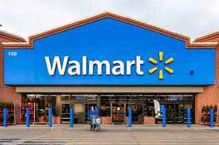

CATEGORY MANAGEMENT: HISTORY & DRIVERS
SHIFTING CONSUMER NEEDS
1990’s -Baby boomers were declining, and Gen X was emerging with different consumer needs, attitudes and behaviors
RISE OF COMPETITON
The rise of discounters like Walmart and Aldi and “Category Killers” forcing traditional retailers to adapt
DATA & TECHNOLOGY
The availability of data, from early POS scan data to loyalty card data gave new insights to retailers and manufacturers

Slide 5

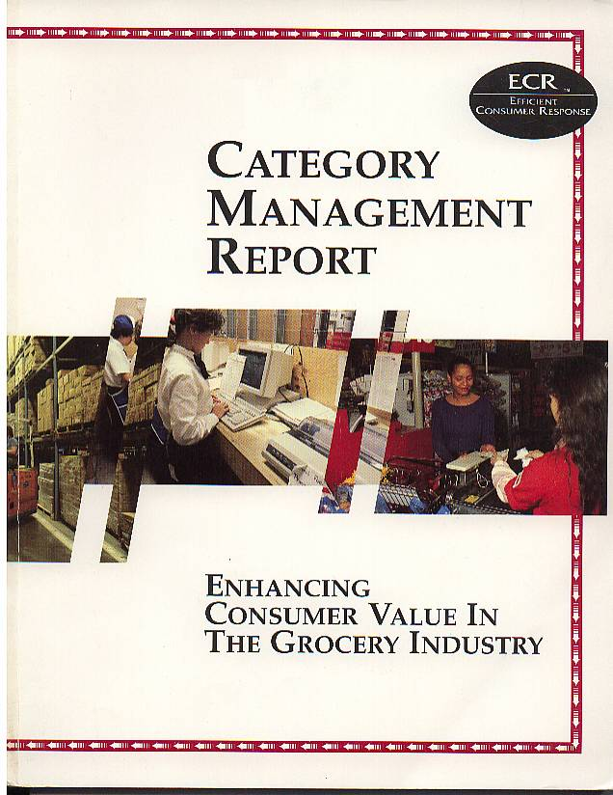



Efficient Consumer Response (ECR)
ECR Model
Global ECR Reports
8 Step Category Management Process
Strategy & Business Process
Information Technology
Organization Capabilities
Collaborative Relationships
Scorecard
Category Definition
Category Role
Category Assessment
Category Review
Category Scorecard
Category Strategies
Category Tactics
Plan Implementation
1995
USA / North America
1997
Europe
1998
South America

Slide 6


CATEGORY MANAGEMENT – A CRITICAL
“WAVE” IN THE EVOLUTION OF RETAIL MARKETING
Shopper Focused Category Management
Omni Channel Marketing
Personalized Marketing
Loyalty Marketing
1990
2000
2010
2020
2030
Next Generation Category Management
Shopper Marketing
Consumer & Shopper Journey
Ai Powered Strategy to Shelf
Category Management
POS & Space Management

Slide 7





LIMITATIONS OF CURRENT CATEGORY MANAGEMENT PROCESS
Strategy No Longer Guiding Process
Focus On Past Performance
Process Is Cumbersome & Time Consuming
Challenges
Of Implementation
Data Abundance But Insight Scarcity
Over- indexing on tactics
Lack of differentiation
Limited view of upcoming trends and how to capitalize on them
Risk of long planning cycles in a rapidly changing environment
Inconsistent execution resulting from siloed functional roles
Expanded data sources and tools with limited insights and solutions

Slide 8


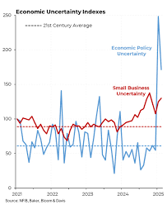

HEADWINDS FACING THE INDUSTRY
“And blowing faster and more intensely than ever”
DECLINING CONSUMER LOYALTY
SLOWED GROWTH, MARGIN PRESSURES POST COVID
ECONOMIC CONDITIONS DRIVING UNCERTAINTIES
TECHNOLOGY ONLY OFFERING SILOED SOLUTIONS
Notes:
1. Declining Consumer Loyalty
Data Point: During the pandemic, approximately 75% of U.S. consumers tried a new shopping behavior—like different channels or stores—and around 36–37% tried a new brand, with most planning to continue that behavior post‑COVID.
(Retail TouchPoints, McKinsey & Company)
Talking Point: Brand loyalty has fractured. With so much experimentation around shopping behaviors, especially among younger demographics, consumers are less tethered to familiar brands and more open to alternatives offering better value, convenience, or alignment with personal values.
2. Slowed Growth, Margin Pressures Post-COVID
Data Point: From 2019 to 2023, food-at-home prices rose about 25%, while grocery store net profit margins remained slim—around 1–1.6%, the lowest since 2019.
(McKinsey & Company, Los Angeles Regional Food Bank)
Additional Insight: Food‑and‑beverage retail stores did see net margins improve slightly—from about 2.9% to 4.4%—but this gain is modest relative to the ~$100 billion revenue increase they experienced over the same period. A RACE TO THE BOTTOME: Retailers copycat each other and can often be in a race to the bottom, with promotions outdoing each other further compressing margins by offering deeper promotions and discounts. If one retailer starts a promotion and discounting campaign, it will likely be one-upped by a competitor. As this happens, consumers shift their behaviors to spend only during promotions and discounts and wave off paying full price. This was one of the reason for Bed, Bath and Beyond (NASDAQ: BBBY) demise with their never expiring "20% off on a single item" coupons which trained shopped to always look for discounts.
(Liberty Street Economics)
Talking Point: While retailers have seen massive revenue due to inflation-driven price rises, their profit margins remain razor-thin. With growth flattening post-pandemic and costs rising across the board, both retailers and manufacturers are under pressure—forcing a sharper focus on cost optimization and strategic growth.
3. Economic Conditions Driving Uncertainties
Data Point: U.S. consumer sentiment has recently declined, with the University of Michigan’s index falling to about 58.6, along with one‑year inflation expectations rising from ~4.5% to 4.9%, and longer-term expectations increasing from 3.4% to 3.9%.
(Reuters)
Talking Point: Consumers are growing anxious about inflation and the overall economy, eroding confidence in buying conditions—especially for durable goods. This unpredictability makes demand forecasting, assortment planning, and promotional strategies much more challenging.
4. Technology Only Offering Siloed Solutions
Data Point: A PYMNTS Intelligence study found over half of retail and grocery merchants face challenges with data sharing across departments—limiting integration and value realization.
(Reuters, publitas.com)
Talking Point: Despite significant tech investments across areas like loyalty, pricing, and analytics, many retailers find these systems don't communicate with each other—creating operational friction, siloed decision-making, and an inability to deliver seamless, shopper-centric experiences.
TL;DR Speaker-Note Summary:
Declining Loyalty: 75% of consumers tried new behaviors; ~36% tried new brands, many continuing post-pandemic (McKinsey)
Margin Pressure: Food-at-home prices up ~25%; margins still ~1–1.6% (grocers)
Uncertainty: Sentiment index near 58; 1-year inflation expectations at ~4.9% (University of Michigan)
Siloed Tech: Over 50% of merchants lack integrated systems (PYMNTS)

Slide 9

The Time Has Come for the Next Generation of Category Management
And….the train has already left the station

Slide 10

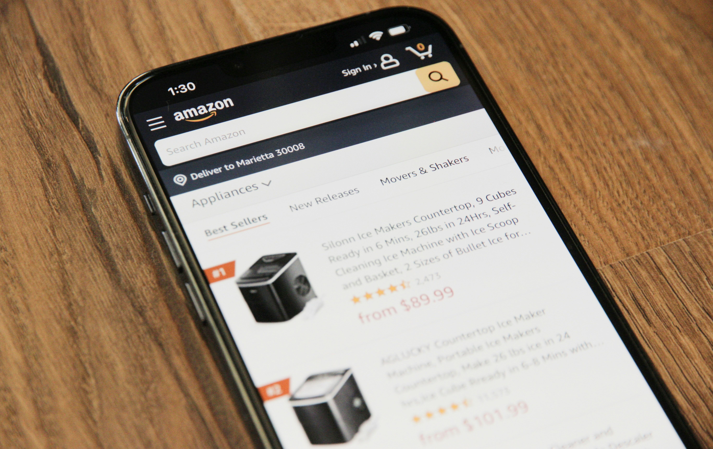
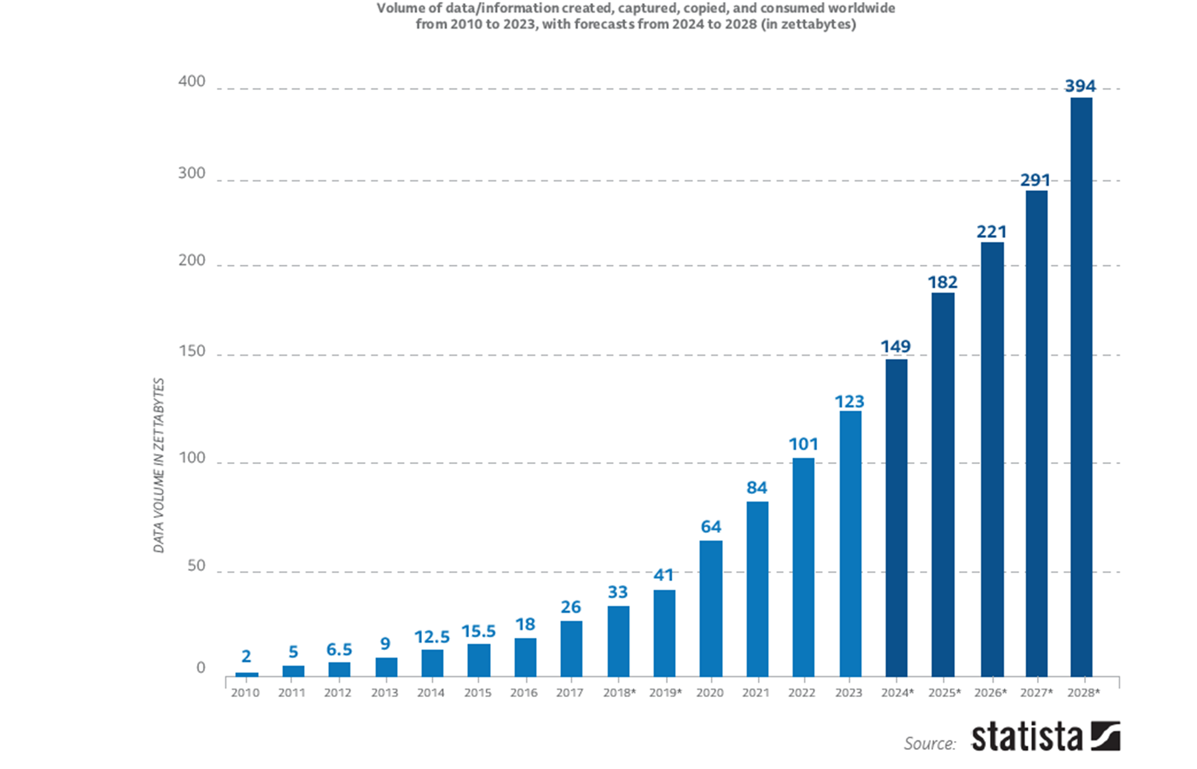
NEXT GENERATION CATEGORY MANAGEMENT:
DRIVERS
SHIFTING SHOPPING BEHAVIOR
The consumer journey continues to be fragmented, with shoppers moving fluidly across missions and channels. New consumer/shopper cohorts with different needs and expectations.
CHANGING COMPETITION
Online, click-and-collect, and delivery are reshaping how categories are bought and sold. Success now requires seamless strategies across physical and digital shelves.
DATA & TECHNOLOGY
Category management is facing a data explosion — data availability will triple in 5 years — yet today’s AI tools are not solving the complex business processes behind the data

Slide 11
Category Management Data Sources
Traditional Core Sources (The “Big 3”)
  POS, Panel, Loyalty
Expanded Shopper & Consumer Data
  Trip Missions, Segmentation, Qualitative Studies, Quant Surveys
Retail Execution Data
  Pricing, Promotion, Planogram, Assortment, Inventory
Digital & E-commerce Sources
  Digital Shelf, Product Reviews, Retail Media
Emerging / Prescriptive Trend Sources
  Social Listening , Macroeconomic Data, Health & Wellness Data, Weather, Traffic

Slide 12



ECR to PCR: Personalized Consumer Response
INTEGRATED DATA ECOSYSTEM
COLLABORATIVE FRAMEWORK
Next Gen
Cat
Man
PEOPLE & CAPABILITIES
TOOLS & TECHNOLOGY

Slide 13
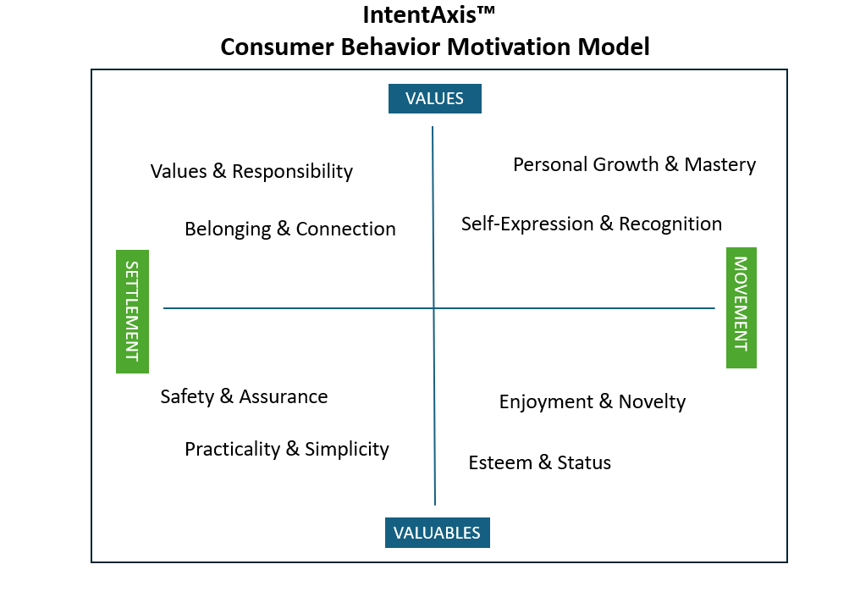
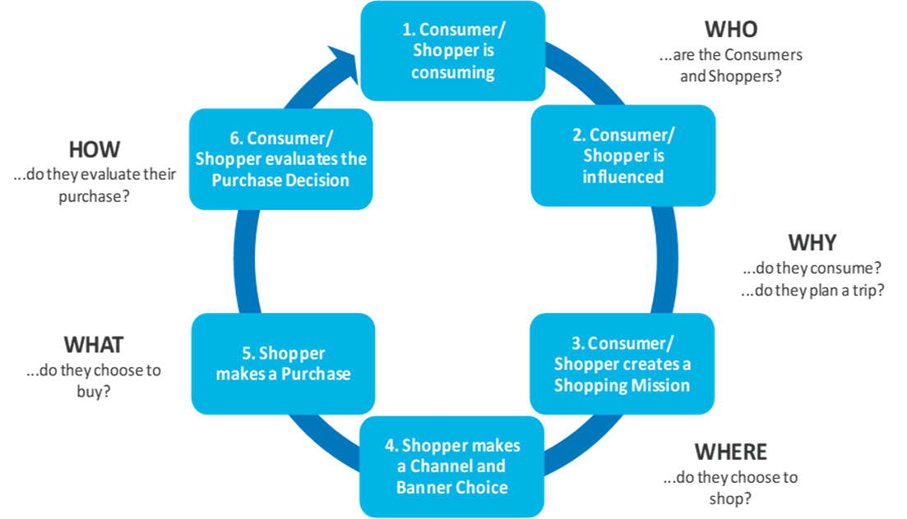
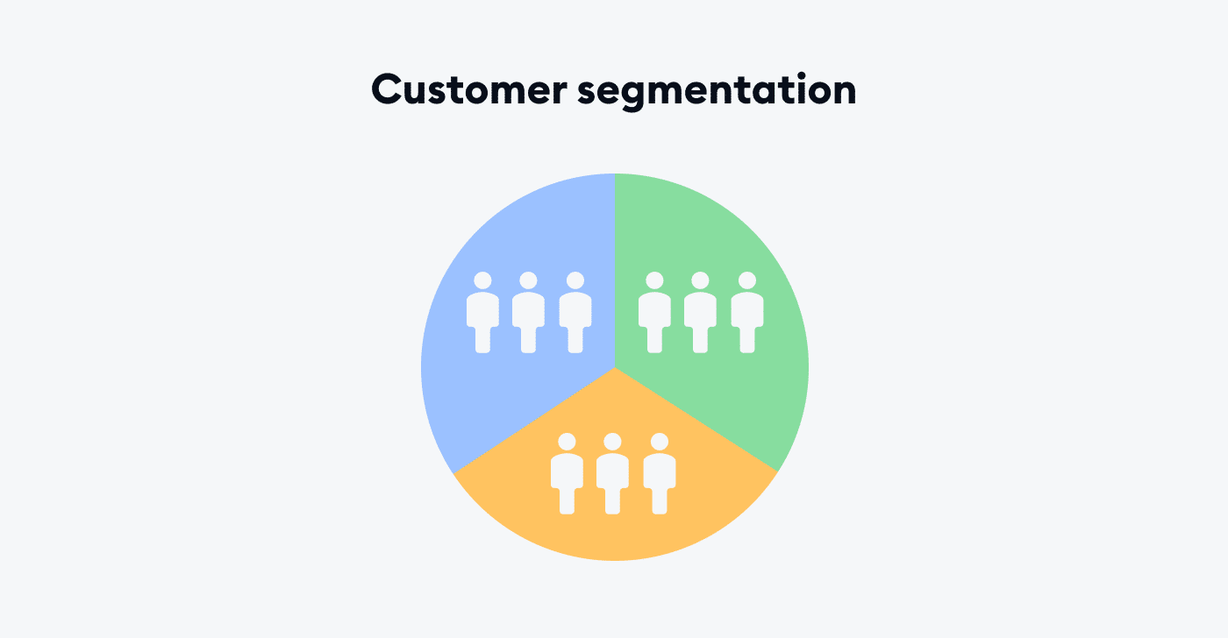

Next Generation Category Management
3 Phases
STRATEGY
PLANNING
EXECUTION
Category Assessment
Category Definition
Category Role
Category Review
Category Scorecard
Category Strategies
Category Tactics
Plan Implementation
CONNECTING THE STRATEGY TO PLANNING & EXECUTION
Notes:
Brian

Slide 14
Next Generation Category Management Process
Steps
Process
1
Prescriptive Market/Consumer & Shopper Insights
2
Integrated Shopper & Consumer Segmentation
STRATEGY
3
Identification of Most Valuable Segments
4
Transformative Growth Platforms
5
Integrated Category/Brand Growth Vision
6
Category Assessment
PLANNING
7/8
Category Definition & Role
9/10
Category Objectives & Strategies
11
Assortment, Pricing, Planogramming, Promotion and Personalization
EXECUTION
12
Retail Media/Shopper Marketing Implementation
13
Measuring Results
www.intentaitech.com
Notes:
Add color background

Slide 15

Next Generation Category Management Has Proven to Deliver Transformational Results
r
#1
4x
30X
RETAILER DIFFERENTIATION
INNOVATION
CORE BRANDS
Regional retailer went from #3 to #1 in the market in under three years
Global soft drink manufacturer identified innovation to deliver 4x growth to segment
A PB dairy brand retailer identified growth platforms resulted +15% CAGR and brand sold for 30x initial size to global manufacture
Notes:
Our EU Partners have validated the Next Gen process to produce spectacular results for retailers and manufacturers

Slide 16




Insight Engine Delivers Strategic Framework
(Steps 1-5)
CONSUMER BEHAVIORS
Lifestyle
Attitudes
Demographics
Psychographics
Consumer Clustered by Characteristics/Buying Power
SHOPPING EXPECTATIONS
+80 Shopping Attributes
Trip Missions
Cross -Category Preferences
Retailer Equity Matching
Ranking of attributes to retailer performance
SEGMENTATIONS
Key Segments with Highest Buying Potential = MOST VALUABLE SEGMENT (>70% Sales)
Growth Platforms with Key Categories
VALUE DRIVERS
Value Drivers of Most Valuable Segment (MVS)
Price Promotion Placement Product Personalization
Notes:
Julie

Slide 17

Most Valuable Segment (MVS):
Integrated Consumer & Shopper Behavior
Finding the Shoppers for Future Growth
Quantify Buying Power
Hyper Focus On Their Needs

Slide 18

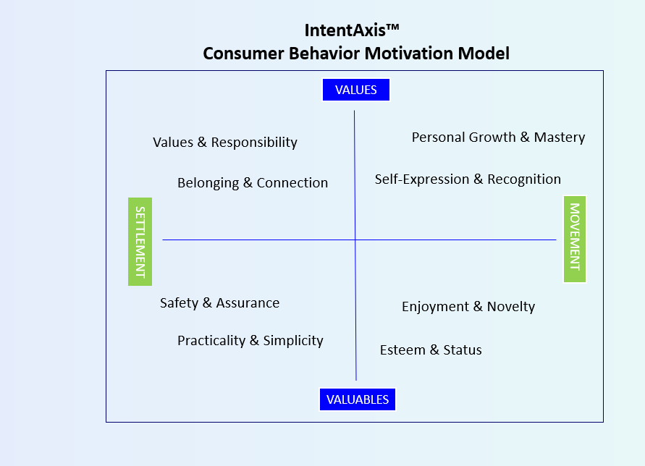





Unlocking Growth with the New Most Valuable Segment (MVS)
THE OLD WAY OF SEGMENTING SHOPPERS
NEW MVS MODEL
“Who they were and what they did”
“Who they will be & why they buy”
Clusters of buying power potential based on motivation-centric model of consumer & shopper behavior
Recency & Frequency of Shopping
Basic Demographic Profiles
Quantify the data to capture 70% of category sales potential using advanced modeling
Past Purchase Behavior
Most Valuable Segment- focuses decisions on assortment, pricing, placement, promotion, personalization

Slide 19

GROWTH PLATFORM FOR MVS
Elevating everyday occasions
MVS VALUE DRIVERS
🥂 Elevated Entertaining
🧀 Artisanal Craftsmanship
🌍 Cultural Discovery
⭐ Distinctive Flavors & Textures
Transforms everyday shopping into premium, memorable experiences
Notes:
Is there an updated version for GLP in Drug

Slide 20
From Strategy to Execution
Price: Tiered trade up strategy
Promotion: Bundles & Occasions
Placement: Cross category displays
Product: Curated premium skus a
Marketing: Digital campaigns, in store signage, personalized offers
Trade Up + Bigger Baskets = Cross Category Profitable Growth

Slide 21

Drug Retailer Growth Platform Example
Most Valuable Segment (MVS):
“On-the-Go Caregiver”
Value Drivers:
Convenience, Trust In Pharmacist, Bundled Solutions, Products That Save Time & Improve Energy
Growth Platform:
“The Recharge Zone”

Slide 22

The Recharge Zone
Growth Platform “The Recharge Zone”
Focus Categories:
  Energy & Immunity- Functional beverages, hydration powders, immune gummies, daily vitamins.
  Stress & Sleep -OTC melatonin, herbal sleep aids, calming teas, aromatherapy rollers.
  Pain Relief & Recovery -OTC analgesics, topical patches, joint supplements, sports recovery creams.
  Skin & Self-Care Resilience -Sunscreen, sensitive skin barrier creams, menopause support lotions, collagen beauty supplements.

Slide 23
How Next Gen Category Management Creates The Roadmap to Growth
01
06
Build a growth roadmap rooted in data, delivering sustainable results
Spot trends early to act before the competition
02
05
Uncover product, service & experience opportunities that resonate
Quantify the impact of meeting MVS needs on sales & share
03
04
Understand shopper expectations and identify how to win their trips
Discover new growth platforms across categories and adjacencies
Notes:
Add something about predictive; see things quicker and you can react

Slide 24

Driving Next Gen Category Management with Ai
Notes:
brian

Slide 25
Next Generation Category Management
Ai Requirements
01
Integrated Next Generation Process
Allows user to leverage proven process to drive strategy
Unifies all the Data:
02
Acts as an umbrella over multiple data sources, creating a single source of truth for answers, in minutes not months
03
Connects Strategy to Execution:
Links consumer motivational behavior and shopper execution to create a strategy that informs all pricing, assortment, space and promotion decisions-across all buying points (online, instore, etc)
04
Learns and Adapts in Real Time:
Continuously improves as shopper and market dynamics shift allowing user to respond to trends in real time
05
Scales Expertise:
Functions like a virtual category manager, freeing teams to focus on growth, strategy and collaboration
Empowers Not Replaces Decision Making:
Allows users to spend time on more strategically important work
Notes:
Brian
The industry can’t afford silos and slow, tactical processes anymore — it needs one intelligent system that unifies all the data, learns in real time, and drives strategy through execution. Nothing less will do.”
First one needs to emphasize the process necessity

Slide 26

Agentic Ai Solution for Next Generation Category Management
The Ai Tool Needs to Address 3 Core Applications
Category Reviews One Click- Strategy, JPB, Execution all linked
Real Time Category Diagnostics- Real time with strategic recommendations on action
Category Alerts- notified on trends and what to do about it to stay ahead

Slide 27






AI Responsive Intelligent Coach & Advisor for the Next Generation of Category Management
STRATEGIC FRAMEWORK
13-Step Integrated processes for next generation Category Management
ON DEMAND
INSIGHTS ENGINE
Statistical model combining consumer behavioral research. Consumer & shopper journey research to identify the Most Valuable Segment (MVS)
AI AGENTS
KEY BUSINESS QUESTIONS
Curated questions for each step in the integrated process
TRANSACTIONAL DATA
MARKET DATA
Loyalty Card
Point of Sale
Brand/Consumer Insights
Social media activity
ECommerce
Inventory
Weather, traffic patterns
Product reviews
Notes:
This is an example of a tool that works in this way
Intent AI has 4 Elements
Strategic Framework is the foundation (next gen cat man)
Insights Engine to help define strategy. Leverages data (either from client or Intent AI)
Consumer behavioral insights
Consumer & Shopper journeys
MVS identification
Growth platforms, etc.
Library of Key BQs – covers the entire spectrum from strategy to planning, & to execution. The idea is to help merchants stay aligned with overall business strategy while making decisions daily. Key BQs are meant as a guide for the merchant
All of these are delivered thru AiRICA
Brings real-time data insights to merchants
Is an ally, coach, mentor who’s consistently helping drive better decisions, while staying aligned with the strategy

Slide 28

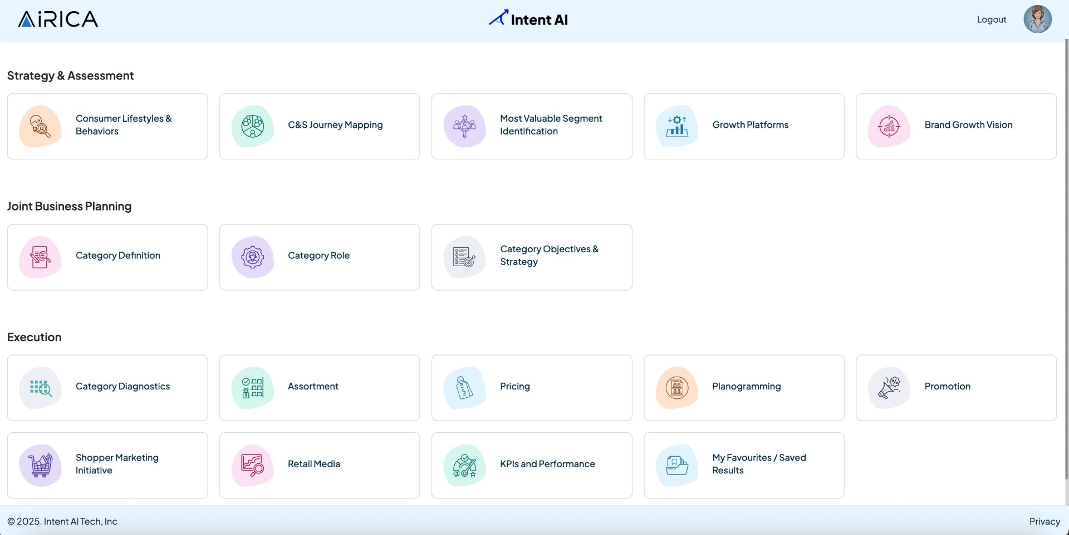










CATEGORY REVIEW
Pricing Recommendations
Category Managers
Assortment Recommendations
Shelving Recommendations
Promotion Recommendations
Omni Channel MKT Recommendations
External data
Internal Data Sources
Notes:
“AiRICA connects seamlessly to syndicated data. That said, access may vary depending on your contracts with providers, so part of our pilot process includes working with you to assess and address that together.”
AiRICA has an omni-channel front end – can sit on top of any application as a chat based virtual agent; but it can send reports via email; answer Qs or send notifications via text and also integrate with Teams as a channel or Slack for e.g.
At the heart of the solution is the Agentic Orchestrator that does the AI heavy lift.
AiRICA is integrated with the required backend systems – systems of record + third party data sets; that have the data necessary to provide answers to the user.
From AI perspective, solution is agnostic. We can leverage any of the leading LLMs. We also have an option to use client preferred GenAI stack – so we can integrate with your LLM hosted within your firewall through an AI Gateway.

Slide 29



The Right Business Questions Guide Ai Analytics
STRATEGY
Which shopper missions are growing the fastest in the market?
Is there a relationship between pantry loading and price perception?
Has the pantry loading shopping trip become more or less important in the market?
How do we compare to other retailers in the market in meeting pantry loading shopping missions?
Prioritize which categories are most important to the shopper in pantry loading
Which competitors are growing in the key pantry loading categories in my market?
What are the top reasons we’re losing this shopping trip?
PLANNING
Which segments of our consumers and shoppers are driving pantry loading trip?
Are we losing share pantry loading to our most important shopper segments?
What the growing shopper segment of pantry loading?
What is the pentration of P/L in our pantry loading trip for our shoppers?
Which shelf stable categories are growing the fastest with our key shopper segments?
What are the top 3 growth platforms that will drive more pantry loading shopping trips into our stores?
EXECUTION
  Which categories and brands are considered destination?
  What changes do I need to make to assortment, pricing, promotions and planogramming to win this trip mission?
Notes:
The curated questions, strategy will be focused one area of price perception

Slide 30
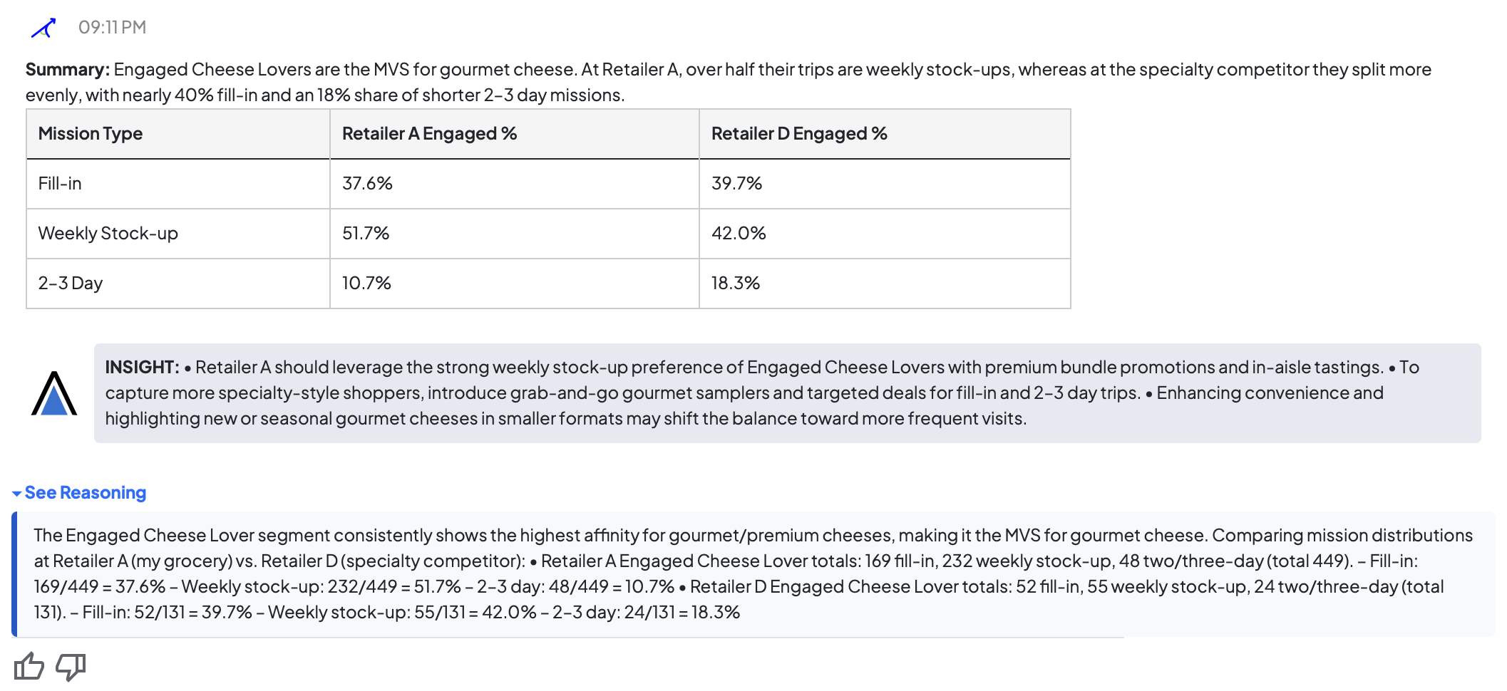
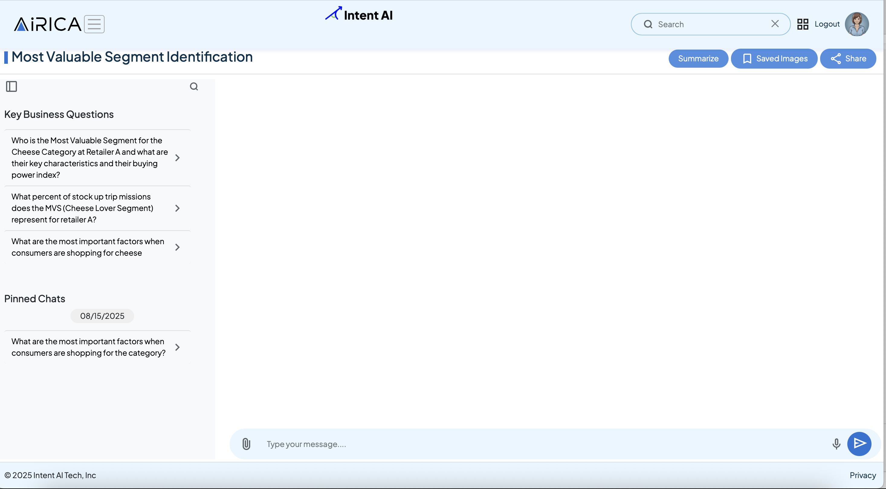
“AiRICA- Who is my MVS for gourmet cheese, and how does their trip mission behavior differ across my grocery and specialty competitors?”
Source: Intent Axis Consumer Behavioral Study, Shopper Study 2025, Numerator, Loyalty Card

Slide 31
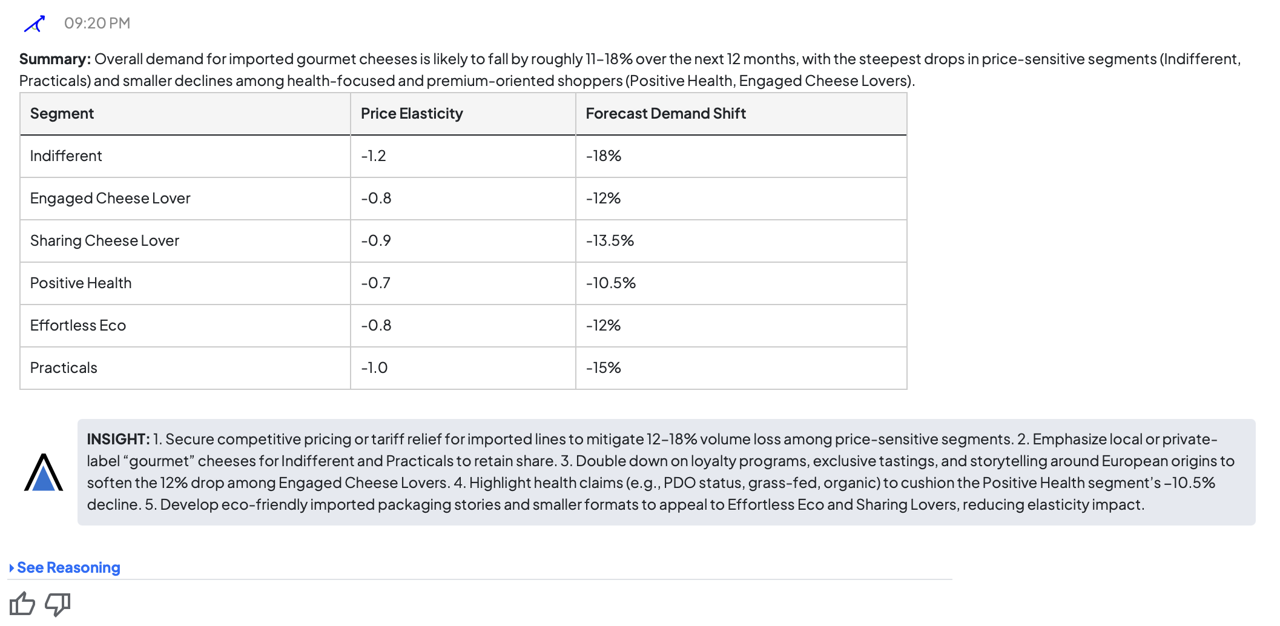
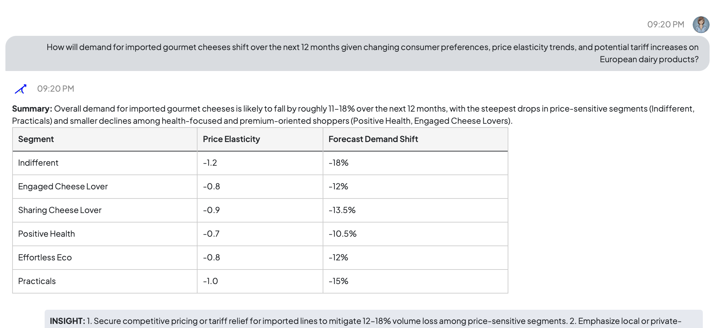
“AiRICA--How will demand for imported gourmet cheeses shift over the next 12 months given changing consumer preferences, price elasticity trends, and potential tariff increases on European dairy products?”

Slide 32
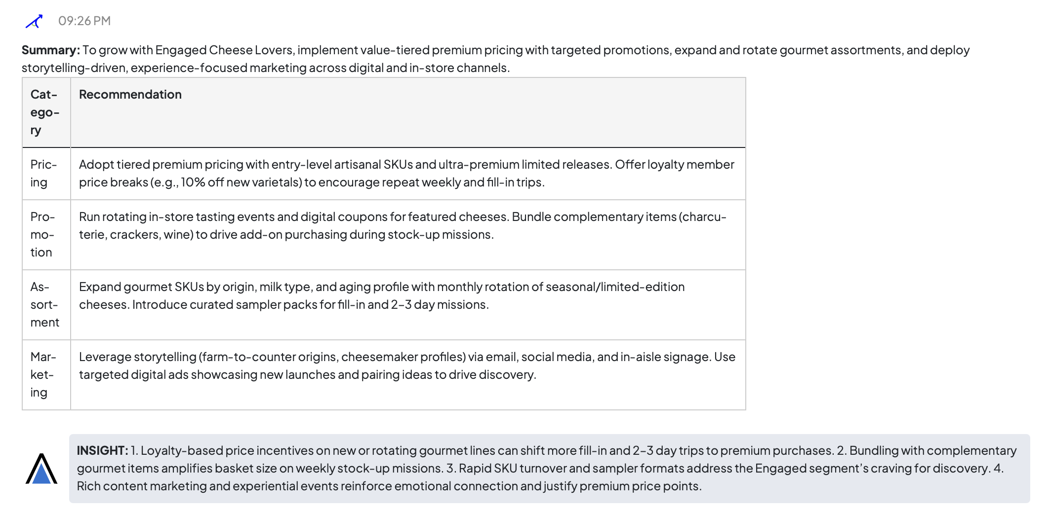
“AiRICA-Give me recommendations on how to best approach pricing, promotion, assortment and marketing to continue to grow with Cheese Lover MVS”
Lever | MVS Response (Cheese Lover)
Pricing | Maintain premium imported SKUs; use smaller packs or limited-time formats to soften tariff-driven increases.
Promotion | Targeted loyalty offers (e.g., “Buy 2 Imports, Save $5 on Wine”); limited prestige promos during holidays.
Assortment | Protect iconic imports (Brie, Manchego, Parmigiano) as loyalty anchors.
Marketing / Experience | Storytelling signage (“Imported Treasures”); personalized wine & charcuterie pairings pushed digitally.

Slide 33

Dr. Harris’ Predictions
Strategic Paradigm Shifts
Next Generation Category Management Process enabled by AI will become the global standard
Category Management Will be Strategy Driven
Integrated Consumer & Shopper Insights Will Drive Decisions
MVS Becomes the Focal Point for Growth
Directly Connected to Shopper Missions
Cross-Category Growth Platforms will become major growth drivers

Slide 34
Dr. Harris’ Predictions
Execution & Collaboration Shifts
Personalization will drive execution
Redefines Category Definitions & Roles
Retail Media Will Be Seamlessly Integrated
Collaboration Will Be Reimagined
New Capabilities & Skills Will Be Needed

Slide 35

Get on Board Now — Growth Won’t Wait
Board the Train Early → secure your seat before the train leaves the station, avoid the cost of delay
Build Speed → Scale Fast – don’t wait for perfect data; momentum matters more.
Stay on Track → AI + Proven Processes – AI must run on the rails of existing business practices.
Our Destination is Clear: Re‑ignite growth through bold, sustainable initiatives that propel us forward.”

Slide 36

Q&A

Slide 37



THANK YOU
Julie.Beck@intentaitech.com
www.intentaitech.com

