Slide 1
Patient - Centered.
Tech -Enabled.
Regulation- Ready.

Slide 2

NABP Research and Innovation Institute
NACDS TSE, San Diego, CA
August 25, 2025
James T. DeVita, RPh, NABP Chief of Business Strategy

Slide 3
National Association of Boards of Pharmacy (NABP®)
Mission: NABP® is the independent, international, and impartial Association that assists its member boards in protecting the public health.
Vision: Innovating and collaborating today for a safer public health tomorrow.
Founded in 1904
Association of Regulatory Boards of Pharmacy in U.S., DC, PR, USVI, Guam and Canada
501c3 non-profit impartial organization, governed by an Executive Committee
NABP’s purpose is to support organizations in their mission to protect public health and safety
Known for Pharmacist Competency Exams, Licensure Programs, Accreditations, Inspection services

Slide 4
Situational Landscape
AACP reports 30% drop in pharmacy school enrollment between 2021 and 2025
In 2024, eight percent of graduating class did not pursue RPh licensure
NCPA reports the closing of ~500 community pharmacies 2023-2024
3,000+ pharmacies closing between Rite Aid, CVS and Walgreens
US census data reports 46 million people over 65 in 2025… Estimated to increase to 90 million by 2050
<65 y.o. = 5 Rx per year
>65 y.o. = 22 Rx per year
Declining pharmacy school enrollment
Decreasing number of community pharmacies
Aging population increasing demand for healthcare
Expanding role of the pharmacist
Challenging workplace conditions
Payer reimbursement pressure

Slide 5
Pharmacy School Student Enrollment in Decline
<36%>
1 - AACP Profile of Pharmacy Students, Table 43: Summary of Enrollments in First Professional Degree (Baccalaureate, Pharm.D.1) Programs
2 - 2023-2024 PharmCAS Applicant Data Report
2025

Slide 6
Advanced pharmacy practice models and innovative technology have the potential to:
Bar code scanning
Telehealth
Telepharmacy
Virtual care
Remote practice
Centralized services
Robotics
Automation
Kiosks
Drone delivery
Artificial Intelligence
Advanced technician role
Improve patient safety
Improve patient access to optimal care and medical outcomes
Close the gap in health literacy
Improve workflow efficiencies
Lower overall healthcare costs

Slide 7
Many barriers exist to implementation of technology including the need for:
Industry to make the appropriate investments in technology
Pharmacy payment reform
Regulators, legislators and payers to recognize pharmacists as providers
Regulators to address overly restrictive or outdated regulations

Slide 8
Regulatory hesitancy is primarily caused by uncertainty
“It should be understandable why a BOP sometimes rejects proposals for new innovations due to uncertainty regarding patient risk”
- CEO, Pharmacy Innovator
Lack of understanding of the proposed practice model or technology
Lack of BOP time and expertise to comprehensively evaluate proposal
Lack of a trusted source of information for BOP to make an informed decision

Slide 9
Research and Innovation Institute (RII): Purpose
Address the imbalance in industry knowledge and pharmacy regulator subject matter expertise
Develop deeper understanding of innovative practice models and opportunities designed to improve patient outcomes
Empower BOP’s to confidently assess new technology and digital health concepts for safety, accuracy, confidentiality, etc.
Facilitate BOP ability to make informed and evidence based regulatory and policy decisions

Slide 10
Research and Innovation Institute (RII): Goals
Create an environment for regulators and pharmacy stakeholders to communicate and collaborate
Establish a neutral repository of balanced data and information regarding practice models, technologies and digital health concepts
Provide data-driven insights to guide regulatory decisions
Build a service that meets our member board of pharmacy needs

Slide 11
NABP RII: Activities to Date
Networking with regulators, pharmacies, tech companies and healthcare associations to learn more about challenges within landscape
Steering Committee established
Board of Pharmacy Survey underway
Received four (4) proposals to date
Plans to develop reports, educational materials, and presentations to drive engagement

Slide 12
NABP RII: How to Participate
Submit on-line Proposal Form to share description of:
Applicant Organization
Proposed Technology / Practice Model
How patient care will benefit from proposal
Specific regulatory barriers encountered
Applicant suggestion of how Research and Innovation Institute can provide assistance
https://nabp.pharmacy/initiatives/presidential-initiative/

Slide 13
https://nabp.pharmacy/initiatives/presidential-initiative/
https://nabp.pharmacy/initiatives/presidential-initiative/#institute

Slide 14
Patient-Centered. Tech-Enabled. Regulation-Ready.
John Colaizzi
August 25, 2025

Slide 15
Prescription volume is expected to increase over time¹ as PharmD graduates continue to decline^{2,3} (2013-2027)
(Projected)³
Statistica, Total number of retail prescriptions filled annually in the United States from 2013 to 2025 (in billions), Total number of retail prescriptions filled annually in the U.S. 2013-2025 | Statista
AACP, Fall 2022 Degrees Conferred- Profile of Pharmacy Students, fall-2022-pps-degrees-conferred_0.xlsx (live.com)
AACP, Fall 2022 Enrollments – Profile of Pharmacy Students, fall-2022-pps-enrollments-appendix_0.xlsx (live.com)
Notes:
Total number of retail prescriptions filled annually in the U.S. 2013-2025 | Statista

Slide 16
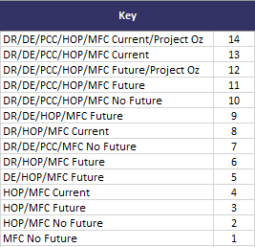
Detailed Rx Fulfillment/Rx Capability Summary

Slide 17
Remote Processing allowances:
Using a Centralized out-of-state pharmacy without requiring in-state licensed RPh’s

Slide 18
Remote Processing allowances:
Allowing in-state licensed RPh’s to perform remote processing activities

Slide 19
Central Fill Allowances

Slide 20
Technician: Pharmacist Ratio Allowances

Slide 21




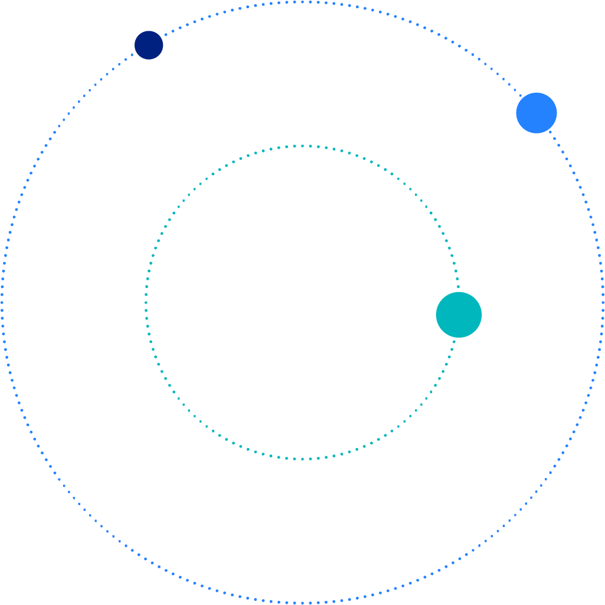





Leader in pharmacy-led patient & pharmacist engagement solutions
Impact
Overview
Historical Strategy: Partner with pharma and pharmacy to enable a seamless medication journey
Approach: Plug & play solutions to enable pharmacy led programs that drive results
Hundreds
Patient engagement programs delivered
annually
Millions
20M+ digital patient
engagement messages
annually
Strong relationships with pharmacy, based on 30+ years focused on driving patient engagement
Pharmaceuticals
Pharmacy
Billions
Digital/non-digital patient engagement messages delivered every year
Proven Results
Full-service, plug & play Patient Engagement Platform with in-house creative team
~25%
avg vaccine program lift
Relationships: Decades-long relationships across top pharmacy chains and manufacturers
6%
avg adherence programs lift
Tech forward approach, leveraging AI, ML to revolutionize the patient engagement experience, simplify medication management and reduce pharmacist burden
11%
avg awareness programs lift
Serving 9 of 10 leading pharmacy chains for an average of 20+ years
Executing programs for 16 of
the top 20 Pharma, for an average of 15+ years
~1%
Opt-out rate historically across
all programming

Slide 22

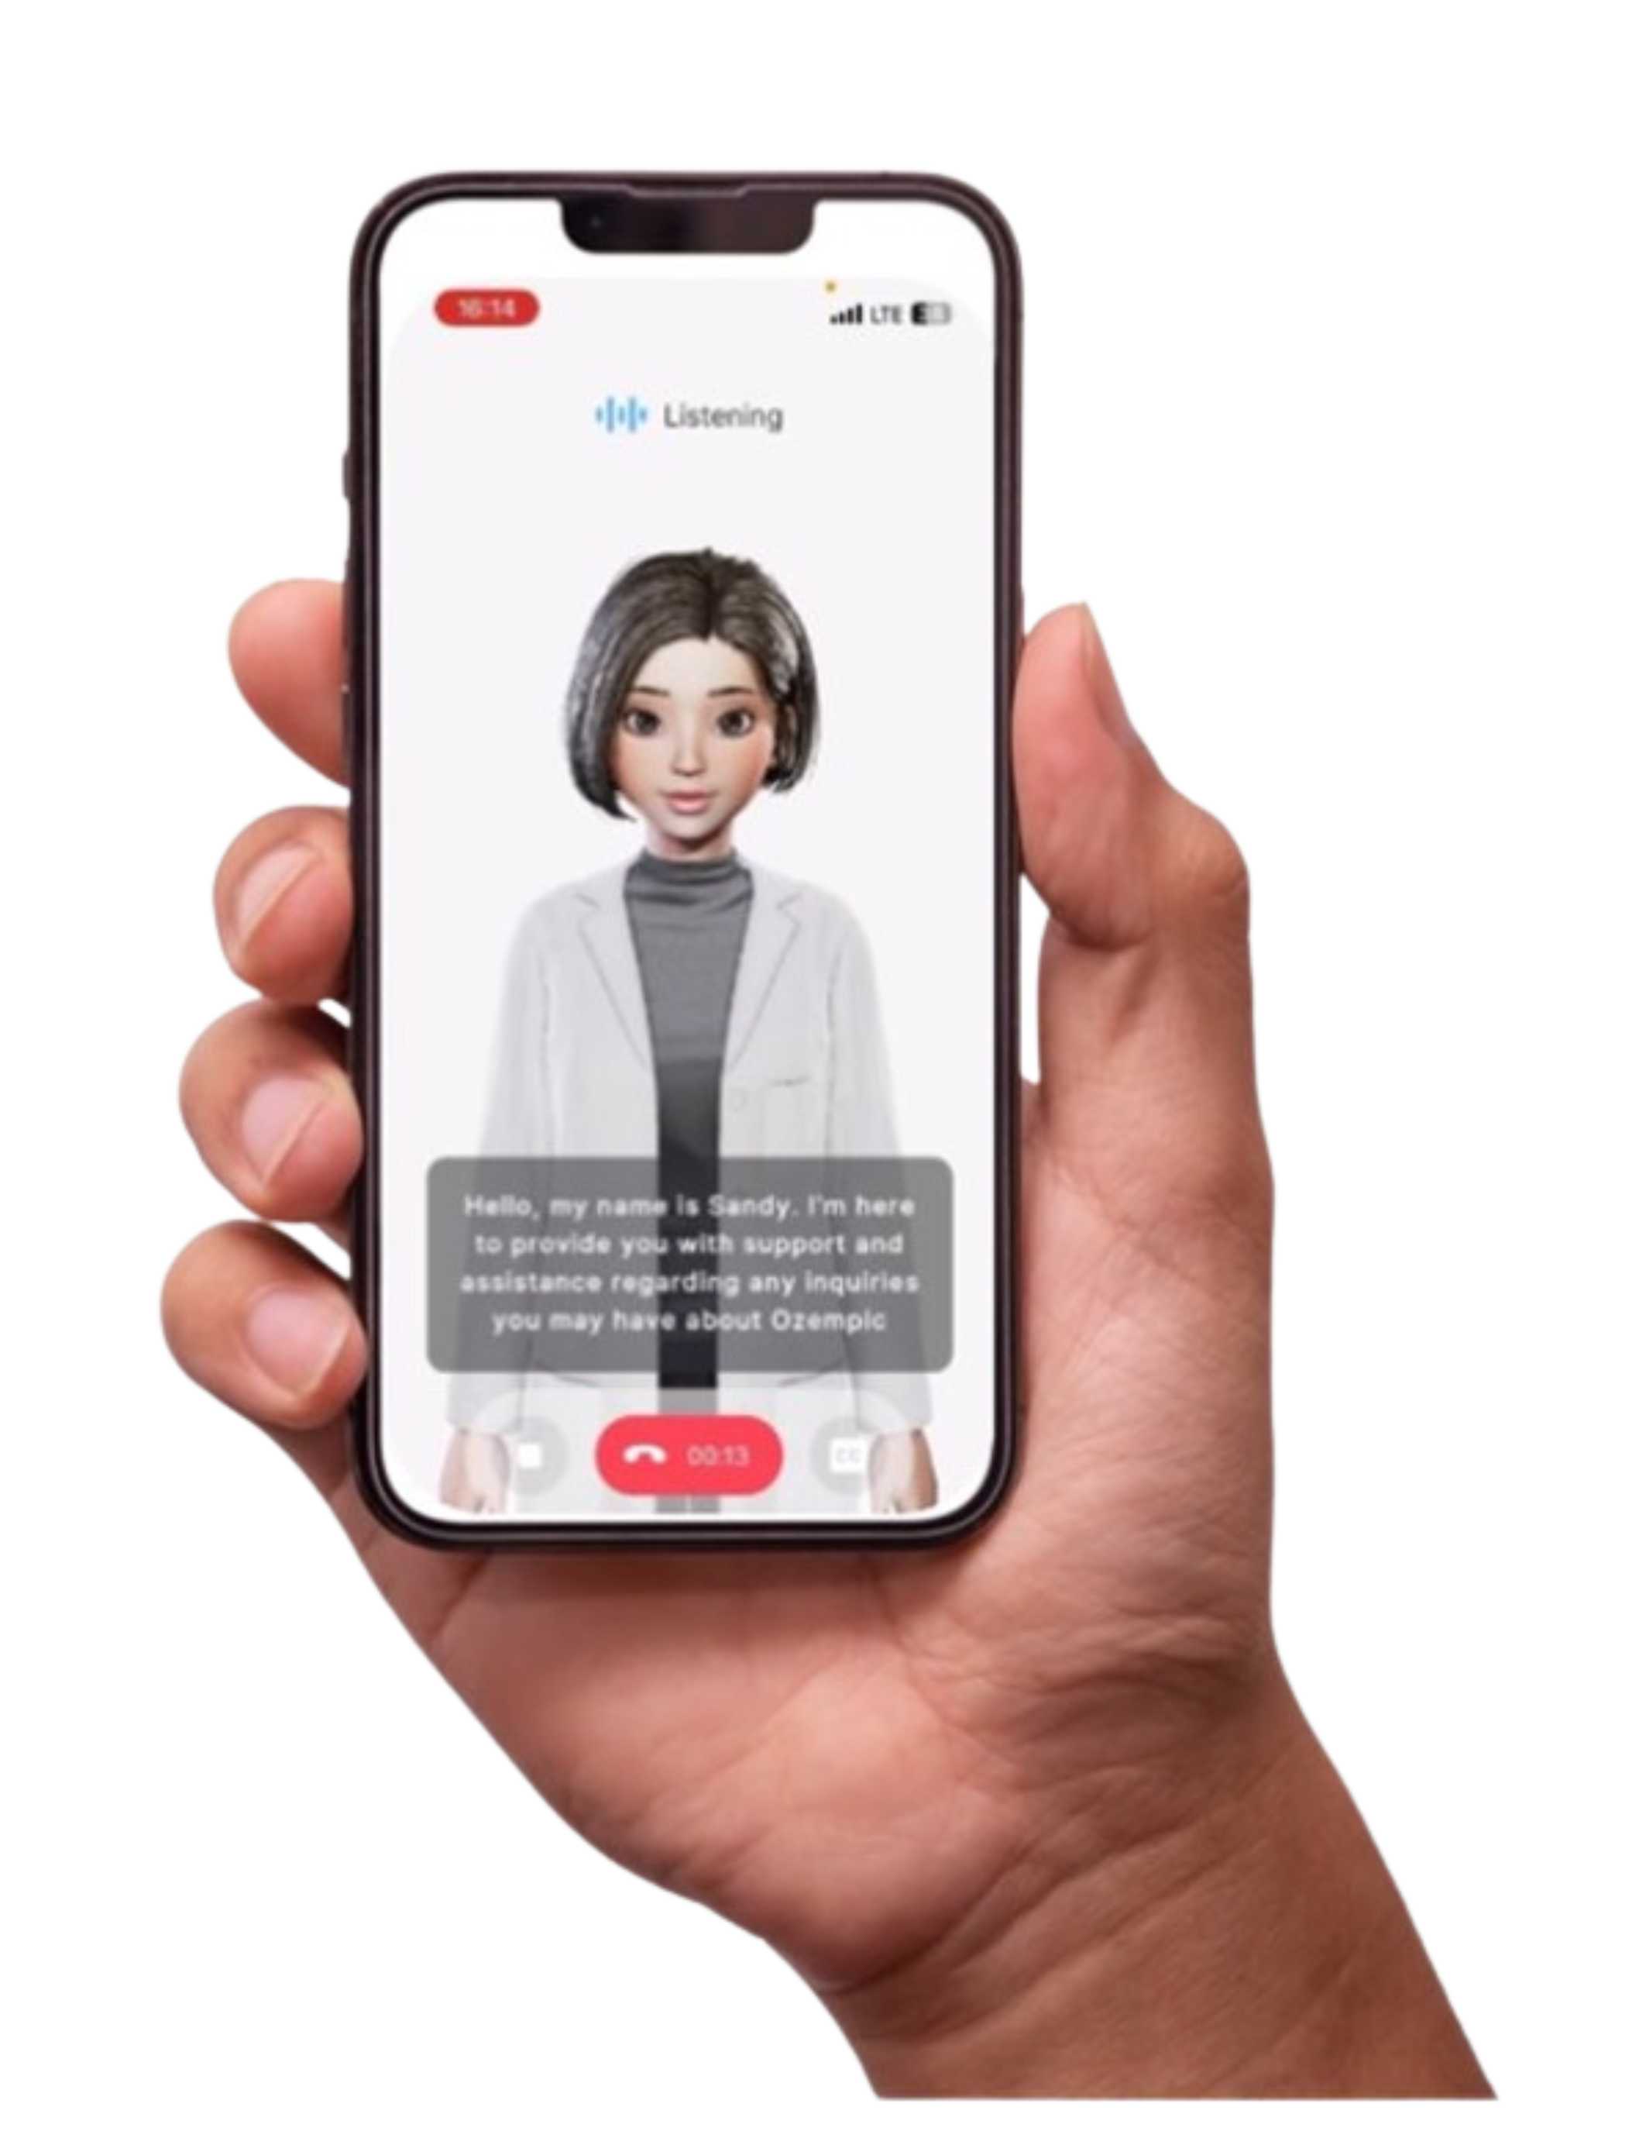



Interactive Medication Assistant
Interactive medication assistant
Enhances the patient experience by providing on-demand, interactive support, education and resources to improve engagement
Supports access to expressly approved patient information and education to support new to brand patients and complex therapies
Reach underserved communities through multi-lingual resources and accessible information
Notes:
Follow previous

Slide 23
AUDIENCE
QUESTIONS

Slide 24
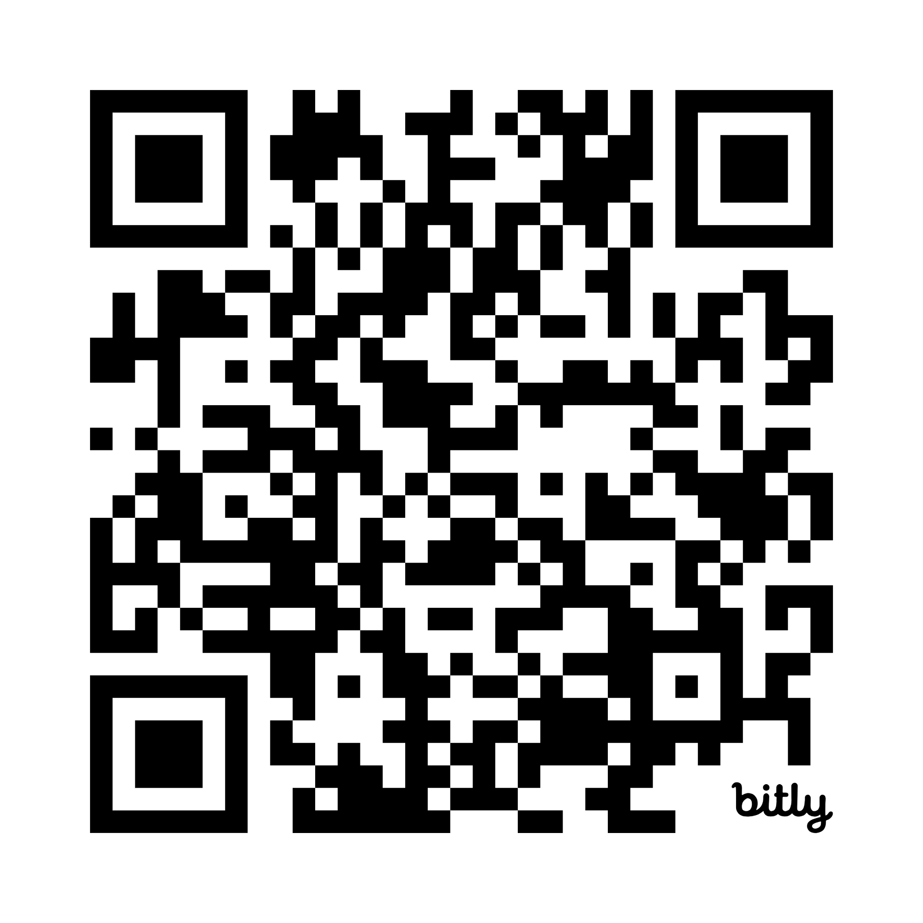
QR CODE
FOR
PRESENTATION
DOCUMENTS

