Slide 1
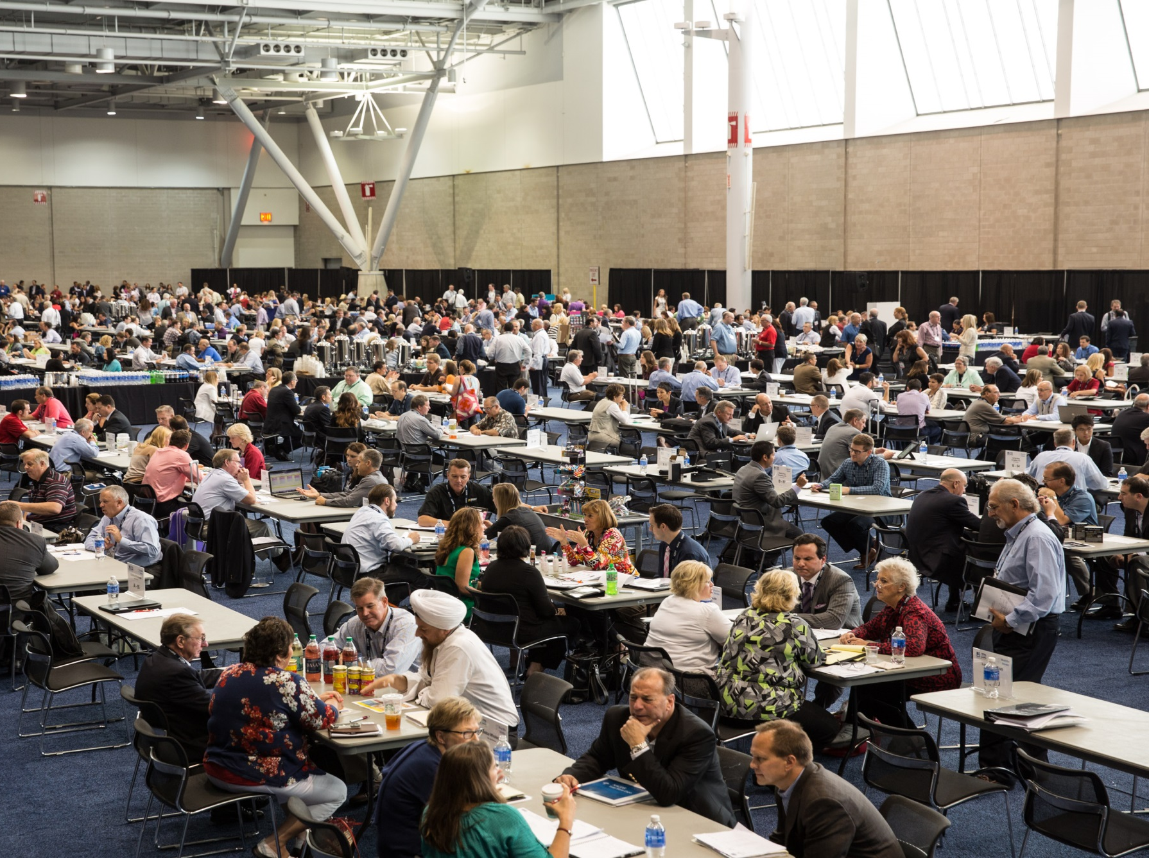

NACDS
Meet the Market
Preparation

Slide 2

Agenda
01
Meet the Market Overview
02
Schedule of Events: Pre & During TSE
03
Presentation Template
04
Helpful Hints
05
Questions
06
TSE Website

Slide 3
How We Match
Companies - Suppliers
Company Name
  Product Information – brand name/category/subcategory
  Launch date
  Up to 3 products per company
MTM Attendees
  Main Representative (only point of contact per company)
  Additional representative
Retail Exclusions (Geography, type of business)
Special requirements (ie. Orthodox)

Slide 4
Meet the Market Information
Helpful hint – badge colors!
10 minute meetings/2 minute travel time
Organized by product category
Over 5,400 Prescheduled appointments
Manufacturers 272 companies 500 individuals
Retailers 73 companies – 240 individuals

Slide 5
Appointment Optimization Schedule:
July 17, 2026
1st Run
July 31, 2026
2nd Run
August 13, 2026
Final Schedule Sent
Note: You will receive an e-mail with your start time on August 14, 2026
Questions: mary.medawar@nacds.org

Slide 6
MTM Schedule of Events: Saturday, August 17, 2024
9:00am – 5:00pm
Meet the Market
12:30 p.m. – 3:00pm
Special Session
Check the full schedule of events for updates at tse.nacds.org

Slide 7
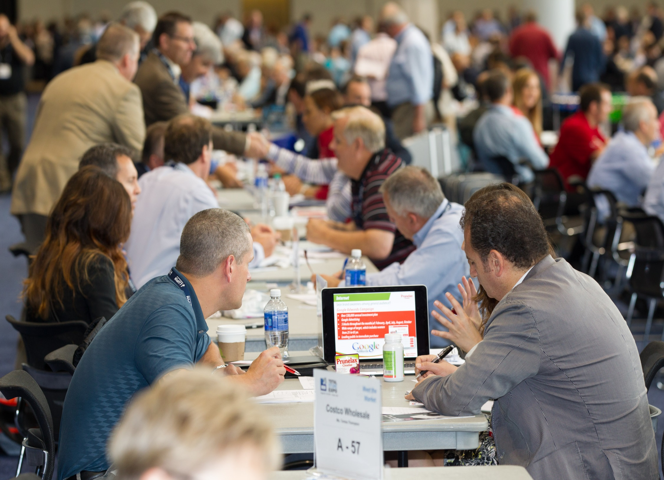

Slide 8
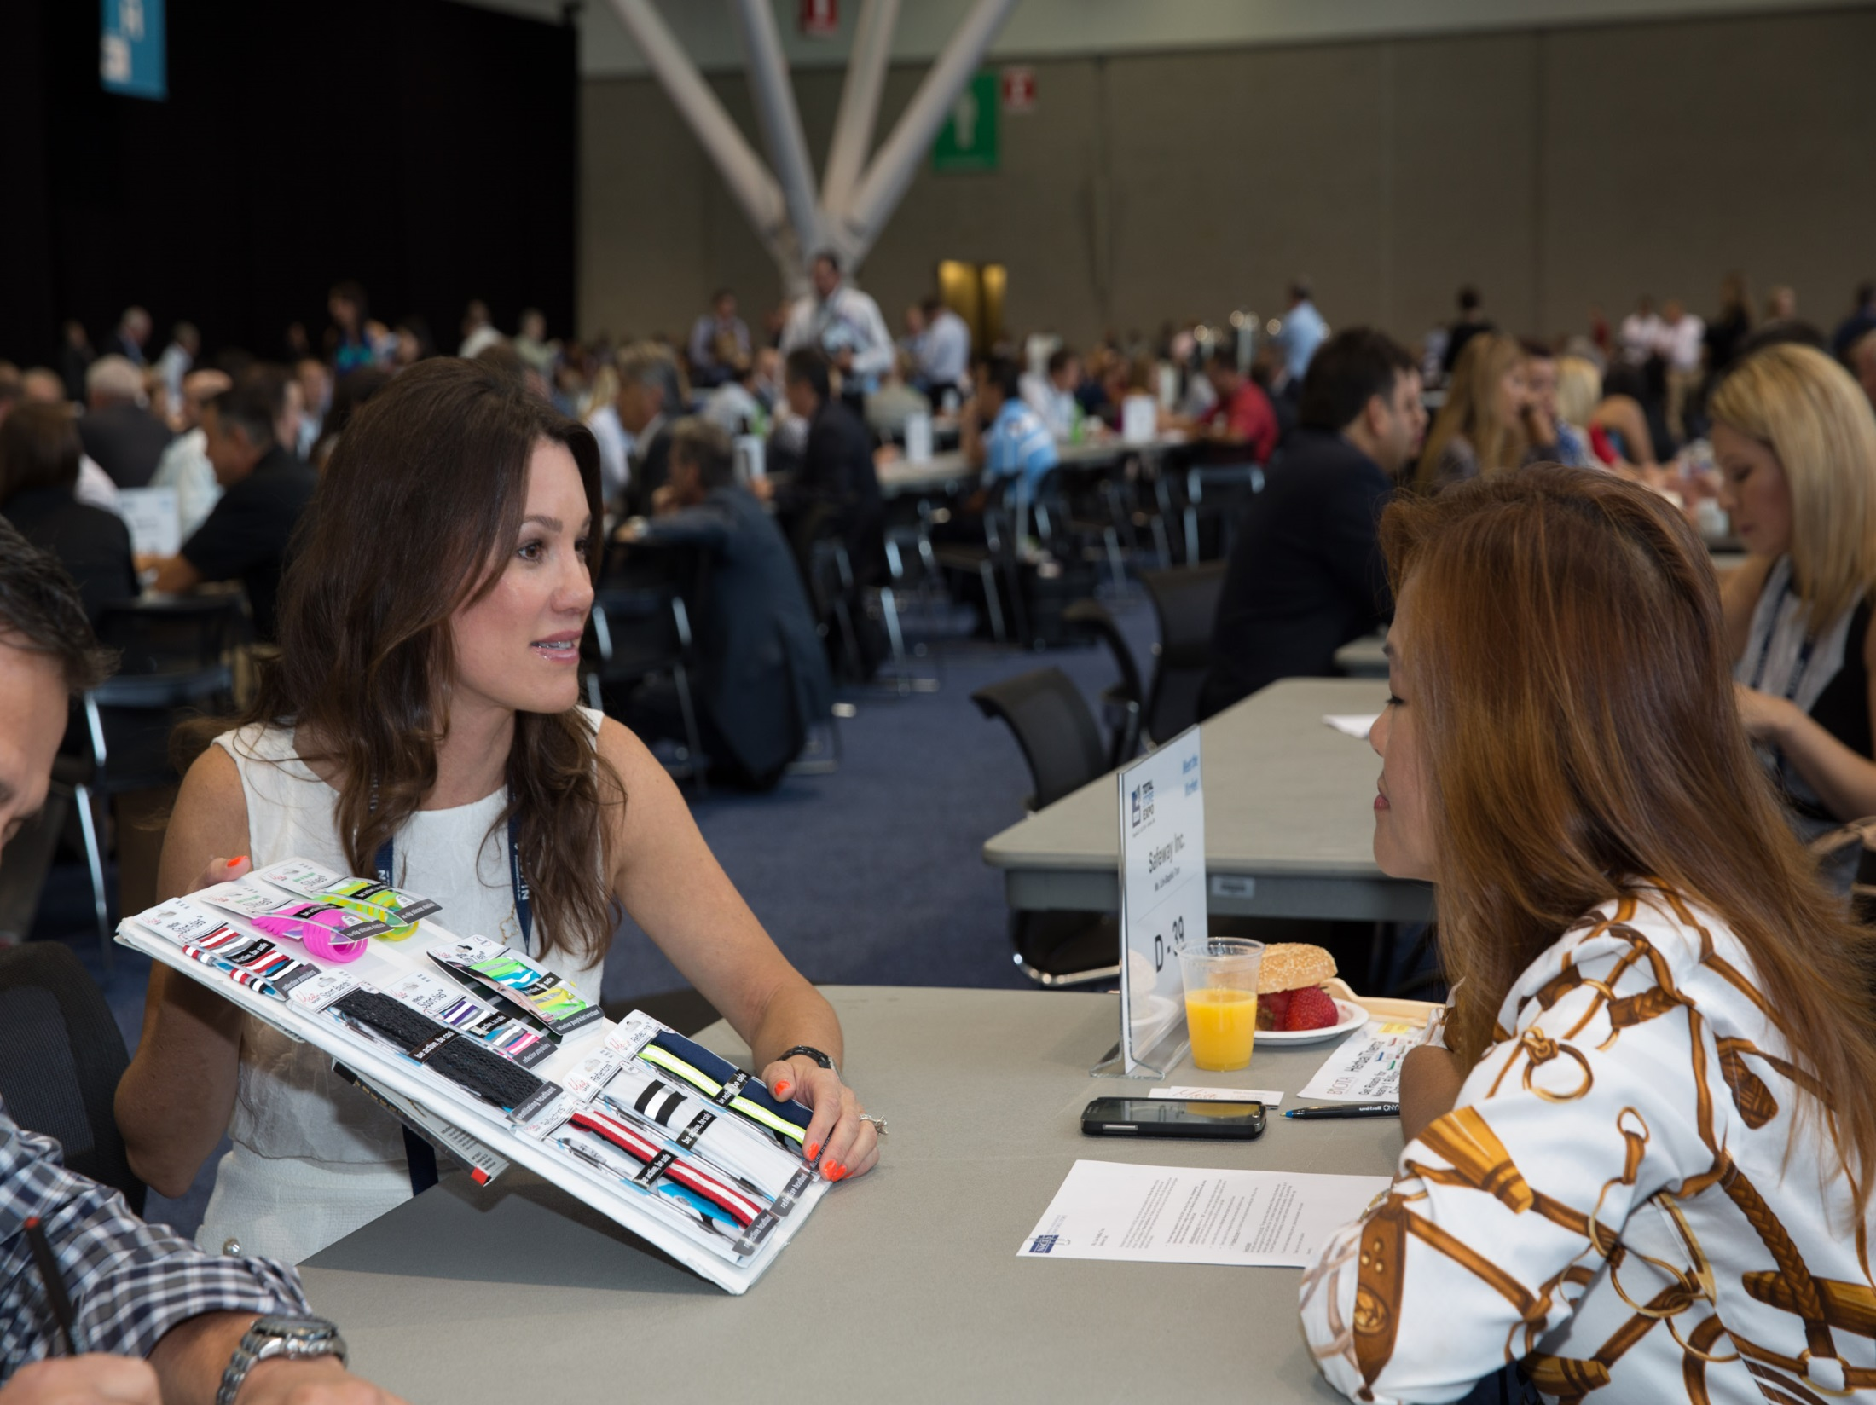

Slide 9
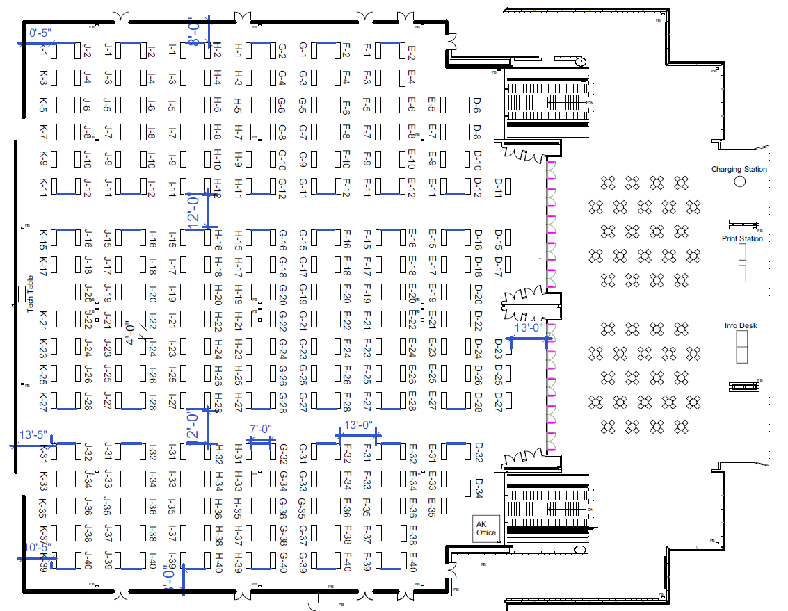
Meet the Market Floor Plan
A-24
A-26
A-21
A-23
A-25
A-27

Slide 10
Meet the Market Template Purpose & Comments
This template was designed as a “how to” in getting prepared for your 10 minute Meet the Market (MTM) meetings. The goal of this template is to help maximize efficiency, effectiveness and productivity on both sides of the table.
I
Importance of being prepared
“Know” the retailers you are meeting
  HQ location
  Type of store
  Store locations
  Website
  App
  Promotion preference
I
Be prepared to discuss
  Your company
  Management talent
  Financial resources
  Sales coverage
  Visit helpful hints for more details

Slide 11
Meet the Market Template Purpose & Comments
Plan on providing the basics of your new item or program. You need to be prepared with key details of your initiative and enough data to “whet the appetite” of the retailer community.
Proper preparation yields favorable outcomes.
A favorable outcome of a MTM meeting is:
  a follow-up at your Total Store Expo booth,
  an appointment opportunity at the retailers HQ
  a request to send more information.
Retailers provided guidance for the preparation of this template.
One of the key takeaways was that many suppliers failed to properly follow-up after their MTM sessions.
Expedient and accurate follow-up is a #1 priority
Please make sure to access the NACDS website noted above and review the Products to Market White Paper which provides further information to increase your industry knowledge.

Slide 12
Meet the Market Template
Company Overview
Name:
Website:
Ownership (Years in business):
Company Description:
Annual Revenue:
On-Line business:
Key Executives:
Product Categories:
Market Position:
Social Media:

Slide 13
Meet the Market Template
Company Overview
Name: ABC Consumer Products
Website: www.abccp.com
Ownership (Years in Business): Privately held (founded in 2020)
Company Description: Manufacturer and marketer of upscale Bath & Body products and luxury toiletries. Can also manufacture store brand B&B items.
Annual Revenue: N/A
On-line business: Began with D-T-C to build targeted consumer profile
Key Executives: Bill Singer, CEO (billsinger@abccp.com) Mary Williams, VP Sales
(marywilliams@abccp.com)
Product Categories: Bath, Lotions, Fragrances, Bar soaps
Market Position: In-line Bath & Body, Lotion, Bath & Bar Soap section
Social Media: Employ multiple TikTok Influencers, testing Retail Media

Slide 14
Meet the Market Template
Product Information
Product Description:
Product Distribution:
Category Placement:
Product Attributes & Points of Difference:
List of SKU’s:
Expected sales per door, per week:

Slide 15
Meet the Market Template
Product Information
Product Description: Spring Garden Bath & Body Collection
Product Distribution: Finish exclusive distribution with food retailer in December
Category Placement: Adjacency with Bath Category
Product Attributes & Points of Difference: Spring Garden is an “affordable indulgence” line of high quality bath products that are expertly produced with the best ingredients. Spring Garden will attract those consumers who currently purchase these products in alternative outlets including Bath & Body Works, which will generate incremental sales & profits. Delivers an average Gross Margin of 50%.
List of SKU’s: Various flavors of Bath Gel, Body Lotion, Body Spray, Scrubs & Bar Soap
Expected Sales Per Door, Per Week: 5 pieces per door, per week in average grocery/drug/mass retailer
Supply Chain Capability: Full EDI compliance and EFT capable.
Market Coverage: National retail coverage with Results Only Retail Group. HQ coverage with 15 person direct sales and trade marketing sales team.

Slide 16
Meet the Market Template
Product Positioning
Describe the Target Consumer:
Provide Consumption Data and/or Consumer Research:
Describe Any Regional Or Cultural Preference:
Do You Offer Bi-Lingual Packaging:

Slide 17
Meet the Market Template
Product Positioning
Describe the Target Consumer: Our Target customer is female, ages 18-45.
Provide Consumption Data and/or Consumer Research: Please see attached IRI & Nielsen data that shows consumption by Trade Class and customer. Also reference the Consumer Attitudes and Shopping Behavior Study.
Describe Any Regional Or Cultural Preference: We index particularly high with the Hispanic consumer.
Do You Offer Bi-Lingual Packaging: All Spring Garden products have English and Spanish packaging.

Slide 18
Meet the Market Template
Product Marketing Support
Describe Media Campaign (TV, Print, Radio, FSI, Social) and Note Total Planned Investment Dollars:
Describe Trade Marketing and Account Promotional Support Investment:
Discuss Promotional Calendar and Any Merchandising Vehicles or Events:
Review Social Media Support Capabilities:
Discuss any Customization Capabilities:

Slide 19
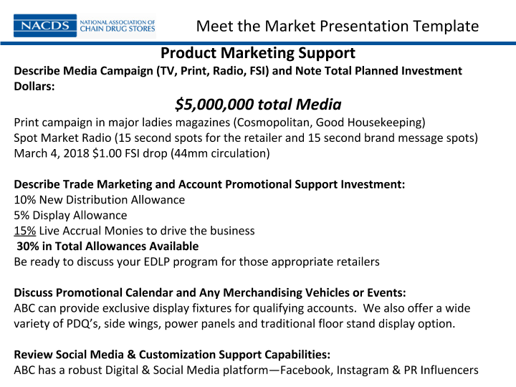

Slide 20
Meet the Market Template
Program Launch Specifics
Cost:
SRP:
Gross Margin %:
Projected Year 1 sales:
Overall Gross Margin Dollar Contribution:

Slide 21
Meet the Market Template
Program Launch Specifics
Cost: $1.49
SRP: $2.99
Gross Margin: 50%*
Projected Year 1 sales: $475,000
Overall Gross Margin Dollar Contribution: $237,500
*please see attached chart which lists individual item costs, gross margins and Year 1 projected sales.

Slide 22
Meet the Market Template
Product Specifications
Brand Product Description:
Product Size:
Item Number:
Product GTIN:
Case GTIN:
Units Per Case:
Case Inner pack (# of inners & # of pcs per inner):
Each Dim. (In.) D" x W" x H“:
Inner Dim. (In) L" x W" x H“:
Case Dim. (In) L" x W" x H“:
Case Cube (Ft):
Case Weight (lbs):
Ti x Hi (Cases):
Cases Per Pallet:
Terms:
Image for website:

Slide 23
Helpful Hints
BEFORE
DURING
AFTER
Retailers want you to know their business before the meeting – prepare ahead and do your research
  # of stores
  Where HQ is located and geographic operating Regions
  Size of stores and class of trade
  Competition
  Research online and also the retailer websites to ensure accurate customer background
Retailers want to see company representatives and/or brokers (only if the broker is familiar with the retailer)
Properly prepare your template, contact info and have product samples with you -
Introduce yourself let the retailer know you are well prepared, and ask if there’s anything they’d like to discuss first
Be prepared for the meeting and include item recommendations and action plans
Keep the meeting focused, short and actionable. Pictures and images are better than words . Less is more!
Retailers describe a successful meeting as an appointment at your TSE booth (bring your TSE schedule so you can add this meeting), a request for additional information or an appointment at the retailers HQ. Make sure you ask for one of these outcomes!!
Regarding “leave behinds” consider the following:
  Business Cards with Booth # added
  One Page sell sheet
  Brochures, Price Lists
  Most retailers aren’t interested in taking samples or materials
Prepare and follow-up with the goal of having the retailer remember you and your product. Be creative and concise with your presentation and FOLLOW UP in a timely fashion!!

Slide 24
Helpful Hints
New Manufacturer Presentation
Through a survey questionnaire to NACDS retailers, it was determined that 3 major types of presentations will be conducted at MTM. These retailers also suggested a presentation flow and timing for each segment:
Order | Length of Time
Company Overview/Introduction | 1 minute
Item | 5 minutes
Category | 30 seconds
Consumer | 1 minute
Competition | 1 minute
Marketing Support & Strategy | 90 seconds

Slide 25
Helpful Hints
Existing Manufacturer, New Item Presentation
Order | Length of Time
Item | 5 minutes, 30 seconds
Category | 1 minute
Competition | 30 seconds
Consumer | 1 minute
Marketing Support & Strategy | 2 minutes
Existing Manufacturer, Current Line Not Stocked Presentation
Order | Length of Time
Item | 4 minutes
Category | 1 minute
Competition | 1 minute, 30 seconds
Consumer | 1 minute
Marketing Support & Strategy | 2 minutes, 30 seconds

Slide 26
Meet the Market Leave Behind
Company Name: Booth #: __________
______________________________________
Meet the Market Attendees:
Name: _______________________________
Email: _______________________________
Name: _______________________________
Email: _______________________________
Key Facts: (About your company)
Key Facts: (About your brand)
Key Facts: (About your marketing plan)
Retailer Notes:
_____________________________________________________________________________________
_____________________________________________________________________________________
_____________________________________________________________________________________
_____________________________________________________________________________________
_____________________________________________________________________________________
_____________________________________________________________________________________
_____________________________________________________________________________________
_____________________________________________________________________________________
PLEASE VISIT US AT BOOTH #: ______
Staple Business Card Here

Slide 27

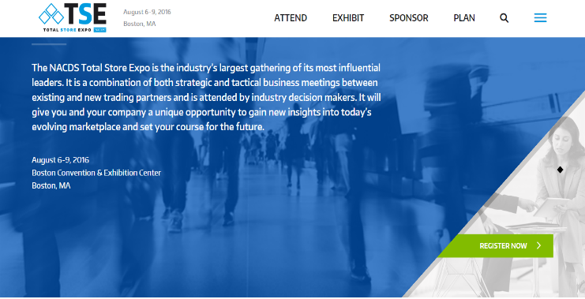
Bookmark
Https://tse.nacds.org

Slide 28
Helpful Hints
Retailers want you to know their business including:
# of stores
Where HQ is located and geographic operating Regions
Size of stores and class of trade
Competition
Consider a check of the retailer websites to ensure accurate information
Retailers want to see company representatives and/or brokers (only if the broker is familiar with the retailer)
Be prepared for the meeting and include item recommendations and action plans
Offer suggestions for how, when and where to “merchandise”

Slide 29
Helpful Hints
Regarding “leave behinds” consider the following:
Business Cards with Booth # added
One Page sell sheet
Brochures, Price Lists
(most retailers aren’t interested in taking or transporting samples and materials back with them)
Focused follow-up with the retailers is key and should occur within two weeks
Prepare and follow-up with the goal of having the retailer remember you and your product. Be creative and concise with your presentation and FOLLOW UP in a timely fashion!!
Retailers describe a successful meeting as an appointment at your booth, a request for additional information or an appointment at the retailers HQ. Make sure you ask for one of these outcomes!!
Be sure to bring your TSE booth schedule with you so you can lock in an appointment if asked by the retailer.

Slide 30

Questions?

